Slide 1
Let’s Get Ready to Trade!
3.7 Export Potential Notes
BS 18/4/4
© NZCETA BS18/4/4

Slide 3
Internal Assessment
The Export Potential internal assessment is based on the potential of a business exporting into a new market or looking to start exporting.
You are to investigate a market (possible ones include large emerging countries such as China or India) and the benefits and risks of doing so.
You are to decide whether the business should export into this new market or not, and the reasons for your decision
The assessment is worth 3 credits

Slide 4
NCEA requirements
Students are required to undertake all aspects of an investigation, which typically includes planning the research, consulting domestically (or, for Merit and Excellence, consulting internationally), collecting evidence, evaluating the export potential and integrating business knowledge.

Slide 5
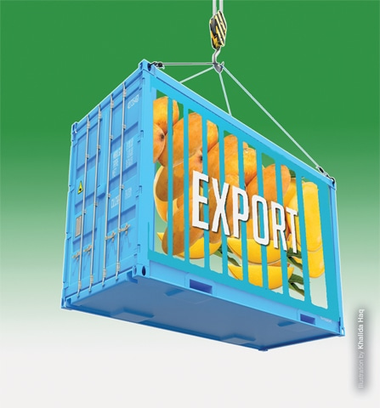
Which business to choose?
The business must be NZ registered and can either be large or small.
The product may be exported already or it has the potential to be exported overseas (eg: do not use a fast food business!)
The whole class can use the same business
Your teacher will decide if you are working individually or in small groups
Find a business that you can either visit, have a guest speaker come in, or they have an excellent website or you can email them
You also need the assistance of someone from overseas, such as NZTE or an agent

Slide 6
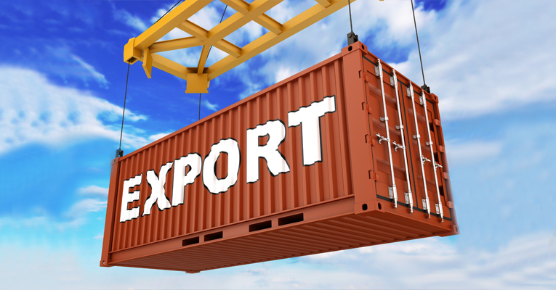
Topics we will cover
The Exportation Process:
Cultural intelligence
Transport & distribution
Finance
Intellectual property
Compliance
Jurisdictions
Trade agreements
Exchange rates

Slide 7
Cultural Intelligence
Definition
Cultural intelligence is recognising and understanding of the different beliefs, values, attitudes, and behaviours of a group of people and the ability to apply that knowledge toward the achieving of specific goals.
It includes knowledge about economic and legal systems, norms for social interaction, religious beliefs, aesthetic values, and language in different cultures.

Slide 8
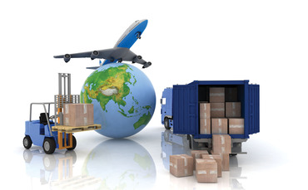
Transport & Distribution
The business must decide how they will transport their product to their destination
Options include air, sea and possibly road once the product arrives
Air is considerably more expensive but speed is essential should the product be perishable- such as seafood or flowers
Sea is far less expensive but takes a much longer time to reach the destination. Often the goods need to fill a container in order to be cost effective

Slide 9
Finance
Businesses require large amounts of capital in order to export. A business needs a healthy working capital in order to achieve this.
Often the business will require flexible trade finance to pay for expenses such as shipping, purchase of raw materials, wages, taxes and other bureaucratic documentation in the overseas country.

Slide 10
Intellectual Property
“Intellectual Property is knowledge, creative ideas, or expressions of human mind that have commercial value and are protectable under copyright, patent, service mark, trademark, or trade secret laws from imitation, infringement, and dilution. Intellectual property includes brand names, discoveries, formulas, inventions, knowledge, registered designs, software, and works of artistic, literary, or musical nature. It is one of the most readily tradable properties in the digital marketplace.”
In other words intellectual property are the ideas a business comes up with that have the potential to make them money. Intellectual property can be protected by using copyrights, patents and trademarks.

Slide 11
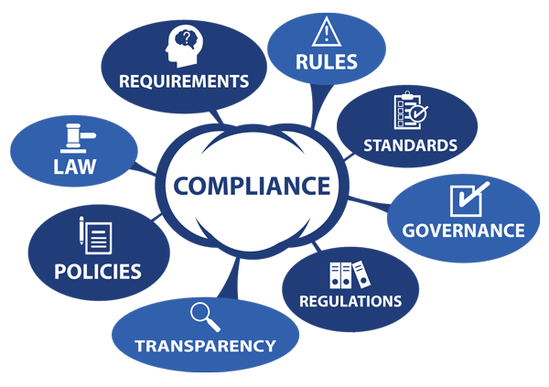
Compliance
When it comes to a business and corporate management, compliance refers to the company obeying all of the legal laws and regulations in regards to how they manage the business, their staff, and their treatment towards their consumers. The concept of compliance is to make sure that corporations act responsibly.

Slide 12
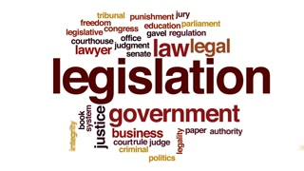
Jurisdiction
Rules, regulations and legislation that businesses must comply with when exporting into a foreign country.
NZTE can assist businesses in abiding by laws in a certain country.
Failure to follow a country’s rules and regulations can result in large fines.
See handout notes for NZ legislation

Slide 13
Trade Agreements
New Zealand was the first country to sign a free trade agreement (FTA) with China in 2008.
FTAs open up market opportunities, streamline processes, reduce costs, and create more certainty and security for companies doing business overseas.
They help New Zealand businesses become and remain more competitive in overseas markets.

Slide 14
Exchange Rates
An exchange rate tells you how much your currency is worth in a foreign currency.
Think of it as the price being charged to purchase that currency.
Factors affecting exchange rates
Interest rates
Money supply
Economic growth & financial stability

Slide 15
Trading Partners
Q1: Which countries are New Zealand products exported to?
Almost all of them! NZ sends products to over 218 different countries/territories
Q2: Which countries does it NOT trade with?
As a member of the UN, trade is not permitted with
Cote d'Ivoire
The Democratic People's Republic of Korea
Democratic Republic of the Congo
Eritrea
Iran*
Iraq
Lebanon
Liberia
Libya
Sierra Leone
Somalia
Sudan

Slide 16
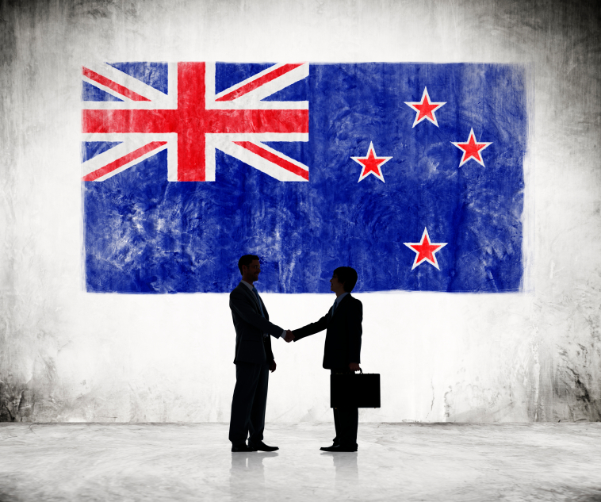
Quick question
What are the top 3 countries that New Zealand trades with?
What is our top export products?
List 10 products that we import

Slide 17
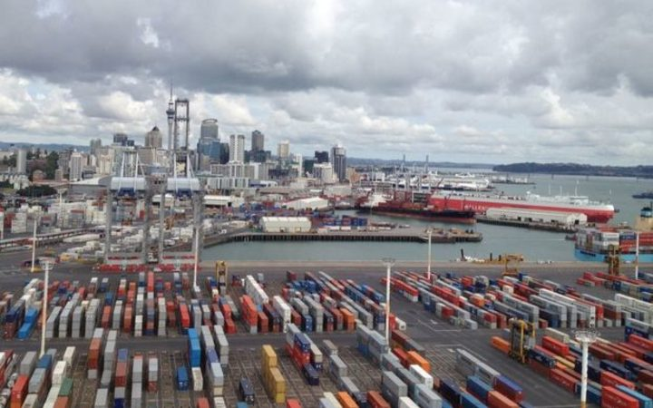
Exporting
Definition: A function of international trade whereby goods produced in one country are shipped to another country for future sale or trade.

Slide 18
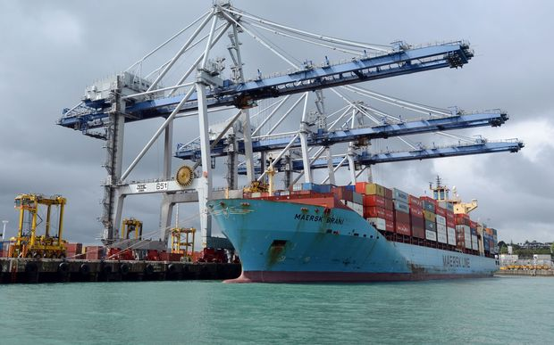
Importing
Definition: A good or service brought into one country from another.

Slide 19
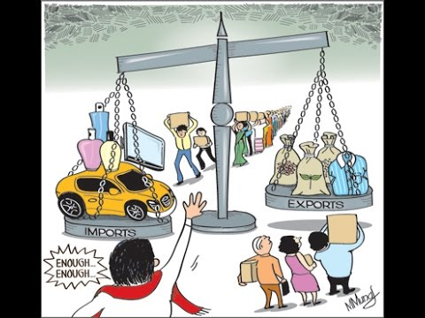
Balance of Payments
Balance of payments measures the difference between our imports and our exports.
As a country we need to ensure our income from exports is greater than our spending on imports
Think of it like a bank account. If we spend too much we end up going into debt and we have to borrow from overseas countries.
As a small country, New Zealand relies heavily on trade for our growth and development.

Slide 20
Discuss why businesses
import and export….

Slide 21
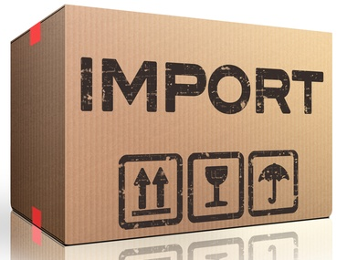
Reasons to import
Goods or services that are either
1) necessary for the economic well-being of the country or
2) highly desired by consumers but are not available in the domestic market
Goods or services that meet a country’s needs or wants and can be produced more inexpensively or efficiently by other countries, and therefore are able to be sold at lower prices

Slide 22
Reasons to export
Exporting by selling products, services or knowledge overseas can help businesses grow and prosper
It can also improve the business’s competitiveness by exposing the business and its staff to new ideas and demands from overseas consumers

Slide 24
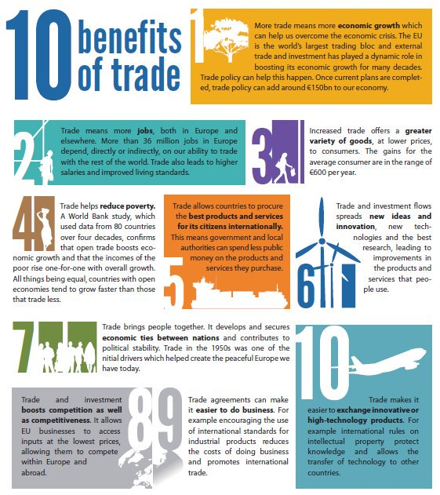

Slide 25
Does New Zealand have a more specific need than other countries to export and import?
Discuss

Slide 26
Answers
Yes – because we are small and rely on overseas countries to provide us with income so we can increase our standard of living.

Slide 27
In pairs write down 10 goods or services that are imported into New Zealand and state which country you think these goods or services come from

Slide 28
In pairs, write down 5 products or services that are exported from New Zealand and state which country you think the goods or services go to

Slide 29
What are some possible issues for importers / exporters?

Slide 30
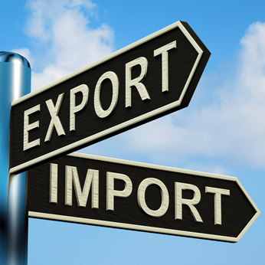
Examples of issues
Risk of product not making it to the destination
Risk of product not meeting consumers’ demand
The value of the import / export dollar
The impact on domestic / foreign markets
Global issues – war, terrorism, political unrest
Taxes, tariffs, quotas, etc
Can YOU think of any other issues?

Slide 31
Practice for Assessment for Achievement Standard 91385 (3.7)
Find and investigate the New Zealand Trade and Enterprise website (search NZTE on the internet)
Explore the various Chamber of Commerce websites (in the real assessment they might choose to use a regional Chamber of Commerce depending on where in the country the good they choose is produced)
Research the New Zealand Export Credit Office and see what service they offer to NZ exporters – www.nzeco.govt.nz

