Slide 1
Level 2 Business Studies
2.2 - AS90844 Demonstrate understanding of how a large business responds to external factors
BS 11/3/11/5v2

Slide 2
2.2 Technological Change
Students will explain technological change on business
Identify the technological change that can impact on business
Explain the positive and negative impacts of technology on business stakeholders

Slide 3
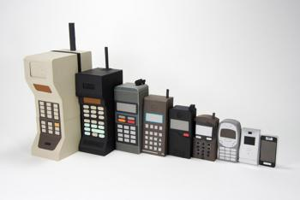
Technological Change
Technology has changed the pattern of demand and the range and nature of the product that satisfy our needs.
Business has been forced to adapt to changing technology in two main ways
The products that firms make are vastly different from those made ten years ago. So research must be undertaken to establish how the latest technology can be converted into marketable products.

Slide 4
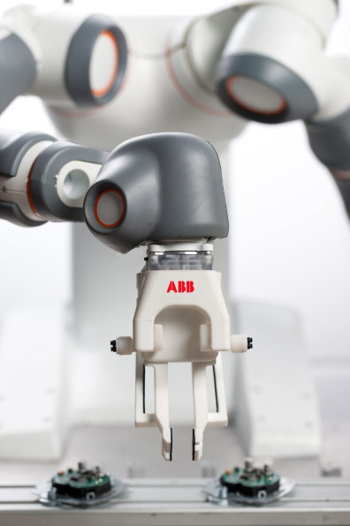
Technological Influences
Methods of manufacturing have been revolutionised by technology. Computer aided machines – robots, computer-aided design and the widespread use of IT have changed the nature of production and the nature of jobs done by production workers.

Slide 5
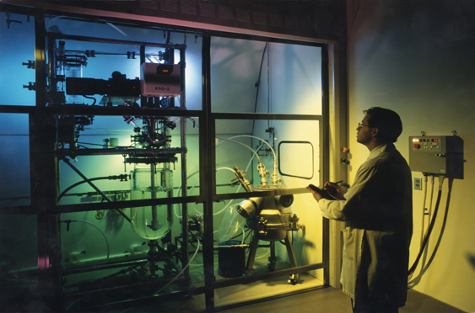
Technological Influences
Technological factors include technological aspects such as
Research & Development activity
automation
technology incentives and
the rate of technological change
They can determine:
barriers to entry (makes it hard for other competitors to enter the market)
minimum efficient production level and
influence outsourcing decisions
Overall, leads to better quality, reducing costs and better innovation

Slide 6
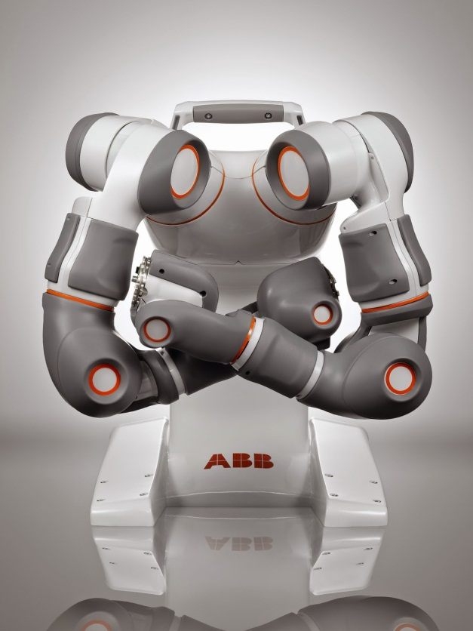
Improvements in Technologies
Technological advancements have allowed the mechanisation and automation of production methods in most industries.
The use of automation keeps businesses ahead of the competition, reduces costs of production, reduces prices and improves the products manufactured

Slide 7
Types of new technologies
Automation
Mechanisation
CAD
CAM
CIM
EFTPOS & Paypass
E-commerce and M-Commerce
Cloud

Slide 8
Automation
This is where the equipment used in the factory is controlled by a computer to carry out mechanical processes such as paint spraying on a car assembly line. The production process usually requires a few people to operate it.

Slide 9
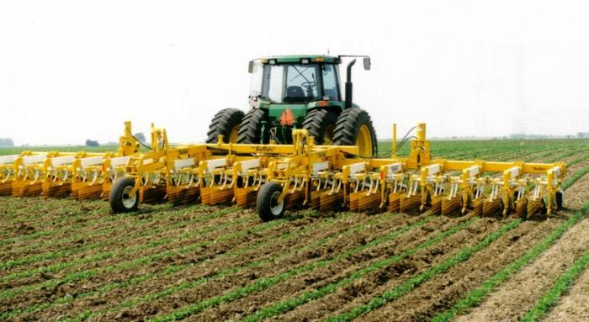
Mechanisation
This is where the production is competed by machines but operated by people.
Robots are useful in this case who are programmed to do tasks particularly if they are dangerous or difficult jobs.
Robots are able to work 24 hours a day and are very accurate (no sick leave or holiday pay needed)

Slide 10
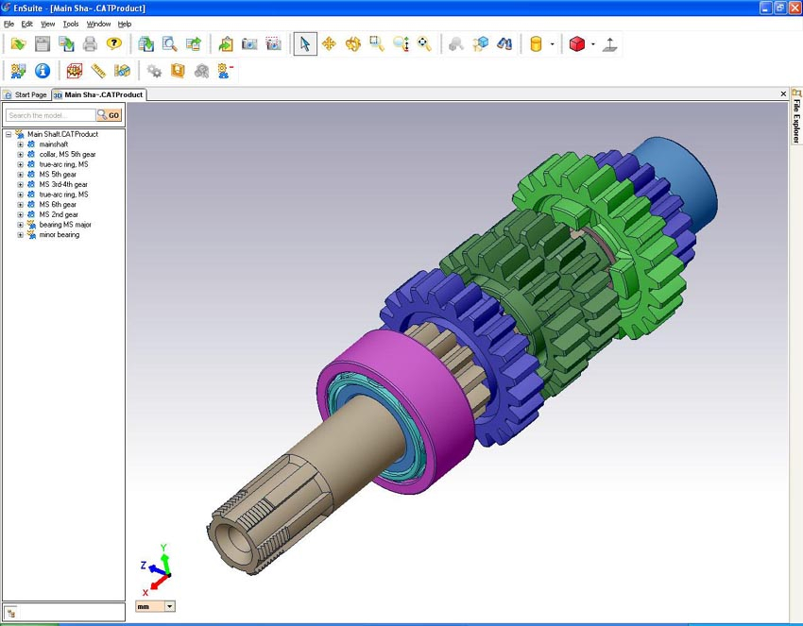
CAD (computer aided design)
This is a software programme that draws items being designed more quickly and allows them to be rotated. This means that the design can be seen from a 3D view. Usually used in architecture.

Slide 11
CAM (computer aided manufacture)
This is where computers monitor the production process and machines or robots are controlled on the factory floor.
Used in car assembly lines such as for spray painting the body work
CIM (computer integrated manufacture)
The manufacturing approach of using computers to control the entire production process (similar to CAM)

Slide 12
EFTPOS
Electronic Funds Transfer Point of Sale
This is when the customers card is swiped and the money is directly credited to the businesses bank account
Makes the process of buying goods and services more streamlined and improves the output at the sales counter
Paypass is when the credit card chip is waived over the terminal for purchases under $80

Slide 13
E- commerce
E-commerce is electronic business over the internet
Due to the developments of the internet, e-commerce has become common for many businesses
This has opened up new markets for businesses who will have either a physical or online presence, sometimes both.

Slide 14
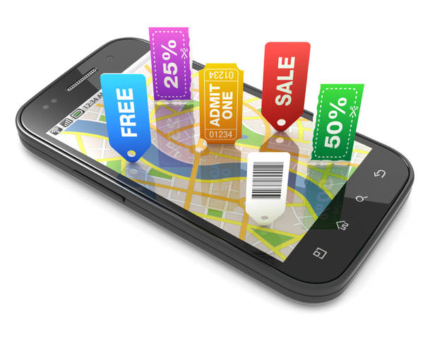
M-Commerce
Buying and selling of products over people’s smartphones
Easier for consumers as they have their mobiles on them all the time
Businesses must ensure their website is accesable on mobile phones

Slide 15
Cloud Computing
Cloud is the new way to store documents on an online cloud in cyberspace
This means that all of a firms work is not stored on the firms hard drive.
This saves storage space and means that work does not become “lost”.
Employees can access their files from any computer in the world

Slide 16
Benefits of using new technology
New opportunities
Lower unit costs of production as technology replaces labour intensive methods increases labour productivity
Better communications and management information systems
Quicker and more effective operations
Better customer service e.g. through internet purchasing
Improves quality and reduces waste

Slide 17
Benefits of using new technology
Technology allows companies to reach consumers in new economic markets, whether regional, national or international.
Smaller businesses can also compete with larger organisations using carefully marketed Internet operations.
Internet sales websites can operate 24/7, allowing companies a continual reach to consumers.

Slide 18
Negative impacts of technology
Set-up costs
Staff resistance to change
Businesses that fail to adapt to change can ended up closing
Training costs
Maintenance and updating costs
Breakdown costs and disruption caused by systems not working
It based systems can create information overload

Slide 19
Negative impacts of technology
Technology quickly becomes outdated, which can be of some detriment to businesses.
Failing to upgrade technology can actually increase operating costs more than purchasing and implementing new equipment.

Slide 20
Technological Factors to consider
Technology is vital for competitive advantage, and is a major driver of globalisation. Businesses need to consider the following points:
1. Does technology allow for products and services to be made more cheaply and to a better standard of quality?
2.Do the technologies offer consumers and businesses more innovative products and services such as Internet banking, new generation mobile telephones, etc?

Slide 21
Technological Factors to consider
3.How is distribution changed by new technologies e.g. books via the Internet, flight tickets, auctions, etc?
4.Does technology offer companies a new way to communicate with consumers e.g. banners, Customer Relationship Management (CRM), etc?

Slide 22
Other issues to consider
Social Media – is it useful for a business to have a presence on Facebook for example? Social media, in particular, is proving to be a divisive issue for small firms and entrepreneurs, with some hailing it as a revolutionary and cost-effective marketing tool, and others dismissing it as a time consuming fad with no real commercial benefits.
Internet Speed - another increasingly high-profile technological issue facing businesses is that of internet connection speeds.

Slide 23
Other issues to consider
Communication - has electronic media such as email and text messaging made it easier for businesses to communicate with customers and suppliers? Or is it just a distraction a business doesn’t need?

