Slide 1
Level 2 Business Studies
2.2 - AS90844
Demonstrate understanding of how a large business responds to external factors
11/3/11/3v2 2016

Slide 2
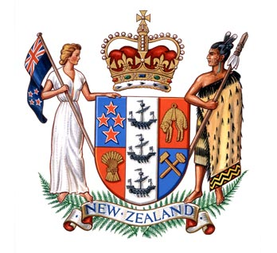
Political Influences (Changes to government policy)
Students will explain political influences on business
Identify the political changes that impact on business
Explain the impact of changes in government on business
Understand the role played by trade unions and employer associations

Slide 3
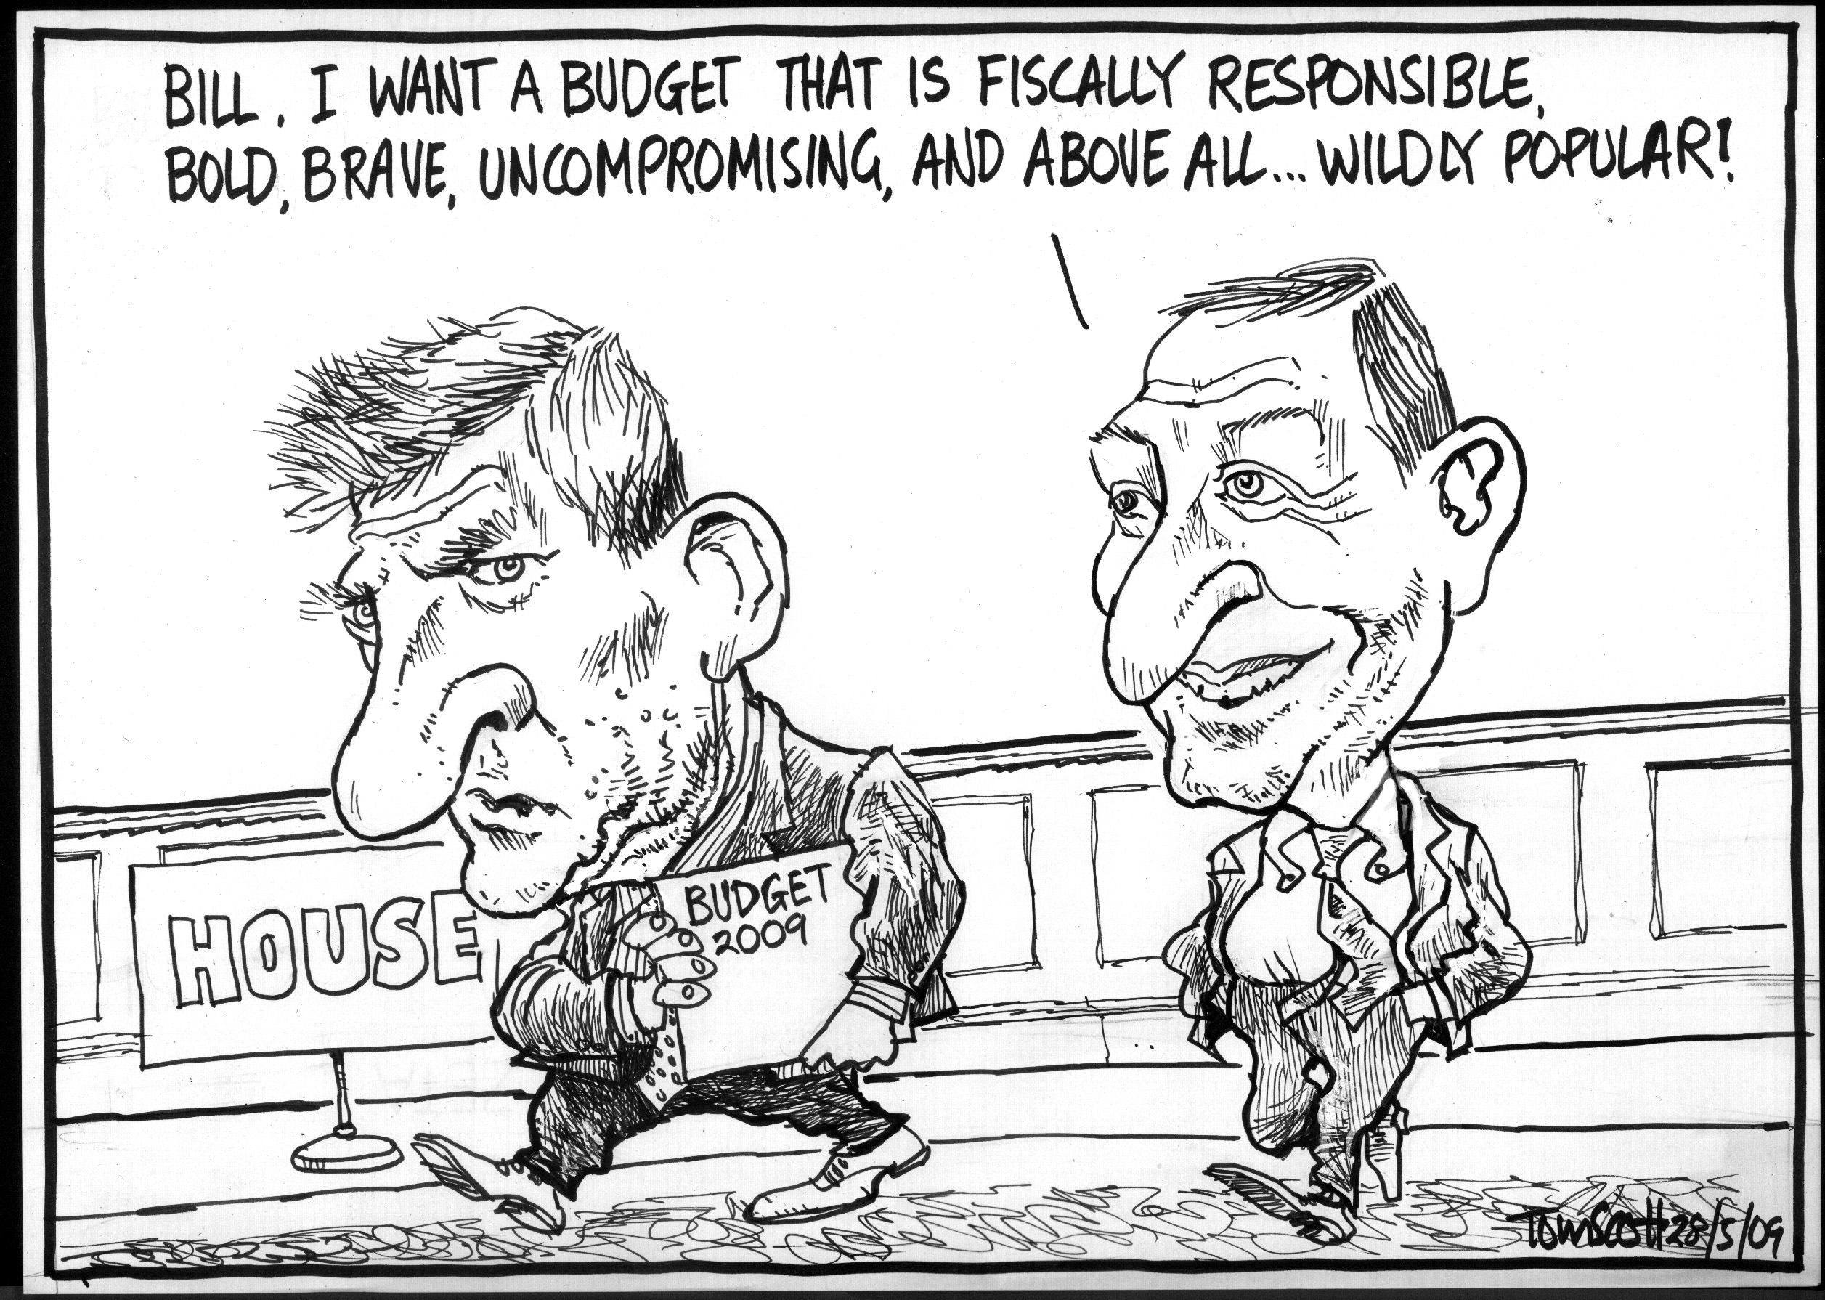
Instructions
On a piece of paper, write down the following answers to the discussion questions on the next slide

Slide 4
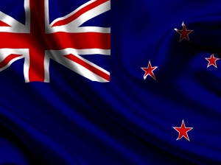
Discussion questions
Why do you think we need a Government?
What do you think would happen if NZ didn’t have a Government?
What do you think is the role of Government and Business?
Which countries do you think NZ relies on for trade?
Which parts of the world do you think NZ should be doing more trade with?
Do you think the tax laws are fair in NZ? Why/ why not?

Slide 5
Suggested solutions
To control the people, to avoid chaos and riots, creates rules for the population to avoid anarchy
It would become corrupt, no rules or order, crime would increase
To work together to improve the wealth of the nation, to provide jobs and employment for New Zealanders
Australia, UK, Europe, America, China etc
More of Asia, South America, Africa (next big growth country after Asia)
Yes – High taxes means more services provided for eg: health & education ----No - Low taxes means less is provided by the Government and people have to pay more of their own money for health etc

Slide 6
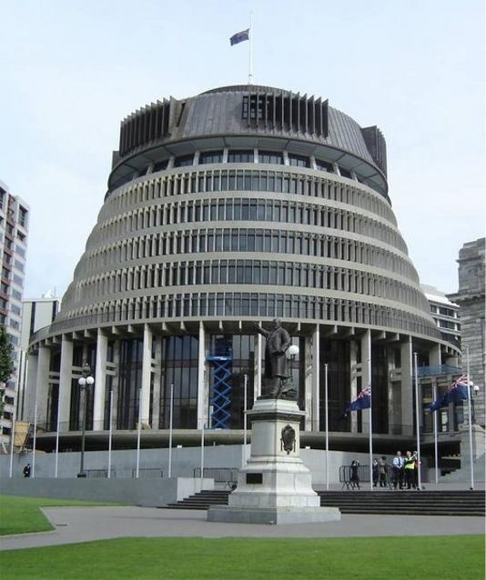
Political Influences Overview
These are factors that the Government sets in Parliament that will affect how businesses run their operations

Slide 7
Factors
The different factors include:
Minimum wage
Unemployment rate
Company tax rate
GST changes
Kiwi saver – retirement age increasing
Laws – such as Environmental and Consumer
Interest rate changes
Free trade – Trade negotiation
Exchange rate
Research and Development

Slide 8
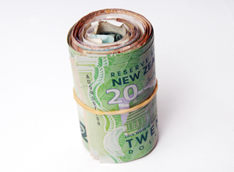
Minimum Wage
What is the current minimum wage?
What if they are only 16, how much do they get?
Wages are a cost to businesses, so if the Government increases the minimum wage, then this increases the expenses of a business
This will mean less profits so less money left over for expansion, hiring of more staff, buying new equipment etc
Current workers who are already receiving the equivalent of minimum wage will have to have their wages increased also to be above those who have just had a pay rise

Slide 9
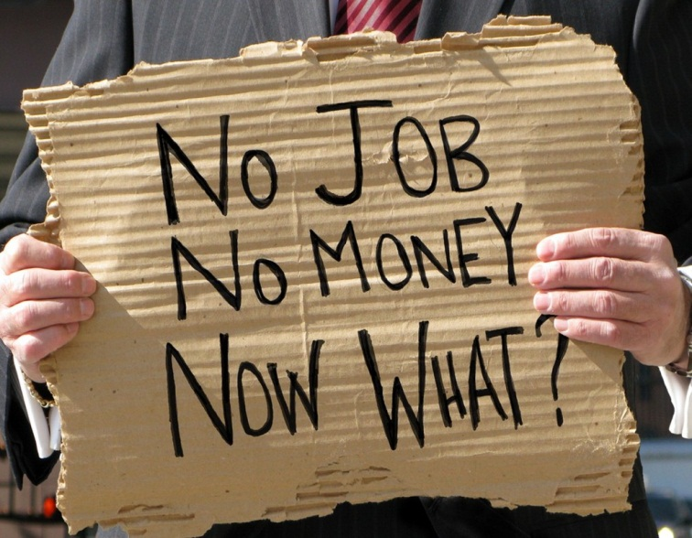
Unemployment Rate
If the Government decreases the unemployment rate then this means that those people who are on the benefit will decide it is not a lot to live on so they will go out and find jobs.
This is good for business as there is more people available for work
However, it could increase crime as these people sometimes are “unemployable” and choose not to work

Slide 10
Company Tax Rate
Currently this is 28%.
So if a firm earns a profit of $100,000 (after all their expenses have been paid), then they have to pay $28,000 to the Government and they will have $72,000 left over to spend on their businesses
If the Government increases the company rate, this will mean the business has less profit left over
So less is able to be spent on hiring new staff, upgrading their technology, building another location etc
However, if the company rate decreases, this is a positive impact on the business as they now have more profit left over after they have paid their tax

Slide 11
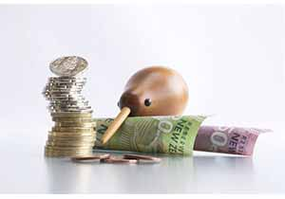
Kiwisaver
Retirement age is 65 years old
New Zealanders can choose to set up a Kiwisaver account through a financial provider (eg: a Bank) which is like a bank account that they cannot touch until they are 65 years old (when they retire)
However, money can be taken out to buy your first home, if you have a terminal illness or you are in financial difficulty
Businesses take 3% out of your pay packet and then they also put in 3% *(you can choose to put in 3%, 4% or 8% of your income into Kiwisaver)

Slide 12
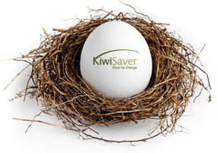
Retirement Age
Is currently 65 years, this is when most NZ’s can retire as they receive superannuation (pension money from the Government)
However, a lot of New Zealanders are choosing to work longer than 65yrs and they still receive superannuation
If the Government was to raise the retirement age then less people would be receiving superannuation so it would save the Government money

Slide 13
GST Changes
Currently is 15%.
GST is a cost to a business that they pass onto customers.
If businesses buy any machinery/ assets they can claim back the GST part from the Govt.
However, this costs the company time and money to do all these administration tasks
In summary, GST is a cost to the business and if the Government puts the GST up again businesses will have to increase their prices to cover the increase.
Customers then cut back on buying their products.

Slide 14
Laws
The Government sets and changes laws in Parliament
One they often change is Environmental Laws
They usually make businesses more environmentally-friendly.
This adds to a firm’s costs as they have to now comply with these new laws eg: a paint company may no longer be able to dump paint down the drain so instead has to take it to a refuse tip where it is safely deposited however, this costs the business time and money to comply

Slide 15
Laws continued
Consumer Laws are the Fair Trading and Consumer Guarantees Act
Fair Trading Act means the firms cannot mislead the public by falsely advertising that a product does something which is doesn’t.
Consumer Guarantees Act means that the consumer is protected if a product is faulty or does not do the job that it intends it for
Businesses have to make sure they comply (follow) with these consumer laws otherwise they can be taken to court.

Slide 16
Interest Rate Changes
The OCR (official cash rate) is reviewed 8 times a year
It is designed to keep inflation between 1-3% - the Government doesn’t want inflation to increase past that or our money becomes worthless (people cant buy as much as they could before)
Currently New Zealand has an OCR of 3.5%
This is the minimum that the banks can charge interest on loans out to
The banks will put their profit on the amount so a firm will pay a minimum of 5.5% on their loans

Slide 17
OCR continued
If a firm has a $10,000 loan and the interest rate from the bank is 5.5%, then they have to pay interest on top of their loan of $550
However, if interest rates increase, then they have to pay more for their loans so they are not inclined to borrow as much
So less borrowing = less spending on new equipment, buildings, technology etc

Slide 18
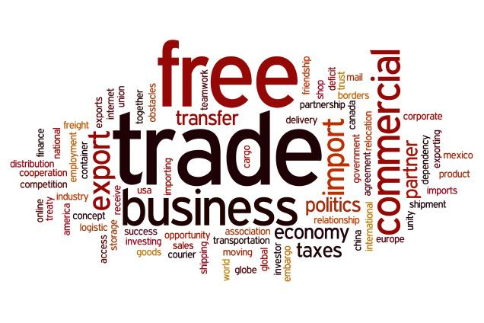
Free Trade & Trade negotiations
New Zealand has free trade agreements with many countries including Australia, China, Korea, Chile, Singapore, Malaysia, Thailand, Brunei, Hong Kong
This means we pay no tariffs (taxes on imports or exports) or quotas (a limit on the amount we can export to these countries)
By having a free trade agreement it makes it easier for NZ firms to export their products to these countries which creates new markets, more customers and more profits.

Slide 19
Exchange Rate
The value of the NZ dollar will affect how many people buy our products from overseas
If the $NZ is high then our exporters suffer as overseas countries find us too expensive so wont buy our products,
However, a high $NZ is good for importers as it is cheaper to buy products from overseas (this does not benefit NZ in any way though)
If the $NZ is low, then overseas countries will see our products are cheap, so will buy more
Also with a low NZ$ imports will be relatively more expensive so we wont buy as many new cars, electrical good etc

Slide 20
Research and Development
If a business has developed cutting-edge technology that will benefit NZ in some way but costs a lot to fund
Then the Government will give them a subsidy especially for research and development
This is to help the business continue to come up with new ideas which can provide jobs and new innovative products to NZ
If the Government decides to cut funding of Research and Development, then these firms suffer as they can no longer get funding and will have to shut down their ideas
In the long run, this means less jobs for New Zealander’s and products that are not as leading edge and competitive with overseas products

Slide 21
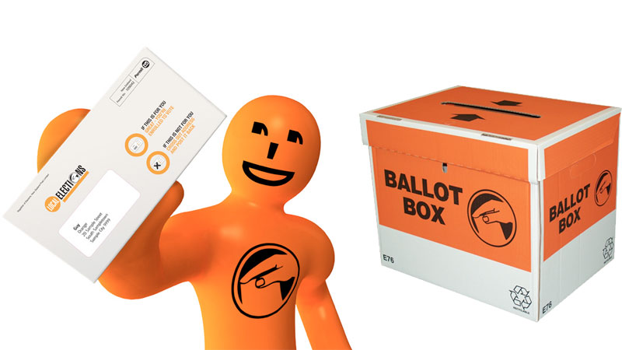
Political Influences
Political factors may also include goods and services which the government wants to provide or be provided (merit goods – learn to swim, baby seats, panadol, quit smoking campaign) and those that the government does not want to be provided (demerit goods – cigarettes, gambling, alcohol, drugs)
Governments also have great influence on the health, education, and infrastructure of a nation.

Slide 22
What do businesses need to consider?
The political arena has a huge influence upon the regulation of businesses, and the spending power of consumers and other businesses. Businesses must consider issues such as:
1.How stable is the political environment?
2.Will government policy influence laws that regulate or tax your business? GST, Company tax, ACC
3.What is the government's position on marketing ethics?
4. What is the government's policy on the economy?
5. Does the government have a view on culture and religion?
6. Is the government involved in trading agreements such as Closer Economics Relations (free trade with Australia), NAFTA, ASEAN (Free trade with Asian countries), or others?
source: http://www.marketingteacher.com

Slide 23
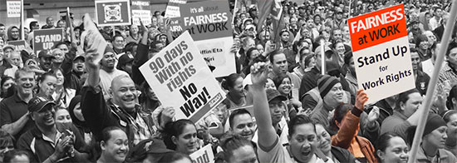
Trade Unions
Definition - A trade union is a group of workers who join together in order to protect their own interests and to be more powerful when negotiating with their employers.
Each employee who wishes to join a trade union must pay an annual fee, which contributes towards the costs and expenses that the trade union incurs when it provides services to its members, and supports industrial action by the workers.

Slide 24
Trade Union Aims
To improve the pay of its members.
To improve the working conditions and the working practices of its members.
To support the training and the professional development of its members.
To ensure that their members' interests are considered by the employers when any decision is made which will affect the workforce.

Slide 25
Advantages of being in a Trade Union
More powerful voice when bargaining as a group
Improved conditions of employment, e.g. rates of pay, holidays, hours of work
Workers will have their individual rights better protected e.g. if dismissed unfairly or discriminated against
Improved working conditions, e.g. health and safety conditions
Improved opportunities for training and therefore increased job satisfaction
Advice and financial support if members thinks they are being unfairly dismissed or made redundant

Slide 26
Methods used by Trade Unions
1. Collective bargaining: Where trade unions are able to operate openly and are recognised by employers, they may negotiate with employers over wages and working conditions.
2. Political activity: Trade unions may promote legislation favourable to the interests of their members or workers as a whole. To this end they may pursue campaigns, undertake lobbying, or financially support individual candidates or parties for public office.

Slide 27
3. Industrial Action: Trade unions may enforce strikes or resistance to lockouts in furtherance of particular goals. There are several different types of industrial action that could be taken:
Strike – Workers select a day(s) on which they will not come into work.
Work to rule – Workers apply the firm’s rules and procedures to the ‘letter’ with the objective of slowing down production. For example a machine worker may be told to ensure his machine is clean and safe before starting work and so he will be deliberately nit-picking and spend hours doing exactly this.
Go slow – Employees carry on working but at the minimum pace possible in order to slow down production but avoid disciplinary action.
Overtime ban: Workers simply refuse to work overtime as they are not obliged to. This can prevent a firm being able to produce quickly enough to meet demand and they may lose orders.

Slide 28
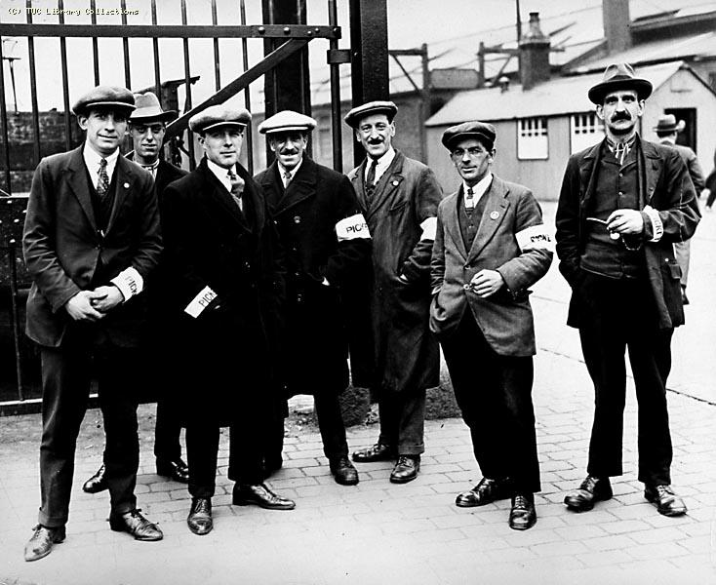
Achievements
Various New Zealand Trade Unions throughout history have negotiated with governments to have the following Acts passed into law.
1894 - New Zealand was the first country to implement a national minimum wage, enacted by its government through the Industrial Conciliation and Arbitration Act 1894.
1893 - votes for women, was won in, making New Zealand the first country in the world where every adult had a vote.
1936 - Factories Act amendment introduces 40-hour, five-day week, with eight public holidays
1944 - Annual Holidays Act provides two weeks' annual leave for all workers

Slide 29
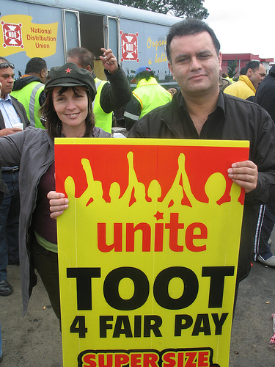
Achievements
1960 - A long time union demand, equal pay for women, was introduced in the public service in 1960, and to the whole workforce four years later
1972 - Equal Pay Act passed
1980 - Maternity Leave and Employment Protection Act passed
1974 - Three weeks' paid annual minimum holiday entitlement

Slide 30
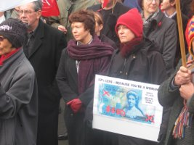
Achievements
2003 - Holidays Act provides for
a. four weeks' annual leave from 2007,
b. at least five days’ paid sick leave per year
c. employees are entitled to up to 52 weeks unpaid leave and may be eligible to receive payment from the government for 14 weeks of paid parental leave.
Employment contracts
Plus support, advice and mentoring

Slide 31
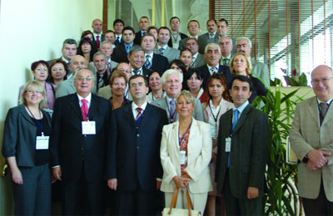
Employer Associations
Definition - An employer association is an organisation that represents a group of employers who share similar interests or areas of trade and aims to promote and represent their opinions and concerns.
Employer associations often help negotiate awards.

Slide 32
Employer Associations
Employer associations generally charge each of their members annual subscriptions.
In exchange, members receive advice and information designed to help them improve the functioning of their business.
They represent employees and negotiate with trade unions on behalf of their members

Slide 33
Examples of NZ Employer Associations
Communication Agencies Association of New Zealand: Industry association for advertising and communication agencies; site carries a directory of members; services: management advice, contracts, job descriptions and legal guide; newsletters; library and reference resources; networking opportunities
The New Zealand Food & Grocery Council (FGC): Association of manufacturers & suppliers of food, beverage and grocery brands; based in Wellington
Packaging Council of New Zealand: Organisation representing manufacturers, fillers, wholesalers, retailers and consumers of packaging; has worked to provide a holistic approach to the issue of packaging waste and has worked with key players in government, industry and the community

Slide 34
Examples of NZ Employer Associations
Insurance Council of New Zealand: Industry organisation representing fire and general insurers; consists of 20 members who write approximately 95% of New Zealand's general insurance business; based in Wellington
Magazine Publishers Association (MPA): Auckland-based body; site has information on members (contacts, Internet sites etc), readership, circulation etc
New Zealand Retailers Association: Leading retail trade association with over 4,600 members; has its head office in Wellington and regional offices in Auckland, Bay of Plenty and Christchurch; supports retailers with advice, specific information, education & lobbying

