Slide 1
Level 2 Business Studies
2.2 - AS90844
Demonstrate understanding of how a large business responds to external factors.BS 11/3/11/4v2 2016

Slide 2
Social Influences (change in demographics)
Students will explain social influences on business
Identify the demographic changes on sales and production
Explain how ethical influences can affect businesses
Explain how societal expectations can influence business decisions

Slide 3
Social Factors
Social factors include:
cultural aspects/ethnic/religious factors
health consciousness,
demographics/population growth rate/age distribution,
career attitudes and lifestyle trends
consumer attitudes and opinions
media views

Slide 4
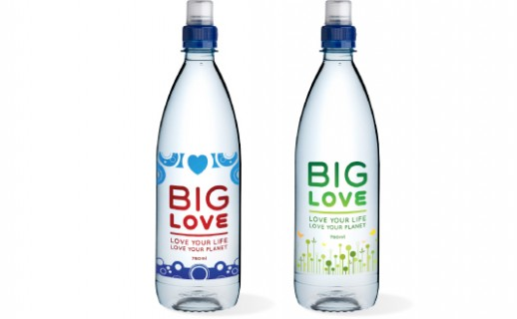
Social Factors
Social factors include:
law changes affecting social factors
brand, company, technology image
consumer buying patterns
fashion and role models
major events and influences
buying access and trends
advertising and publicity
ethical issues

Slide 5
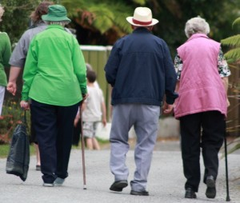
Social Factors
Trends in social factors affect the demand for a company's products and how that company operates.
For example, an aging population may imply a smaller and less-willing workforce (thus increasing the cost of labour).
Furthermore, companies may change various management strategies to adapt to these social trends (such as recruiting older workers).

Slide 6
Demographics
Definition - The physical characteristics of a population eg: sex, family size, income, education, location and occupation
Demographics are used by a business to learn more about a populations’ characteristics
Understanding the demographics of a businesses target customers is critical for the success of any business.
Not only do they need to understand them in order to decide exactly what their product and services mixes will include, but this information will also affect pricing, packaging, promotion and place.

Slide 7
Demographic profile
Businesses must know the demographic profile of their potential customers.
Businesses need to look at their community's:
Purchasing power. Find out the degree of disposable income within the community.
Residences. Are homes rented or owned?
Means of transportation. Do prospective customers in the area own vehicles, ride buses or bicycles, and so on?

Slide 8
Demographic profile
Age ranges. Does the community consist primarily of young people still approaching their prime earning years, young professionals, empty nesters or retirees?
Family status. Are there lots of families in the area or mostly singles?
Leisure activities. What type of hobbies and recreational activities do people in the community participate in?

Slide 9
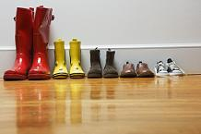
Understanding customer demographics
Gives businesses cost-effective access to what makes their customers, and those you would like to be your customers, tick.
It allows businesses to understand their wants, habits and preferences so they can develop and target their products and services, marketing and advertising to gain maximum impact and buy-in.

Slide 10
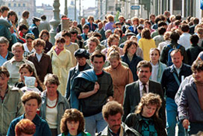
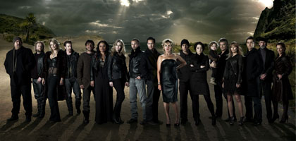
Understanding customer demographics
Any organisation with identifiable regular customers, or members, who want to develop their business with their customers or attract new ones, such as hotels, restaurants, spas, health and fitness clubs, golf clubs and leisure centres, should have this information at the heart of its marketing activities

Slide 11
Social influences on business activity
The structure of society is constantly evolving. The changes occurring in many countries include:
An ageing population- although in some nations the average age is falling due to high birth rates
Changing role of women- not just to bear and look after children but to seek employment and to take posts of responsibility in industry.
Increasing provision of education facilities is creating a vast army of students seeking part time employment and is creating improved quality workforces.
http://bizanalyst.com/articles/social-influences-on-business.html

Slide 12
Social influences on business activity
Early retirement in many Western countries is leading to more leisure time for a growing number of quite high-income pensioners.
In some countries, rising divorcing rates are creating increasing numbers of single person householders.
Job insecurity is forcing more employees to accept temporary and part time employment- some workers actually prefer this option.
http://bizanalyst.com/articles/social-influences-on-business.html

Slide 13
Ethical Practice
What does Ethics mean to you?
Being honest,
Doing the right thing
Playing fair
Sense of moral duty
Not ripping people off

Slide 14
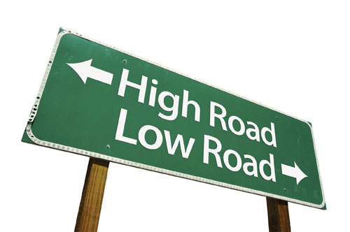
Ethical Behaviour
What is accepted by society as ‘good’ or ‘right’ as opposed to ‘bad’ or ‘wrong’
Social Responsibility
Taking responsibility for actions of the organisation which may impact on society

Slide 15
Consider these situations
Is it right:
For an employee to call in sick when they are just having a day off?
For an employee to do personal business in company time?
For an organisation to recycle its waste paper?
For a manager to give a job to a friend of the family rather than to the person with the best skills and qualifications

Slide 16
Factors affecting managerial ethics

Slide 17
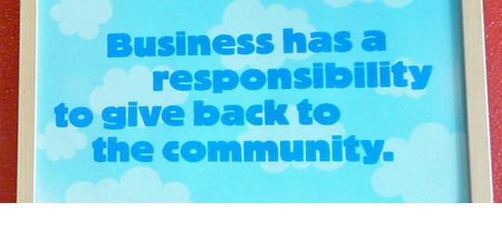
Social Responsibility
Organisations which are socially responsible take into consideration the influence their actions will have on all stakeholders
Stakeholders are those people or organisations who will be affected by the actions of the organisation eg: community, suppliers, employees, customers etc

Slide 18
Societal Expectations
Society expects that businesses will treat their workers and the community fairly
Society expects that all businesses engage in some sort of charity or CSR work
Society expects businesses to be role models and “step up” and help disadvantaged individuals.

