Slide 1
Level 2 Business Studies
2.2 - AS90844
Demonstrate understanding of the internal operations of a large business

Slide 2
Enterprise Culture
Students will understand the need for an enterprise culture in New Zealand society
Discuss the term enterprise culture
Identify New Zealand businesses with a strong enterprise culture
Explain the importance of enterprise culture in new Zealand society

Slide 3
Enterprise Culture
Being enterprising involves being prepared to take risks and to 'think out of the box' in developing solutions to problems.
The term culture refers to the typical way of behaving within an organisation or in society as a whole.
An organisation therefore with an enterprise culture is one where people are imaginative and creative, rather than being reluctant to take risks.

Slide 4
Enterprise Culture
Society as a whole can develop an 'enterprise culture'. This partly involves moving away from a 'dependency culture' where people continually expect others (often the government) to sort out problems for them.

Slide 5
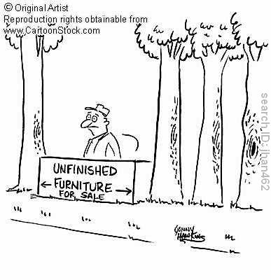

Slide 6
Enterprise Culture
An enterprise culture is made up of enterprising people who are prepared to challenge existing ways of doing things, and to come up with new ideas and solutions to the benefit of society as a whole.
The term 'thinking out of the box' refers to being able to think beyond the straightjacket of existing ways of tackling problems or arranging activities. It requires some form of original thinking.

Slide 7
Enterprise Culture
Being enterprising is about risk taking in all areas of society.
It is about being innovative and developing new products.
It is about challenging existing practices and existing ways of doing things.
This process takes place in new firms.
However, it also takes place in established firms if they are to survive, grow and be profitable.

Slide 8
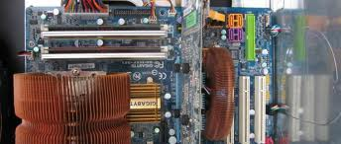
Enterprise Culture
By acting with greater entrepreneurship in their operations, businesses will improve their own efficiency, deliver better value for money and improve services to their customers and the public.
More entrepreneurial policymaking by the government will also enable businesses to grow, increase employment and provide the wealth that the country needs.

Slide 9
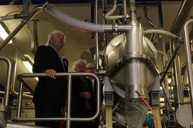
Businesses + Enterprise Culture
An organisation or business with an enterprise culture is one where people are imaginative and creative, rather than being reluctant to take risk.
An enterprise culture is made up of enterprising people who are ready to challenge existing ways of doing things, and come up with new ideas and solutions to the benefits of the entire society.

Slide 10
Businesses + Enterprise Culture (cont’d)
Enterprise culture is the ability to think of new projects and make them successful.
It is an initiative with novel ideas in which people are encouraged to develop small businesses.
Enterprise culture builds entrepreneurship.

Slide 11
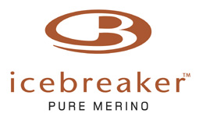
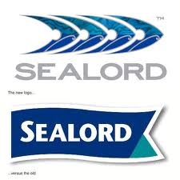
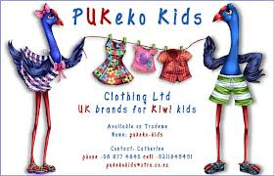
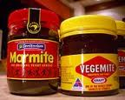
NZ Businesses with a Strong Enterprise Culture

Slide 12
NZ Businesses with a Strong Enterprise Culture 1. Les Mills
Through an 'open to all' policy, and marketing campaigns, the company has led the fitness industry for over forty years. The company also introduced a personal training programme where trainers contract to a Les Mills club, and pay rent to do so, as well as managing their own clients.
The latest initiative is a Team Training category aimed at building stronger connections between members through programmes such as Les Mills BOOTCAMP®, Les Mills LOOK BETTER NAKED® and Les Mills SPARTAN®.
Read more: http://education-for-enterprise.tki.org.nz/Resources-tools-templates/Business-case-studies/Les-Mills

Slide 13
NZ Businesses with a Strong Enterprise Culture 2. Trilogy
New Zealand natural skincare company Trilogy was founded in 2002 by sisters Sarah Gibbs and Catherine de Groot. In just a few years the sisters have built their business from a boutique local operation into a recognised and admired international brand sold in 16 markets worldwide.
Trilogy has appeared on the Deloitte/Unlimited Fast 50 Index for three consecutive years; first appearing as New Zealand’s third fastest growing business in 2006 with a staggering 690 percent growth.
Read more: http://education-for-enterprise.tki.org.nz/Resources-tools-templates/Business-case-studies/Trilogy

Slide 14
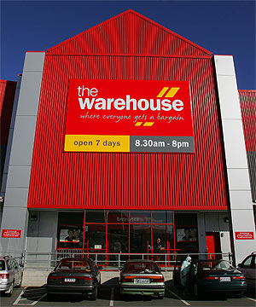
NZ Businesses with a Strong Enterprise Culture 3. Sir Stephen Tindall and The Warehouse
Stephen Tindall is very passionate about the success of the New Zealand economy.
He believes a successful economy is achieved from a culture that wants to be more enterprising.
This enterprising spirit can start with children at a young age by completing simple tasks such as handling money and setting up small stalls.
The man behind The Warehouse
Tindall was exposed to business early in life and has always had an entrepreneurial streak. His first job was at home completing household chores for pocket money, then going on to mow lawns for neighbours.

Slide 15
NZ Businesses with a Strong Enterprise Culture 3. Sir Stephen Tindall and The Warehouse
At the age of 14, Tindall worked at a local store delivering groceries and then helped his father at the hardware store. He also had a holiday job at the Reserve Bank, with a friend, where they drilled holes into old notes. His first job out of school was at his Great Grandfather’s company, George Court & Sons, where he worked for 12 years.
Tindall spent five years part-time at the Auckland Institute of Technology and gained a NZIM Management Diploma and New Zealand Institute of Purchasing and Supply Diploma.
Read more: http://education-for-enterprise.tki.org.nz/Resources-tools-templates/Business-case-studies/Sir-Stephen-Tindall

Slide 16
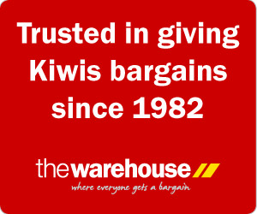
NZ Businesses with a Strong Enterprise Culture 3. Sir Stephen Tindall and The Warehouse
Listen to Stephen Tindall talk about the importance of Enterprise:
http://education-for-enterprise.tki.org.nz/Business-and-community/What-business-leaders-say

Slide 17
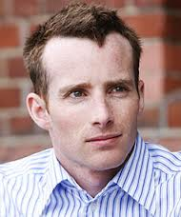
NZ Businesses with a Strong Enterprise Culture 4. Sam Morgan and Trade Me
What makes Sam Morgan different from others is his ability to take action. Some people spend a lot of time talking about things, others get out and do them. Morgan’s ability to act and make decisions has resulted in him creating a multimillion dollar business – Trade Me – and has given him the financial ability to become a philanthropist.
Background
Sam Morgan, founder of Trade Me, had an unconventional family upbringing in Wellington. At one point this included living on a bus with his parents and three siblings.

Slide 18
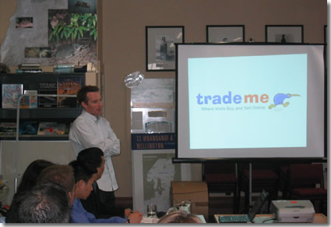
NZ Businesses with a Strong Enterprise Culture 4. Sam Morgan and Trade Me
Trade Me
The idea for Trade Me started when Morgan was searching for a second hand heater for his student flat. During this search he came up with the idea of online auctions in New Zealand. It was an idea that was to make Sam Morgan a multimillionaire.
From a very young age, Morgan had shown that he would follow through with an idea until it was complete. He built Trade Me in his spare time in two months, while he was consulting full-time for Deloitte. He then resigned from Deloitte to run Trade Me full-time. Read more: http://education-for-enterprise.tki.org.nz/Resources-tools-templates/Business-case-studies/Sam-Morgan

Slide 19
NZ Businesses with a Strong Enterprise Culture 5. Gallagher
Overview
Before we entered into the animal management business, we were farmers. It was a typical farmer’s approach to solving farm problems that helped us lead the world into the electric fencing age.
Back in the Depression years of the 1930’s, we didn’t just invent electric fencing systems. Bill Gallagher (Senior) built home made tractors – the first was an old car fitted with iron-shod cleated wheels. It pulled a roller to flatten scrub that was then burnt.
From the 1930’s we developed, on our own family farm, animal control systems to make farm work easier. Today we’re an internationally successful company, known and respected in over one hundred countries.
We’ve continued with ground breaking and inspirational technology that has been the hallmark of the Gallagher brand since its inception. What began as a visionary alternative to the conventional fencing of the day, has grown into technologically superior, highly intelligent and fully integrated animal management systems.

Slide 20
Importance of a Strong Enterprise Culture in NZ
Successful risk-taking will allow NZ to benefit from opportunities that may not occur otherwise, which will increase wealth creation.
Successful product innovation allows companies to offer new, marketable products and therefore increase revenue.
Successful process innovation will allow firms to increase productivity / efficiency.
Source: NZQA exam 2011

Slide 21
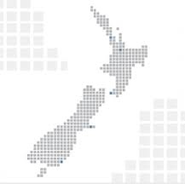
Importance for a country of a Strong Enterprise Culture
It is widely acknowledged that a strong culture of entrepreneurship offers a triple win.
First, it empowers individuals hungry to use their own creativity to achieve success.
Second, it provides the business-savvy employees that companies desperately need to ensure success in a technologically fast paced and fluid business environment.
Third, it boosts the capacity for a country’s economic success by increasing the numbers of individuals able to take advantage of the global innovation economy.

Slide 22
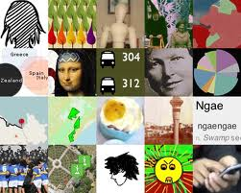
Importance for a country of a Strong Enterprise Culture (cont’d)
Enterprise culture encourages and sustains economic dynamism that enables an economy to adjust successfully in a rapidly changing global economy and enable individuals to use their potential and energies to create wealth, independence and status for themselves in society.

Slide 23
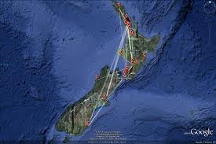
Sources:
http://businesscasestudies.co.uk/business-theory/strategy/enterprise-culture.html#ixzz23CT3mdRt
http://education-for-enterprise.tki.org.nz/
http://www.ft.com/intl/cms/54927cac-54fb-11da-8a74-00000e25118c.pdf
http://ozelacademy.com/OJAS_v4n1/OJAS_v4n1_8.pdf

