Slide 1
Level 2 Business Studies
2.2 - AS90844
Demonstrate understanding of the internal operations of a large business

Slide 2
Ethical Expectations
Students understand the impact of ethical issues relating to business activities
Define ethical business behaviour
Identify types of ethical behaviour
Explain how ethical considerations can influence business behaviour

Slide 3
Ethical Business Behaviour
Ethics are moral guidelines which govern good behaviour
Behaving ethically is doing what is morally right.
Behaving ethically in business is widely regarded as good business practice.

Slide 4
Ethical Business Behaviour
Being ‘ethical’ is a commitment to authenticity, honesty and correctness, which cannot be underestimated: it’s complex, demanding, with few white-and-blacks but a lot of greys.
And it is more about asking questions than there exist answers.

Slide 6
Ethical Business Behaviour
Ethical principles and standards in business:
Define acceptable conduct in business
Should underpin how management make decisions
An important distinction to remember is that behaving ethically is not quite the same thing as behaving lawfully:
Ethics are about what is right and what is wrong
Law is about what is lawful and what is unlawful

Slide 7
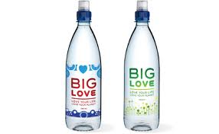
Ethical Business Behaviour
An ethical decision is one that is both legal and meets the shared ethical standards of the community
Businesses face ethical issues and decisions almost every day – in some industries the issues are very significant. For example:
Should businesses profit from problem gambling?
Should supermarkets sell lager cheaper than bottled water?
Is ethical shopping a luxury we can’t afford?
You will probably note the link between business ethics and corporate

Slide 8
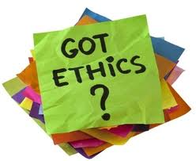
Ethical Business Behaviour
The link between business ethics and corporate social responsibility (CSR).
A socially responsible firm should be an ethical firm
An ethical firm should be socially responsible
However there is also a distinction between the two:
CSR is about responsibility to all stakeholders and not just shareholders
Ethics is about morally correct behaviour

Slide 9
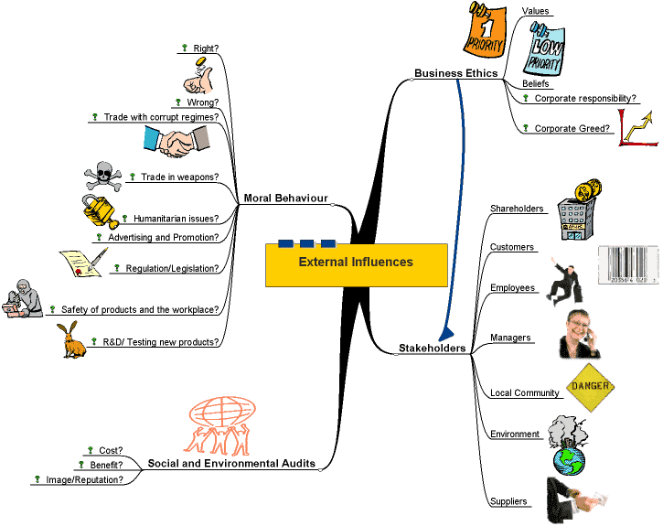

Slide 10
Principles of Admirable Business Ethics
1. Be Trustful: Recognize customers want to do business with a company they can trust; when trust is at the core of a company, it's easy to recognize. Trust defined, is assured reliance on the character, ability, strength, and truth of a business.
2. Keep An Open Mind: For continuous improvement of a company, the leader of an organization must be open to new ideas. Ask for opinions and feedback from both customers and team members and your company will continue to grow.

Slide 11
Principles of Admirable Business Ethics
3. Meet Obligations: Regardless of the circumstances, do everything in your power to gain the trust of past customer's and clients, particularly if something has gone awry. Reclaim any lost business by honouring all commitments and obligations.
4. Have Clear Documents: Re-evaluate all print materials including small business advertising, brochures, and other business documents making sure they are clear, precise and professional. Most important, make sure they do not misrepresent or misinterpret.

Slide 12
Principles of Admirable Business Ethics
5. Become Community Involved: Remain involved in community-related issues and activities, thereby demonstrating that your business is a responsible community contributor. In other words, stay involved.
6. Maintain Accounting Control: Take a hands-on approach to accounting and record keeping, not only as a means of gaining a better feel for the progress of your company, but as a resource for any "questionable " activities. Gaining control of accounting and record keeping allows you to end any dubious activities promptly.

Slide 13
Principles of Admirable Business Ethics
7. Be Respectful: Treat others with the utmost of respect. Regardless of differences, positions, titles, ages, or other types of distinctions, always treat others with professional respect and courtesy.

Slide 14
Types of Ethical Behaviour
1. Fair wages:
Should people be paid what they’re worth, or what the company can afford? Is it an either/or issue?
Example: What if by company policy only statutory minimum wage is paid, or the wages for highly qualified employees are not competitive in a national comparison, which could for example be due to a locally high unemployment rate – and subsequent competition – among potential employees.

Slide 15
Types of Ethical Behaviour
2. Fair trade, fair treatment:
Does the concept of fair trade extend to fair treatment of local NZ staff (e.g. in NZ), or does it only really apply to developing country suppliers?
Example: A company with fair trade certified supply chain, but the staff in NZ are bullied.

Slide 16
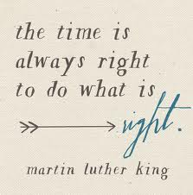
Types of Ethical Behaviour
3. Carbon footprint vs. competitive price:
Working with overseas suppliers often invariably means substantial amounts of travelling, but at the same time cheaper production and retail prices than if produced in New Zealand.
How can in this time and age the extra Kg of CO2 be justified with the cheaper prices that the (high street) consumers are paying?

Slide 17
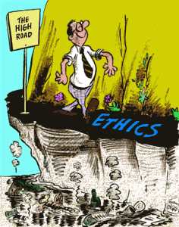
Types of Ethical Behaviour
4. Transparency:
How willingly does a company make their ‘in house’ data publicly available? And what data would that be?
Examples: Turn over, overheads, staff salaries, money spent on trade fairs and related expenses, miles flown, air or transport miles accumulated by the products, average CO2 footprint per product. …

Slide 18
Types of Ethical Behaviour
5. Trade secrets vs. interest of the wider community:
More large suppliers have published lists of their suppliers, for everyone to see and inspect.
However, ‘ethical’ companies however, certainly in fashion, keep their suppliers often as well guarded secret.
Is this fair? After all, this means that said supplier will loose business opportunities through this type of secrecy, and ‘ethical’ companies are actually in the business of spreading the good practises and supporting the sector to grow

Slide 19
Types of Ethical Behaviour
6. Customer service: attention vs. negligence:
Some ‘ethical’ companies are so engrossed in getting their supply chains right, that they forget about how important ‘the one and only’ decisive factor is to their business: the buyer.
Customer service and customer relations is probably THE factor that will have them come back to buy, times and over again.
The product – surprise, surprise – may be the trigger initially, but that novelty wears off quickly. After that, what remains is the relationship.

Slide 20
Code of Ethics (Practice)
Ethical behaviour is merely making good business decisions based on an established "code of ethics". Entrepreneurs should establish a written code of ethics that can serve as a framework for decisions to be made by the entrepreneur as well as the employees. In developing this code of ethics businesses should consider the following:
1. Identify the general principles that would lead to fair business practices.
2. Check your businesses industry association for basic standards to review
3. Allow for the fact that ethical questions do not always have a unique, faultless answer.
4. Write out specific statements that will assist you and others in making day-to-day ethical decisions.
5. Apply your code of ethics to a written policy and procedure manual identifying the major rules for operating the business.
6. Train your employees (and family members) to make ethical decisions about the business.

Slide 21
A code of ethics will apply to all types of business operations including:
Handling cash and checks from customers
"Negotiating" special prices for a friend without permission
Accepting gifts from suppliers and business associates
Selling damaged merchandise
Warranties on products
Returning merchandise to suppliers
Merchandise return policies for customers
Handling shoplifters

Slide 22
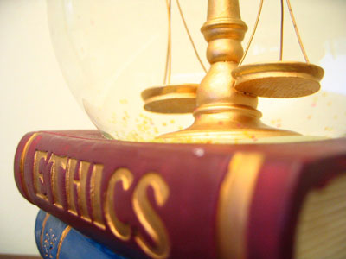
A code of ethics will apply to all types of business operations including: (continued)
Accounting procedures for cash sales
Employee theft
Insurance coverage adequate to protect the business and employees
Supporting advertising promises
Checking in merchandise when received from suppliers
Keeping the premises clean and free from harmful substances or germs.
Handling employee performance problems
Telling customers the truth

Slide 23
The disadvantages claimed for ethical business
The negative effect(s) of behaving ethically may lead to:
increased costs and loss of profit caused by changing workplace practices. e.g. sourcing from Fairtrade suppliers rather than lowest price, a business can cut costs by hiring child labour at very low wages in developing countries. Paying below average wages lowers the firm's total costs.
Higher overheads – e.g. training communication of ethical policy. A danger of building up false expectations

Slide 24
The advantages of ethical behaviour include
Higher revenues – demand from positive consumer support
Improved brand and business awareness and recognition
Better employee motivation and recruitment
New sources of finance – e.g. from ethical investors
Ability to retain staff through their caring approach, which leads to lower labour turnover, which cuts recruitment and retraining costs.
Staff are more committed to success and work hard to help the business achieve its aims.

Slide 25
Pressure for businesses to act ethically
Businesses and industries increasingly find themselves facing external pressure to improve their ethical track record.
An interesting feature of the rise of consumer activism online has been increased scrutiny of business activities.

Slide 26
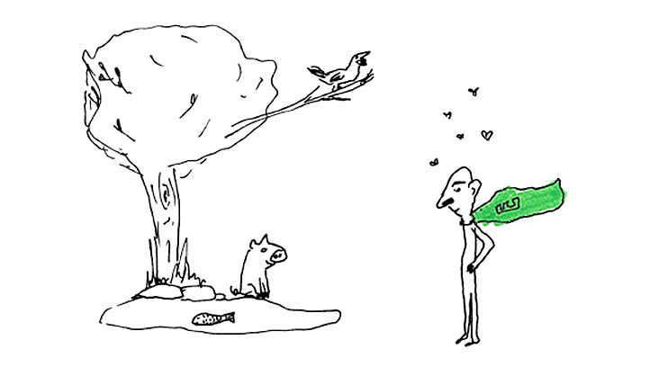
Pressure for businesses to act ethically
Pressure groups are a good example of this. Pressure groups are external stakeholders they
Tend to focus on activities & ethical practice of multinationals or industries with ethical issues
Combine direct and indirect action can damage the target business or industry

Slide 27
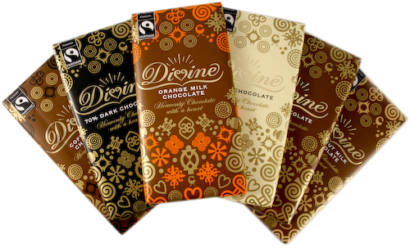
Videos
World's Most Ethical Companies 2011: http://www.youtube.com/watch?v=l1HYrGsM6Ho
Ethics in the workplace: http://www.youtube.com/watch?v=0mUxMpMTT28&feature=related
What is Ethics? What is Business Ethics? http://www.youtube.com/watch?v=vmVu66Fpd9U
Best ethical business: Divine chocolate: http://www.guardian.co.uk/theobserver/video/2008/jun/05/ethicalawards.divinechocolate
Business Ethics: Resolving an Unethical Situation : http://www.youtube.com/watch?v=fyf2xjx4mzU

Slide 28
Sources:
http://shirahime.ch/2011/08/how-ethical-is-ethical-observing-is-knowing-shirahime-post-nr-100/
http://tutor2u.net/business/strategy/business-ethics-introduction.html
http://www.entre-ed.org/_teach/ethics.htm

