Slide 1
Level 2 Business Studies
2.2 - AS90844 Demonstrate understanding of how a large business responds to external factors BS 11/3/11/6v2 2016

Slide 2
Legislation to consider
Employment Relations Act 2000
Resource Management Act 1991
Privacy Act 1993

Slide 3
Employment Relations Act 2000
"Good Faith" is the central principle of the ERA.
"good faith" means that employees and unions must deal with each other openly and honestly
To build productive employment relationships through the promotion of [good faith] in all aspects of the employment environment and of the employment relationship

Slide 4
Under the Act:
employers must pay their employees,
provide a safe workplace,
allow employees to take paid leave,
take responsibility for employees actions
provide written employment agreements.
The Act also expressly prohibits discrimination.

Slide 5
Amendments
90 day trial for all employees
Union must have permission to enter the business
Changes to personal grievances (easier to complain about an issue)
Employers must keep a copy of the employee’s contract

Slide 6
Employment Agreements
The Employment Relations Act 2000 (as amended) requires that all employment agreements are in writing. Written employment agreements are essential in every business. As employers, we run the risk of coming second (to the employee) in the event of a dispute, disagreement or personal grievance if we do not have employment agreements in place

Slide 7
The Resource Management Act 1991
The Resource Management Act (RMA) is a significant, and at times, controversial Act of Parliament.
Is the main piece of legislation that sets out how we should manage our environment.
It’s based on the idea of the sustainable management of our resources, and it encourages us (as communities and as individuals) to plan for the future of our environment.

Slide 8
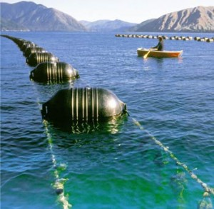
The Resource Management Act 1991
The RMA regulates access to natural and physical resources such as land, air and water, with sustainable management of these resources being the overriding goal.
New Zealand's Ministry for the Environment describes the RMA as New Zealand's principal legislation for environmental management.

Slide 9
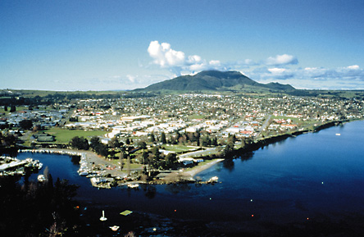
Summary – cutting to the chase
The RMA:
helps us look after the environment
is based on the idea of sustainably managing resources
encourages us to get involved in decisions about our environment.

Slide 10
The Resource Management Act 1991
As the RMA and the decisions made under it by district and regional councils and in courts affect both individuals and businesses in large numbers, and often in very tangible ways, the RMA has variously been attacked for being ineffective in managing adverse environmental effects, or overly concerned with bureaucratic restrictions on legitimate economic activities.

Slide 11
Implications for Business
If you’re going to start your own business, buy an existing business or change or expand your current business there are some things about where you want to locate and how you will operate your business that you should consider.
Any environmental effects of locating and operating your business are considered under the Resource Management Act (RMA).

Slide 12
Critics of the RMA Act
Critics of the act argue that the resource management process is a barrier to investment, being unpredictable, expensive, protracted and often subject to undue influence from local lobby groups, such Maori iwi.
A typical business viewpoint is expressed by the New Zealand Business Roundtable.
'The NZBR has long expressed concerns that are widely shared in the business community about the RMA. It is a cumbersome, time-consuming and costly piece of legislation that adds considerable uncertainty to business decision-making. It is a major impediment to the country's economic growth.’

Slide 13
Critics of the Act
The Business Round Table has also argued that the RMA contains core concepts, such as sustainable management, intrinsic values, Treaty principles, kaitiakitanga and the definition of the environment, which are 'hopelessly fuzzy'.
Other business critics argue that the RMA is destructive of property rights.

Slide 14
Compliance Costs
Defining "compliance" costs is not as straightforward as one might think.
There is no statutory definition of the term.
Business New Zealand defines it as "the administrative and paperwork costs businesses incur when meeting a regulatory obligation".
While this definition is a good starting point for considering compliance costs, it does not fully capture the true extent of such costs.

Slide 15
Non quantifiable and intangible compliance costs
Include:
mental stress and anxiety faced by businesses in complying with the ever changing regulatory obligations.
opportunity costs of time and resources used in ensuring compliance with the legislation that could be employed in more efficient and productive ways.

Slide 16
The Privacy Act 1993
New Zealand's Privacy Act was enacted in 1993 and has been amended several times.
The Privacy Act controls how "agencies" collect, use, disclose, store and give access to "personal information".
It also grants to individuals the right to have access to personal information held about them by any agency.

Slide 17
The Privacy Act 1993
The Privacy Act applies to "personal information," which is any information about an identifiable individual, whether automatically or manually processed.
Almost every person or organisation that holds personal information is an "agency". So, for example, the Privacy Act covers government departments, companies of all sizes, religious groups, schools and clubs.

Slide 18
The objectives of this Act include:
Promoting and protecting individual privacy
Establishing principles for collecting, using, and disclosing information about individuals
Establishing principles for allowing each individual access to information about them that is held by public and private sector agencies
Providing for the appointment of a Privacy Commissioner to investigate complaints about interferences with individual privacy

Slide 19
Concerns in relation to the Act
Uncertainty about the requirements of the Act;
Lack of clear guidelines about the duties of privacy officers; and
Conflict between the Act and other legislation.
In particular, businesses were concerned about the amount of time they had to spend trying to determine correct approaches or having to seek costly legal advice due to
Uncertainty about the Act's requirements. For instance, employers were uncertain about what questions they were allowed to ask prospective employees and were unclear about whether the Act imposed restrictions on their ability to disclose information about employees during due diligence.

Slide 20
Compliance Costs
The most widely cited ongoing business costs under the Privacy Act were:
Ensuring staff are aware of the Act's provisions and guidelines;
Dealing with access requests under the Act, including staff time in checking files
Gathering the required information and then responding to requests; and
Seeking legal advice when required.

