Slide 1
Level 2 Business Studies
2.2 - AS90844
Demonstrate understanding of the internal operations of a large business

Slide 2
Sustainability expectations (economic)
Students will develop an awareness of the need for business to operate in an economically sustainable manner
Define economic sustainability
Explain the importance of conducting cost-benefit analysis
Understand why there is a need for business to operate in an economically sustainable manner
Discuss the impact of economic sustainability of business on the New Zealand economy

Slide 3
Economic Sustainability
The term used to identify various strategies that make it possible for a business to utilise available resources to best advantage.
Economic Sustainability is about ensuring businesses and organisations are "built to last" and are able to function efficiently over a long period of time.

Slide 4
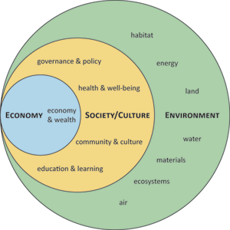

Slide 5
Economic Sustainability
The idea is to promote use of those resources that is both efficient and responsible, and likely to provide long-tem benefits.
In the case of a business operation, economic sustainability calls for using resources so that the business continues to function over a number of years, while consistently returning a profit.

Slide 6
Economic Sustainability
In most scenarios, the measure of economic sustainability is presented in monetary terms.
The worth of assets and resources in dollar figures is common, as is identifying the amount of return generated by the efficient use of those resources.

Slide 7
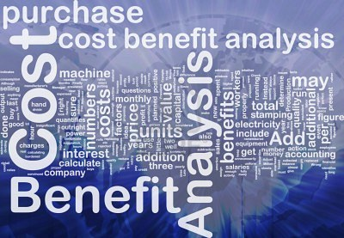

Slide 8
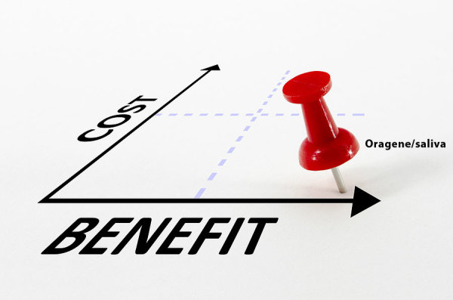
Cost-Benefit Analysis
is a systematic process for calculating and comparing benefits and costs of a project or decision
CBA has two purposes:
To determine if it is a sound investment/decision (justification/feasibility),
To provide a basis for comparing projects. It involves comparing the total expected cost of each option against the total expected benefits, to see whether the benefits outweigh the costs, and by how much.

Slide 9
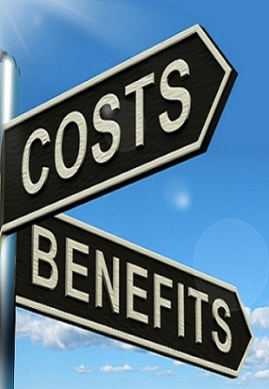
Cost-Benefit Analysis
A cost benefit analysis finds, quantifies, and adds all the positive factors. These are the benefits.
Then it identifies, quantifies, and subtracts all the negatives, the costs.
The difference between the two indicates whether the planned action is advisable.
The real trick to doing a cost benefit analysis well is making sure you include all the costs and all the benefits and properly quantify them.

Slide 10
Benefits (positives)
Cost
(negatives)
-
gives a business information to be able to make sound investment decisions

Slide 11
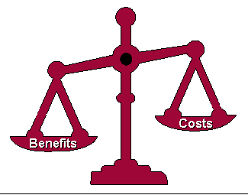
Cost-Benefit Analysis
Costs are either one-off, or may be ongoing.
Benefits are most often received over time.
Businesses build this effect of time into their analysis by calculating a payback period. This is the time it takes for the benefits of a change to repay its costs.
Many businesses look for payback over a specified period of time – e.g. three years.

Slide 12
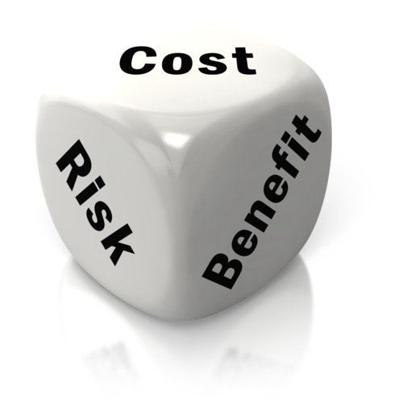
Example Cost Benefit Analysis
As the Production Manager, you are proposing the purchase of a $1 Million stamping machine to increase output. Before you can present the proposal to the CEO, you know you need some facts to support your suggestion, so you decide to run the numbers and do a cost benefit analysis. You itemise the benefits. With the new machine, you can produce 100 more units per hour. The three workers currently doing the stamping by hand can be replaced. The units will be higher quality because they will be more uniform. You are convinced these outweigh the costs.
There is a cost to purchase the machine and it will consume some electricity. Any other costs would be insignificant.
You calculate the selling price of the 100 additional units per hour multiplied by the number of production hours per month. Add to that two percent for the units that aren't rejected because of the quality of the machine output. You also add the monthly salaries of the three workers. That's a pretty good total benefit.

Slide 13
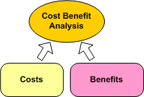
Example Cost Benefit Analysis
Then you calculate the monthly cost of the machine, by dividing the purchase price by 12 months per year and divide that by the 10 years the machine should last. The manufacturer's specs tell you what the power consumption of the machine is and you can get power cost numbers from accounting so you figure the cost of electricity to run the machine and add the purchase cost to get a total cost figure.
You subtract your total cost figure from your total benefit value and your analysis shows a healthy profit. All you have to do now is present it to the CEO.

Slide 14
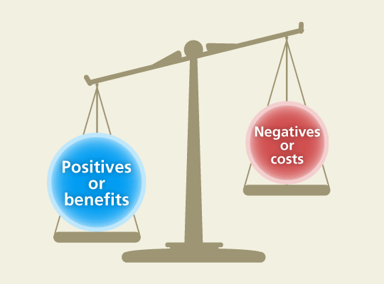
Importance of a CBA A cost-effectiveness analysis suggests how to:
choose among several alternatives
assess the most cost-efficient delivery method
determine whether to continue a project
compare all alternatives
assess the consequences of doing nothing

Slide 16
Reasons for Economic Sustainability
viability of business over the long-term
sustained sales and profit
potential for securing future investments
retaining good staff and maintaining staff levels – minimising recruitment and training demands

Slide 17
Importance of Economic Sustainability
With economic sustainability, the goal is to establish profitability over the long-term.
A profitable business is much more likely to remain stable and continue to operate from one year to the next.
From this perspective, economic sustainability can be seen as a tool to make sure the business does have a future and continues to contribute to the financial welfare of the owners, the employees, and to the community where the business is located.

Slide 18
Impact on the New Zealand Economy
All businesses, both large and small, help drive our economy.
In order for New Zealand to have an economy that is both economically viable and environmentally and socially sustainable, New Zealand businesses need be to be sustainable.

Slide 19
Importance of Economic Sustainability
A healthy local economy is essential for a sustainable and liveable community.
It provides the resources that allow residents and a community to prosper.

Slide 20
Importance of Economic Sustainability
It brings employment and a solid tax base to support services, leading to healthier lifestyles and greater opportunities for personal fulfilment.
With a strong economy we can achieve a higher standard of development, provide more services, and enjoy an overall higher quality of life.

Slide 21
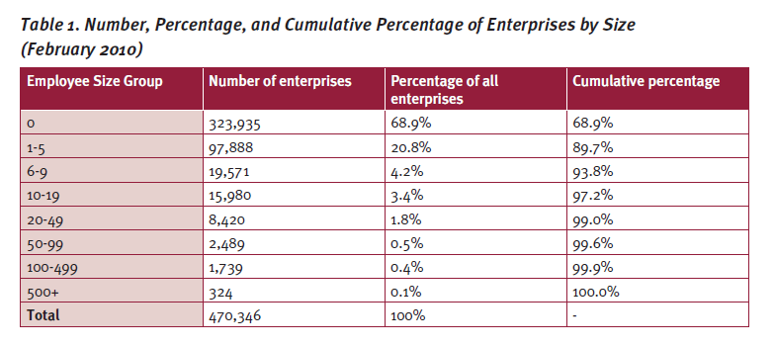

Slide 22
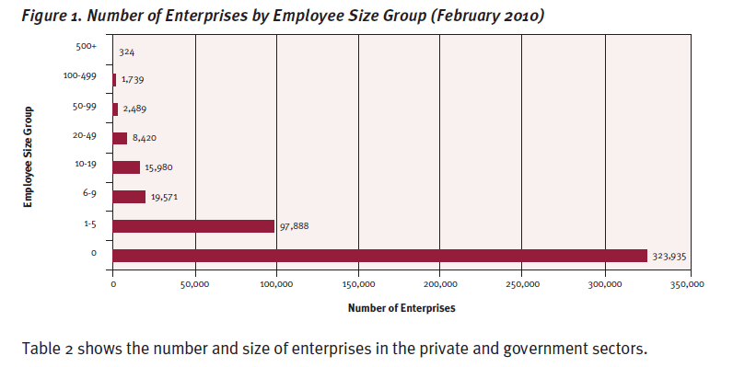

Slide 23
Sources:
http://www.cnv.org/server.aspx?c=3&i=502
http://www.wisegeek.com/what-is-economic-sustainability.htm
http://www.sustainabledirections.com.au/Economic-Sustainability
http://en.wikipedia.org/wiki/Cost%E2%80%93benefit_analysis /
http://management.about.com/cs/money/a/CostBenefit.htm
http://www.med.govt.nz/business/business-growth-internationalisation/pdf-docs-library/small-and-medium-sized-enterprises/small-medium-businesses-in-nz-apr-2012.pdf

