Slide 1
Animal Behaviour

Slide 2
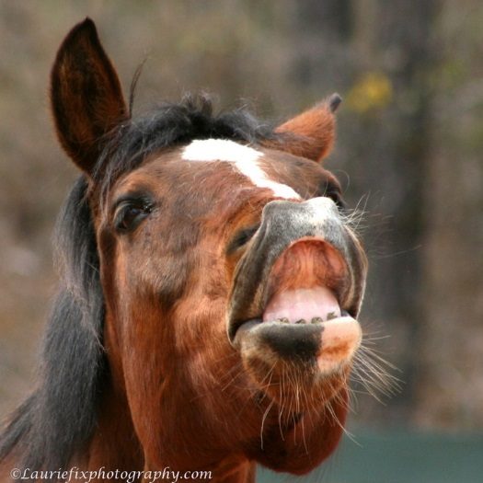
What is animal behaviour?
Animal behaviours are the patterns of action seen in livestock that occur either voluntarily or involuntarily.
Voluntary behaviour is when an animal has chosen to do something like seek shade, food or water.
An animal has no control over involuntary behaviour like eyelid blinking, or the flehman (lip curl) response to females on heat.

Slide 3
Types of behaviour.
Types of behaviour include:
maternal,
social,
agonistic,
ingestive,
eliminative,
investigative,
territorial, and
sexual.

Slide 4
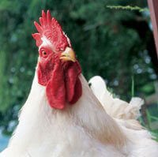
Investigative behaviour
animal senses
Examples:
Pigs, horses and dairy goats are highly curious, investigate any strange object, approach carefully, slowly, sniffing and looking as they approach
Sheep are less curious and more timid

Slide 5
Animal Perception and Behaviour
how animals perceive things
what stimulates them and how do those stimuli function
instinct
neural control
sensory processes: sight, sound, hearing etc.

Slide 6
How animals see…
Wide angle vision
  300 degrees
Poor depth perception
  Shadows look like ‘holes’
Slow pupil response to light
  Changes from dark to light, or light to dark actually blind the animal until their eye’s adjust
Dichromats
  See blue-green and yellow-green colours

Slide 7
Vision in cattle
cattle have excellent wide angle vision
poor depth perception may result in balking at shadows
Brahmans may hold head higher due to heavy skin fold over brow

Slide 8
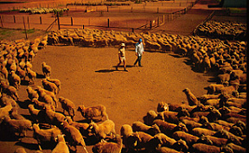
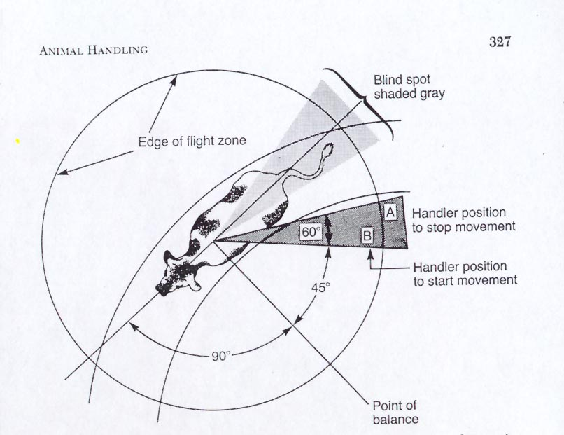
Flight zone
Vision affects the animals “flight zone”
This is their personal space

Slide 9
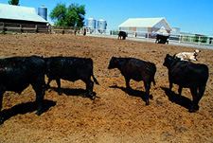
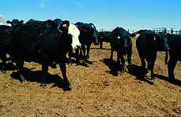
Flight Zone
How close do you get before the animal moves?
How close do you get before the animal bolts?
When flight zone entered, cattle move away
When zone is exited, cattle stop moving and may turn to face handler or predator

Slide 10
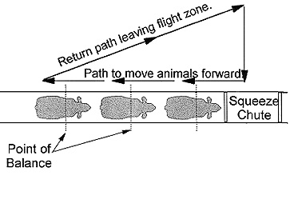
Using the Flight Zone to move animals
  All animals have a point of balance, usually at their shoulders
    Ahead of the ‘Point’ stops
    Behind the ‘Point’ moves

Slide 11
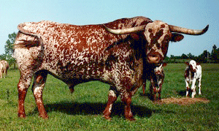
Flight zone is influenced by;
Previous handling- both negative and positive
Where you are approaching the animal from
Temperament
Size of the enclosure

Slide 12
Flight zone
in handling areas it is important not to invade flight zone too deeply as cattle may attempt to move backwards
occasionally cattle will rear up in a single file chute if handler approaches too closely
in either case, backing out of flight zone should terminate escape behaviour

Slide 13
How animals hear….
Auditory sensitivity
  Unexpected loud or new noises can be highly stressful
  Continuous exposure to sounds over 100 decibels causes stress
    Lower daily weight gain
    Decrease in milk production
Cattle are more sensitive to high frequency noises than humans
Loud noises may distress cattle

Slide 14
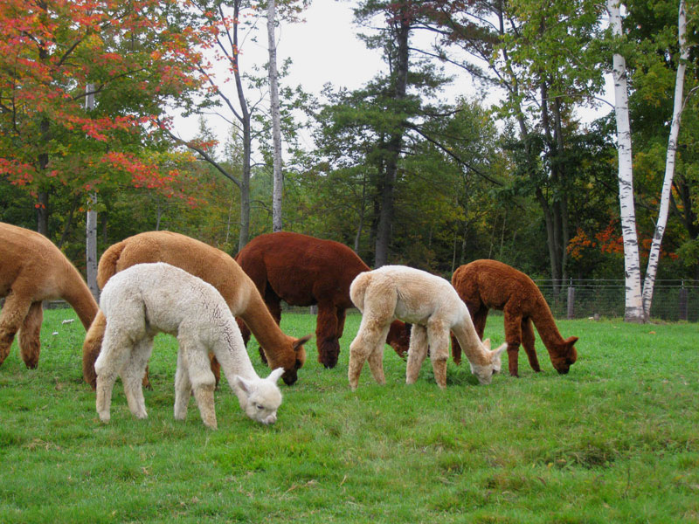
Ingestive (eating) behaviour
Seeking, consuming and digesting feed (grazing, ruminating, drinking and suckling.
Cattle graze 4-9hrs/day, ruminate 4-9hrs/day, regurgitate 300-400 boluses of feed per day
Sheep and goats graze 9-11hrs/day, ruminate 7-10hrs/day, regurgitate 400-600 boluses of feed per day
Cattle usually don’t go more than 5kms away from water
Sheep may travel as much as 12kms a day

Slide 15
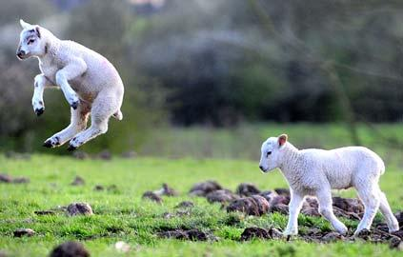
Social behaviour
physical structure
social structure
communication
play, practice and exercise

Slide 16
Social Behaviour
animal societies
aggression
social constraints
social order
play
sexual behaviour
communication

Slide 17
Social structure
How animals interact with each other, the ‘pecking order’. Includes aggressive and passive behaviours between animals.
Males of all farm animals fight when they meet other unfamiliar males of the same species
Cows, sows and mares develop a pecking order, but fight less intensely than males
Cows withdraw from the herd to a secluded spot just before calving
Almost all animals withdraw from the herd if they are sick

Slide 18
Communication
Essential for the survival of the species. Animals communicate with each other through body language (ears, head position) sound and smell.
Distress Calls – Lambs bleat, calves bawl, pigs squeal and chicks chirp
Dams recognise offspring by smell
Farm animals respond to calls or whistles of the producer
Bulls bellow deeply to communicate

Slide 19
Allelomimetic behaviour
Animals of a species tend to do the same thing at the same time, ‘copy cat’ behaviour.
Cattle and sheep tend to graze at the same time, and rest and ruminate at the same time
Range cattle gather at the watering place about the same time each day because one follows the other

Slide 20
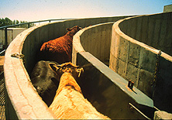
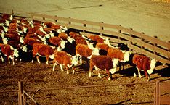
Herding behaviour
cattle follow the leader
like to maintain visual contact with each other
do not like to be isolated from herd mates - can be a dangerous situation for the handler

Slide 21
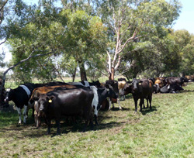
Shelter-seeking behaviour
Seeking shelter from weather or predators.
Animals crowd together in snow and cold winds
Animals seek shelter of trees when it rains
When the weather is hot, cattle seek shade and pigs seek mud.
In extreme situations, animals pile up to the extent that some get smothered

Slide 22
What livestock want…
Prey animals want a herd (social and shelter-seeking behaviours)
  They feel safest in a herd
    Isolation is stressful
  Motivated to maintain visual contact with each other
  Motivated to ‘follow a leader’
  Rapid movement will ‘scare’ livestock

Slide 23
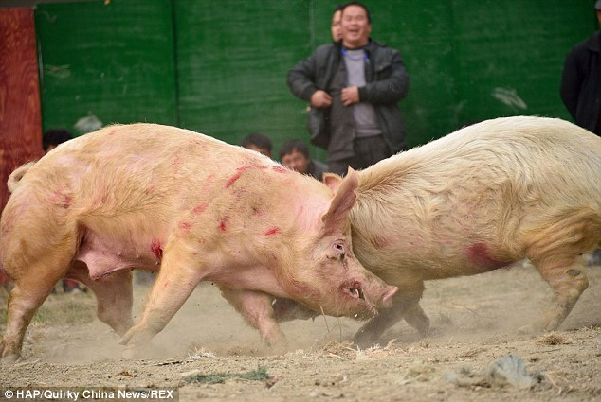
Agonistic (conflict or fighting) behaviour
group size
social stability
threats, submissive, fighting, frightened, alert

Slide 24
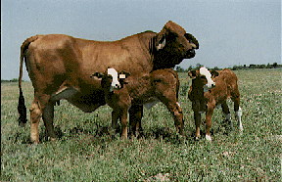
Defense mechanisms
head butting
kicking
Brahman influence cows have been known to bite if protecting calves
cattle with horns tend to be more aggressive
it is best if all cattle in a group are either horned or dehorned

Slide 25
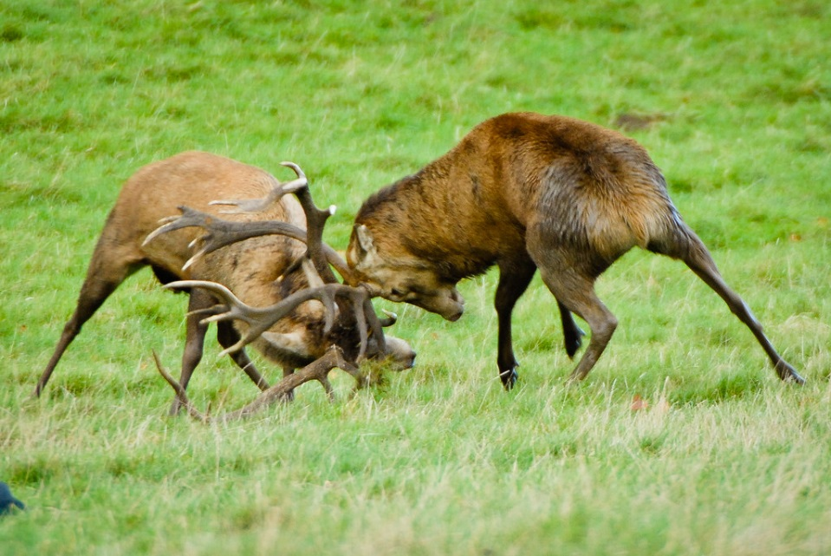
Territorial behaviour
spacing behaviour
types of space
spacing needs

Slide 26
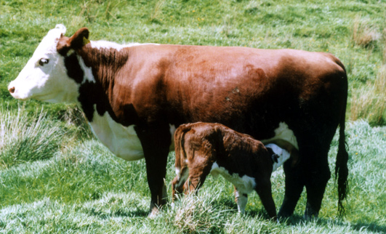
Maternal behaviour
Females taking care of newborn and young animals. This is one of the most intrinsic behaviour in mammals. It is also influenced and enhanced by the hormone: oxytocin. This behaviour occurs before birth, and after birth with nursing / suckling and bonding.
Mothers separate themselves from the herd before calving/farrowing/lambing.
Mothers clean young by licking them
Become aggressive in protecting they young after birth
Mothers fight off intruders

Slide 27
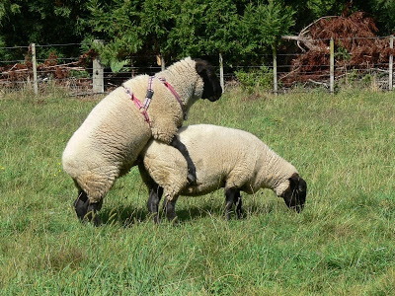
Sexual behaviour
male behaviour
female behaviour
mating behaviour
Useful in implementing breeding programs, refers to the behaviour animals show before and during mating. Typically these behaviours are enhanced by the hormones-estrogen and testosterone.

Slide 28
Examples of Sexual Behaviour:
Cows that are in heat, allow themselves to be mounted by others
Bulls, rams and stallions smell the vagina and urine to detect pheromones
Rams chase ewes that are coming into heat
Sows seek out boars for mating
Mares in heat squat and urinate when stallion approaches and vulva winks

Slide 29
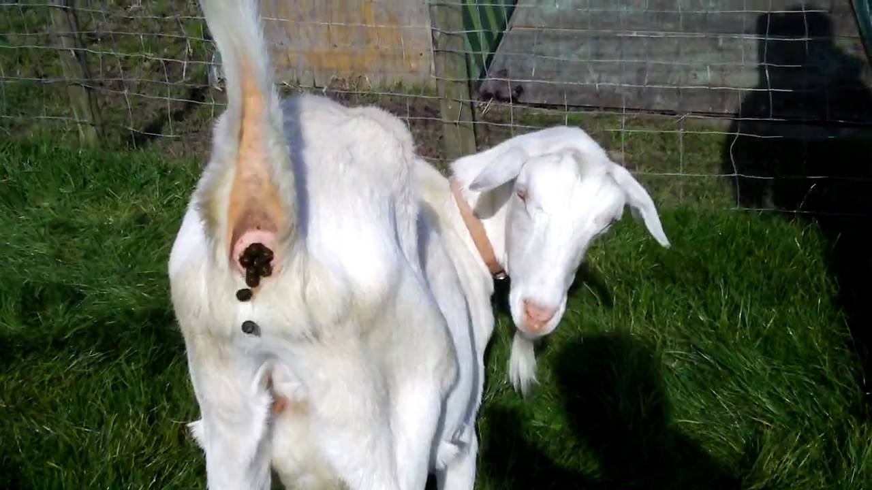
Eliminative (urinating and dunging) behaviour
social significance
location
Elimination of faeces and urine, and the behaviour associated with elimination.
Cattle, sheep, goats and chickens eliminate faeces & urine indiscriminately
Pigs and horses eliminate faeces in definite areas of a pasture or pen
  When given the option, pigs will not lay in their faeces
  Horses typically eliminate in specific areas of the pasture or stall
Cattle defecate 12-18 times/day, urinate 7-11 times/day
Horses defecate 5-12 times/day, urinate 7-11 times/day
Animals defecate & urinate more when stressed or excited

Slide 30
Causes of behaviour
Genetics, learning, external and internal influences;
Reactive, active and cognitive behaviour;
Conditioning.

Slide 31
Genetics and Behaviour
understanding biology
natural selection
genetic variation
development of behaviour
behavioural genetics

Slide 32
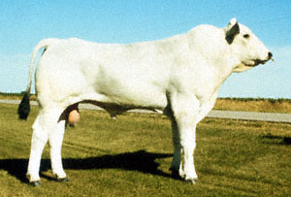
Breed variations
Brahmans & their crosses tend to be more excitable
variations in personalities in Bos taurus breeds, also
  Angus - excitable
  Herefords - quiet
  Chianina - nervous/jump fences

Slide 33
Genetic variation - Swirl theory…
A single swirl between or above the horse's eye indicates a horse with a generally uncomplicated nature.
A single swirl several inches below the eyes, 80% of horses with this feature are unusually imaginative and intelligent.
Two swirls adjoining, horses with this tend to be more emotional and over-reactive than average.
In a study of 1,500 cattle by Temple Grandin at a commercial feedlot, found that cattle with hair whorls above the eyes fought more in a squeeze chute during vaccinations.

Slide 34
Behavioural genetics
Temperament
  How well an animal reacts to handling
  Influenced by the ‘fear’ response of the animal
In cattle, temperament is highly heritable.

Slide 35
Behaviour and the Environment
coordination
orientation
homeostasis
acclimatisation
circadian rhythms
biological clocks
reproductive cycles; etc.

Slide 36
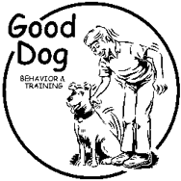
Instinct and Learning
conditioning and learning
extinction and habituation
instrumental learning
reinforcement
operant behaviour (controlled by consequences)
biological and cognitive aspects of learning.

Slide 37
How animals learn….
Learning is broken down into different types.
  Classical conditioning
  Habituation learning
  Operant or instrumental conditioning
  Imprint learning

Slide 38
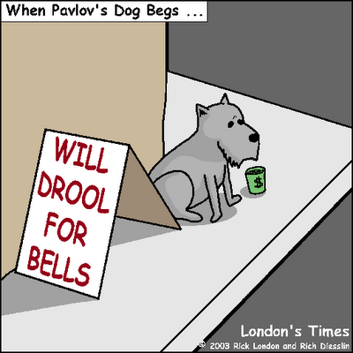
How animals learn….
Classical Conditioning
Pavlov’s Dogs
1890’s Pavlov was investigating the gastric function of dogs
He noticed that the dogs would begin salivating for their food, at the sight of the feeding technician
Pavlov went on to introduce a feeding bell, before feeding.
  The dogs would begin salivating at the bell.

Slide 39
How animals learn….
Classical Conditioning
A neutral stimulus becomes a conditional stimulus capable of getting a given response after being repeatedly presented with an unconditional (significant) stimulus.
Pavlov's bell was rung (conditional stimulus) whenever a dog used in the experiment was fed.
The dog would salivate (response) when it heard the bell ringing, even when the smell of food (unconditional stimulus) was absent.
Conditioning is more effective if the conditional stimulus and unconditional stimulus occur simultaneously and are presented in the same location.

Slide 40
How animals learn…
Operant Conditioning
Learning based upon the consequences of behaviour.
  Positive Reinforcement of a behaviour
    A cow may learn to press a lever when this action produces food.
  Negative Reinforcement of a behaviour
    A cow may learn to avoid eating out of a particular feed station, due to being shocked each time. They will avoid eating out of that feed station even when food is not available in any other area.
http://youtu.be/swORxV88c5o

Slide 41
How animals learn…..
Classical vs Operant
Classical Conditioning results in an association with a sight or sound….that results in a physiological reflex.
  Milk letdown - the action that allows milk to leave the udder, occurs when cows are anticipating being milked.
Operant Conditioning results in a change in behaviour in reaction to a consequence.
  Cattle who are moved with electrical stimulus (hot rods) will avoid the areas where they were shocked.

Slide 42
How animals learn…..
Habituation Learning
Habituation is learning, in which an animal, after a period of exposure to a stimulus, stops responding.
  A train that passes by every day….eventually the cows will not fear the noise.
  Nagging…...when training a horse or dog!

Slide 43
How animals learn…
Imprint Learning
When young animals learn to recognise the sound, smell and actions of their mothers.
  Only occurs in the first few days after birth
  Young animals can be ‘imprinted’ to humans, or other species.

Slide 44
Imprinting - Example
duckling sees human
duckling is a human
mum is a human
duckling sees ducklings
all ducklings love mum.
ducklings grow to be ducks
ducks don't need mum
ducks mate with ducks.
mum is now just another duck.
duck may love mum, or may not

Slide 45
Imprinting - Example
duckling sees human.
duckling is human.
mum is human.
duckling doesn’t see other ducklings.
duckling is only human.
duckling loves and needs mum.
duckling grows to be duck
duck likes humans.
duck doesn’t mate with ducks.
duck loves mum best

Slide 46
Handling Animals
psychological affects of different handling techniques
training animals (horses, cats, dogs, cows etc.)
pet animals
  may be difficult to work
  have little or no flight zone
  may be dangerous during feeding or if seeking attention

Slide 47
Behavioural Problems
abnormal behaviour (e.g. psychotic; neurotic)
domestication of animals
reducing human contact/dependence

Slide 48
Maladaptive behaviour
Animals that are not allowed to express their normal behaviour or that do not adapt to their environment, exhibit inappropriate or unusual behaviour
Chickens and pigs in extensive management (confinement) systems resort to cannibalism. The removal of tails is a prevention method.
Stallions that chew or bite themselves.

Slide 49
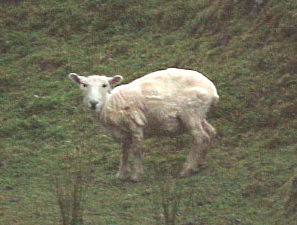
Why is understanding animal behaviour important?
Understanding the behaviour of livestock encourages easy handling, reduces stress, and improves handler safety and animal welfare.
Anticipation of normal behavioural responses during handling improves handler and animal safety.
To be effective, farmers must be able to judge livestock health by observing the animal’s appearance and general behaviour.

Slide 50
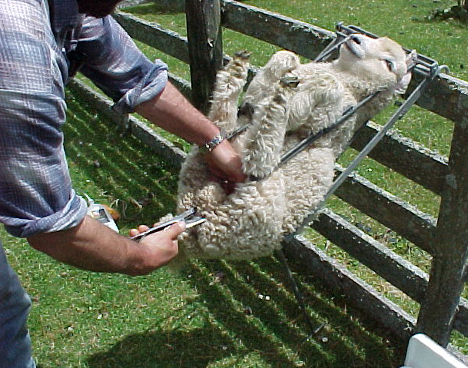
Animal stress and discomfort
Livestock that are under stress won’t be as productive as happy, healthy animals. Environments that put livestock under prolonged stress can alter an animal’s immune system, reproduction and growth.
Signs of stress and discomfort:
vigorous tail flicking (not to be confused with tail wagging)
head shaking
not able to control excretion
nostril flaring
body shivering
eyelid flickering
head retraction and eye closure.

Slide 51
Physiological responses of animals to stress
When livestock are under stress their body functions change to cope with different situations. There are three physiological responses to stress:
1. Emergency response (‘fight or flight’ response)
The immediate response of an animal to stress is to produce glucose from liver glycogen for an immediate energy supply. This helps animals cope with stress by affecting metabolic rate, cardiac function, blood pressure, respiration, visual acuteness, and energy availability.

Slide 52
2. Acute response
The second response to continued stress is to produce glucose from food and muscle protein.
The animal can maintain a steady state because the demand for energy is being met by increased metabolic performance.
3. Chronic response (response to continued stress)
The chronic stress response has harmful effects on animal growth, reproduction and health. A farmer needs to remove the cause of stress before the animal has reached the chronic stress response stage.

Slide 53
Measuring stress
The heart rate (units in beats per minute, bpm) of livestock is used to measure their immediate response to stress.
The normal heart rate range for livestock is 60–80 bpm. To measure the effects of stress over a longer period of time researchers take blood samples from animals.
These blood samples are analysed to determine the concentration of a hormone called cortisol.
Cortisol is produced when animals are under stress. This would enable them to keep metabolic functions at a steady rate.

Slide 54
Cortisol concentration in sheep during different husbandry procedures
 | Peak cortisol concentration (μg mL-1)
Shearing | 131
Transport | 80
Castration | 62
Tail docking | 49
Mustering | 48
Restraint | 34
Cortisol concentration in sheep during different husbandry procedures

Slide 55
What does this mean for farmers?
Response to humans
Since animals do not have language, their memories are in the form of pictures, sounds or smells.
Pleasant experiences will help build trust with livestock. Unpleasant experiences like using electric prods, rushing and forced handling only develop their permanent fear memory.
Animals are very specific in how they perceive events around them.
If chased, livestock are led to think that people are predators.
A handler’s attitude toward working with animals has a significant impact on livestock productivity and welfare. If livestock are scared of a particular handler then this will only make the handler’s job harder. Animals respond well to being handled gently.

Slide 56
Management Practices
Handling animals
Understanding livestock behaviour can reduce stress during handling
  Stress can reduce conception rate
  Stress may cause immune suppression
  Rough handling can cause bruising

Slide 57
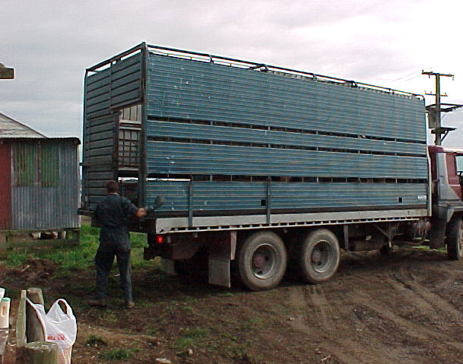
Transporting animals
It is best to yard sheep a few hours before transporting to give them a chance to rest. Stressed sheep tend to have higher pH meat which makes the meat tougher.
Livestock transport has small compartments to prevent smothering and bruising. Covered-in sides prevent cold stress.

Slide 58
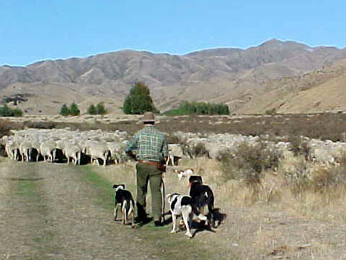
Mustering
A sheep’s natural instinct is to have a strong dislike to dogs. The dog is a sheep’s natural predator.
Farmers use this natural instinct to muster sheep in a large mob and then move the mob with the presence of a team of dogs. The sheep want to move away from the dogs and feel at ease grouped as a mob.
Good shepherds direct sheep using dogs to guide (heading dog) and bark (huntaway dog) at the sheep. They do not allow dogs to chase sheep particularly when working with lambs.

Slide 59
Getting about in mobs
All livestock are herd animals. They can become agitated and stressed when they are separated from their herd mates.
In sheep and cattle, isolation can be highly stressful. Isolated cattle that are agitated and stressed can injure themselves and handlers. Livestock are much calmer when they have body contact with other animals.
Cattle and sheep like to see others in their group. Handlers use this behaviour to their advantage by allowing animals to follow the leaders.
Skilled handlers do not rush animals and concentrate on moving the leaders instead of pushing a group of animals from behind.

Slide 60
Who’s the boss
Livestock live in a social hierarchy with dominant and weaker animals.
Introducing new stock into an established group changes the social order of the group. The socialisation process needed to establish a new social hierarchy is stressful on the newly introduced livestock.

Slide 61
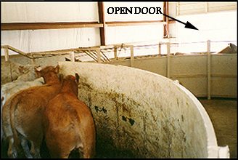
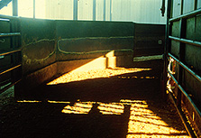
Moving cattle in yards
cattle tend to move towards light if not glaring or blinding
may balk at puddles, drain grates
may balk at changes in floor texture or level
shadows discourage movement

Slide 62
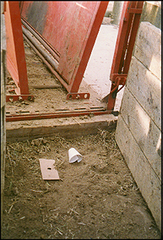
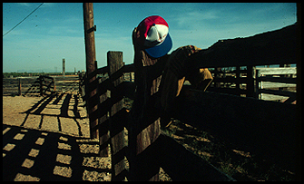
Moving cattle
cattle may balk at clanking metal in chutes
moving or flapping objects may spook cattle
objects in runway, race, chute may causing balking

Slide 63
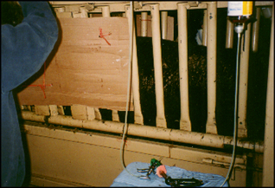
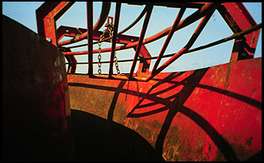
Moving cattle
people standing in front of the squeeze chute discourages cattle movement
objects such as chains hanging within the working area may cause cattle to balk

Slide 64
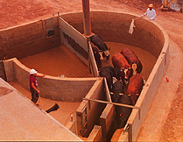
Encouraging cattle movement
plastic strips attached to a stick - cattle tend to move away from noise and movement
cattle will move more easily toward home pasture or pen

Slide 65
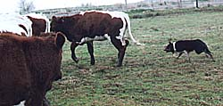
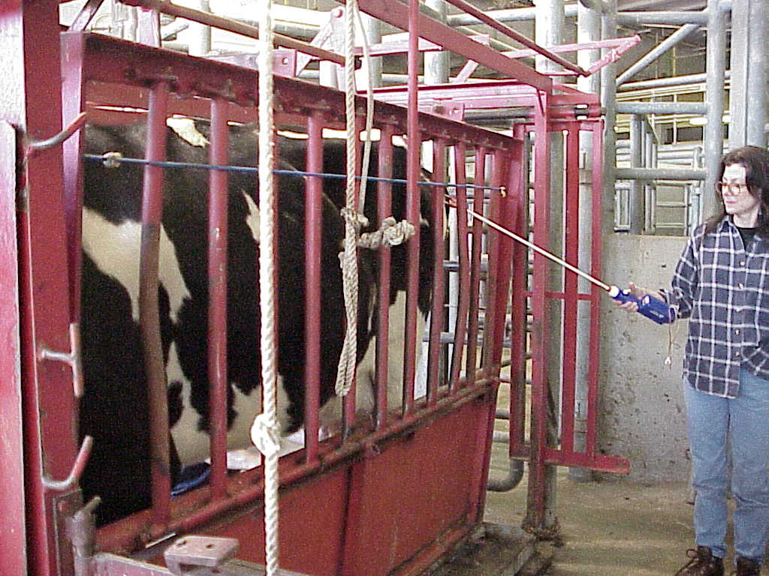
Encouraging cattle movement
dogs - only utilise in open areas or pastures
electric prod - LAST RESORT!!

Slide 66
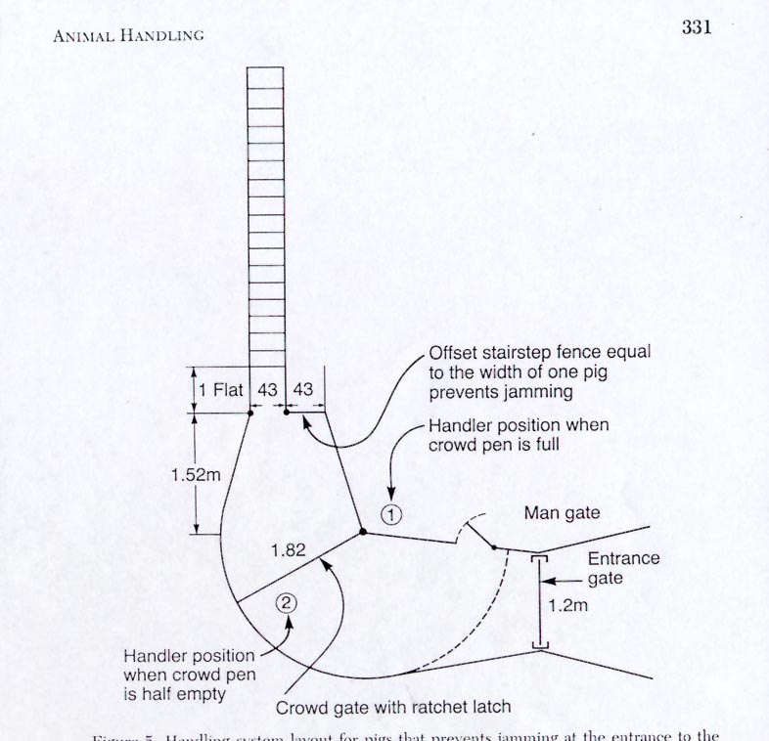
Handling facility design

Slide 67
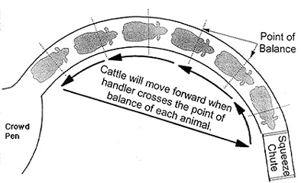
Handling facility design
solid fences in working areas reduce distractions
cattle should only see one way to escape
should be able to see cattle in front of them
utilise “point of balance”

Slide 68
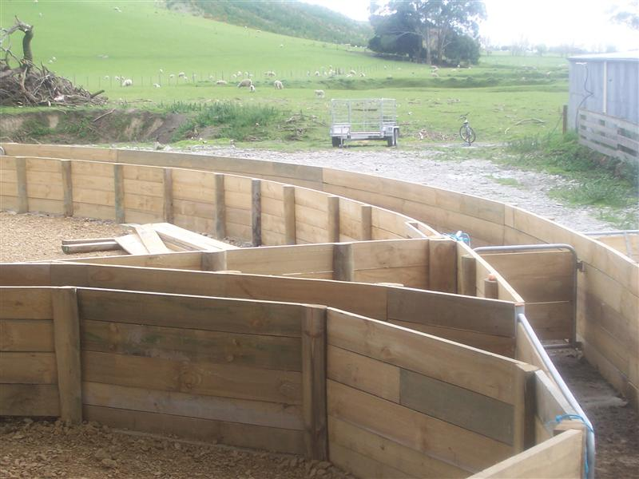

Slide 70
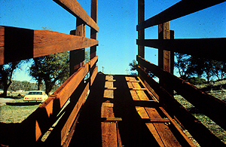
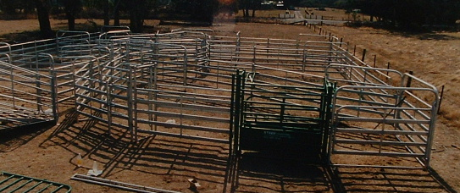
Handling facility design
loading ramps should have solid sides
maximum incline of ramp = 20º

Slide 71
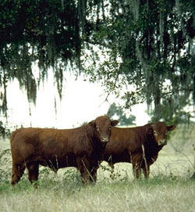
Managing individual animals
be cautious of bulls in pasture - best to respect rather than fear them
newly arrived cattle that are agitated are allowed to acclimate overnight in yards when possible

Slide 72
Individual animal handling
cattle catch on to routine readily, may need to alter tactics used to move them from pen to treatment area
brushing tends to calm cattle (bulls esp.)
food rewards offered after treatment - “conditioned response”
avoid blind spot directly behind animal, may be kicked

Slide 73
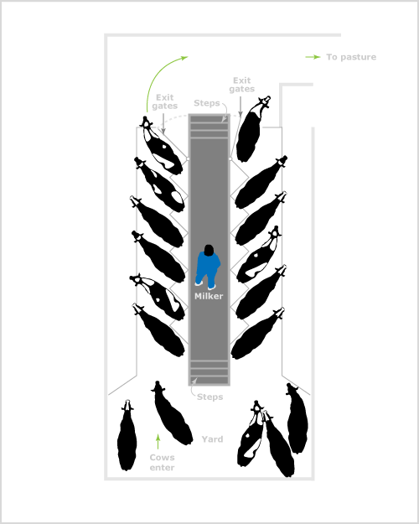
Milking sheds - herringbone

Slide 74
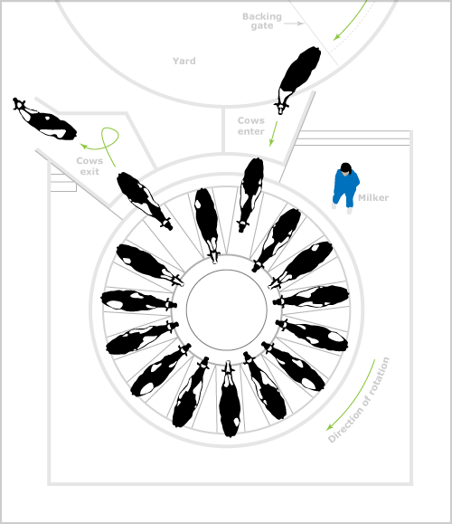
Milking sheds - rotary

Slide 75
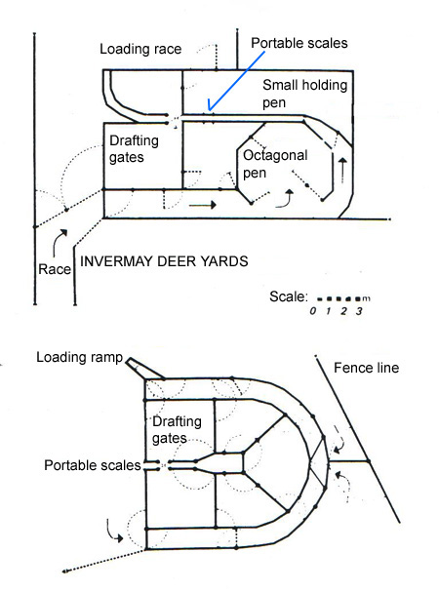
Deer shed design

