Slide 1
Climate change impacts and opportunities: NZ agriculture, horticulture and aquaculture
Prof Margaret Barbour, Te Aka Mātuatua – School of Science

Slide 2
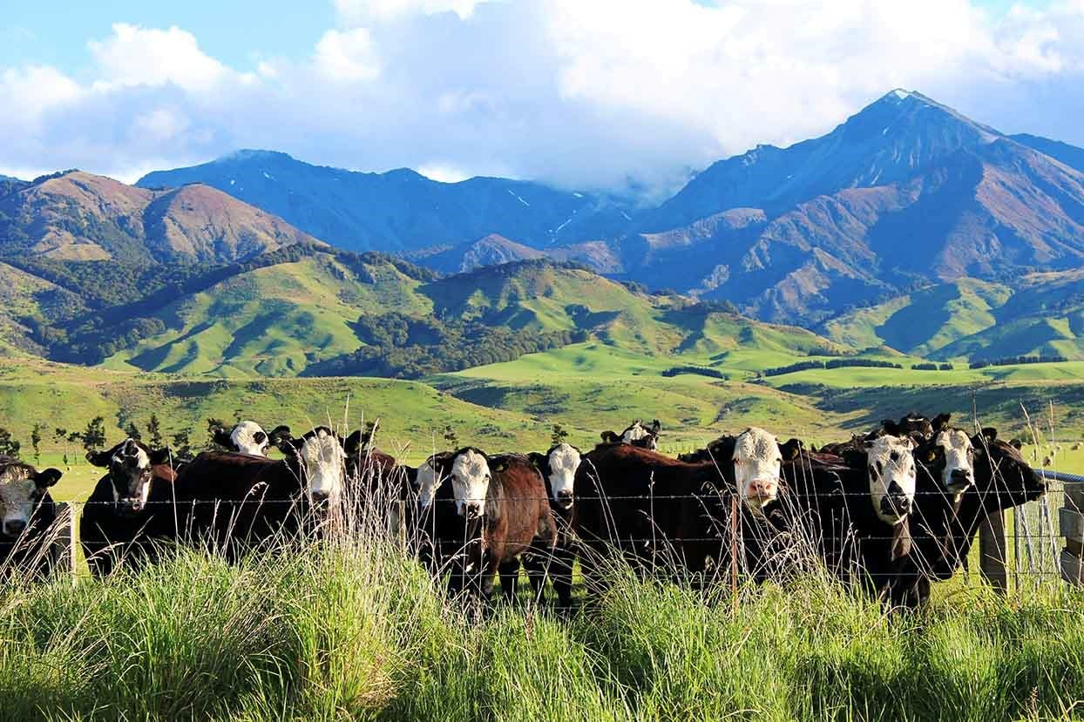
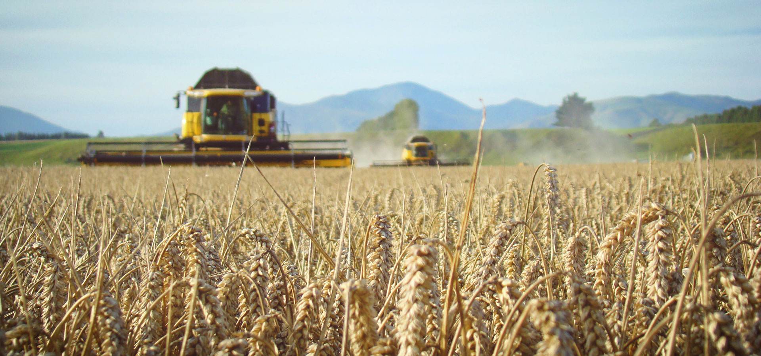
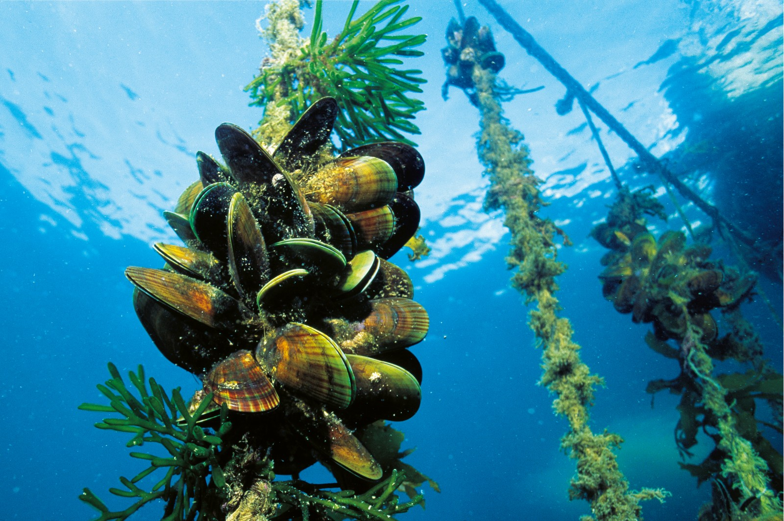
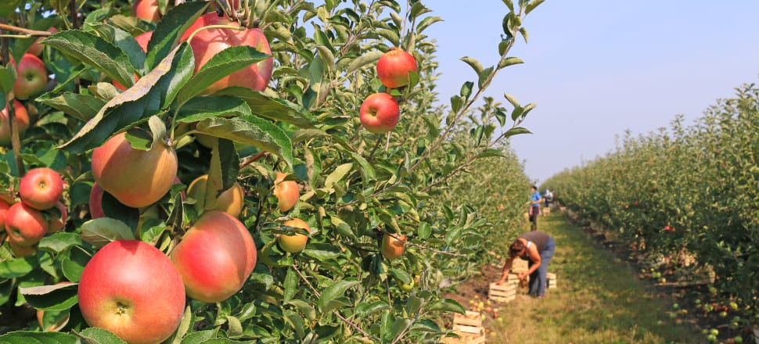
Outline
Climate projections for Aotearoa – New Zealand
Impacts on ag, hort and aquaculture
Unavoidable changes
New opportunities

Slide 3
Climate projections to 2100
Low emissions (RCP2.6) High emissions (RCP8.5)
Temperatures will increase

Slide 4
Climate projections to 2100
Low emissions (RCP2.6) High emissions (RCP8.5)
Temperatures will increase
More hot days

Slide 5
Climate projections to 2100
Low emissions (RCP2.6) High emissions (RCP8.5)
Temperatures will increase
More hot days
Fewer frosts

Slide 6
Climate projections to 2100
Low emissions (RCP2.6) High emissions (RCP8.5)
Temperatures will increase
More hot days
Fewer frosts
Wet areas get wetter, dry get drier

Slide 7
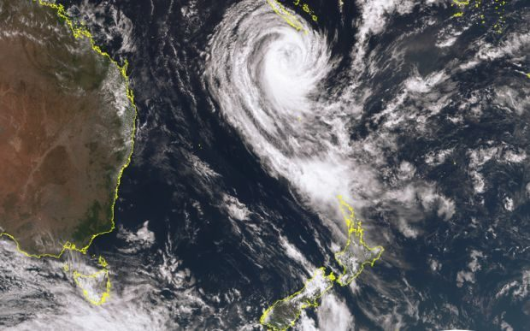
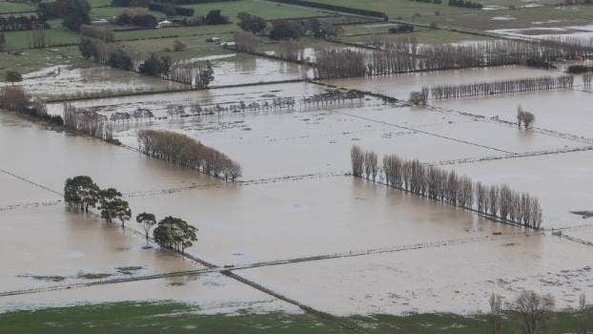
Warmer, wetter and wilder

Slide 8
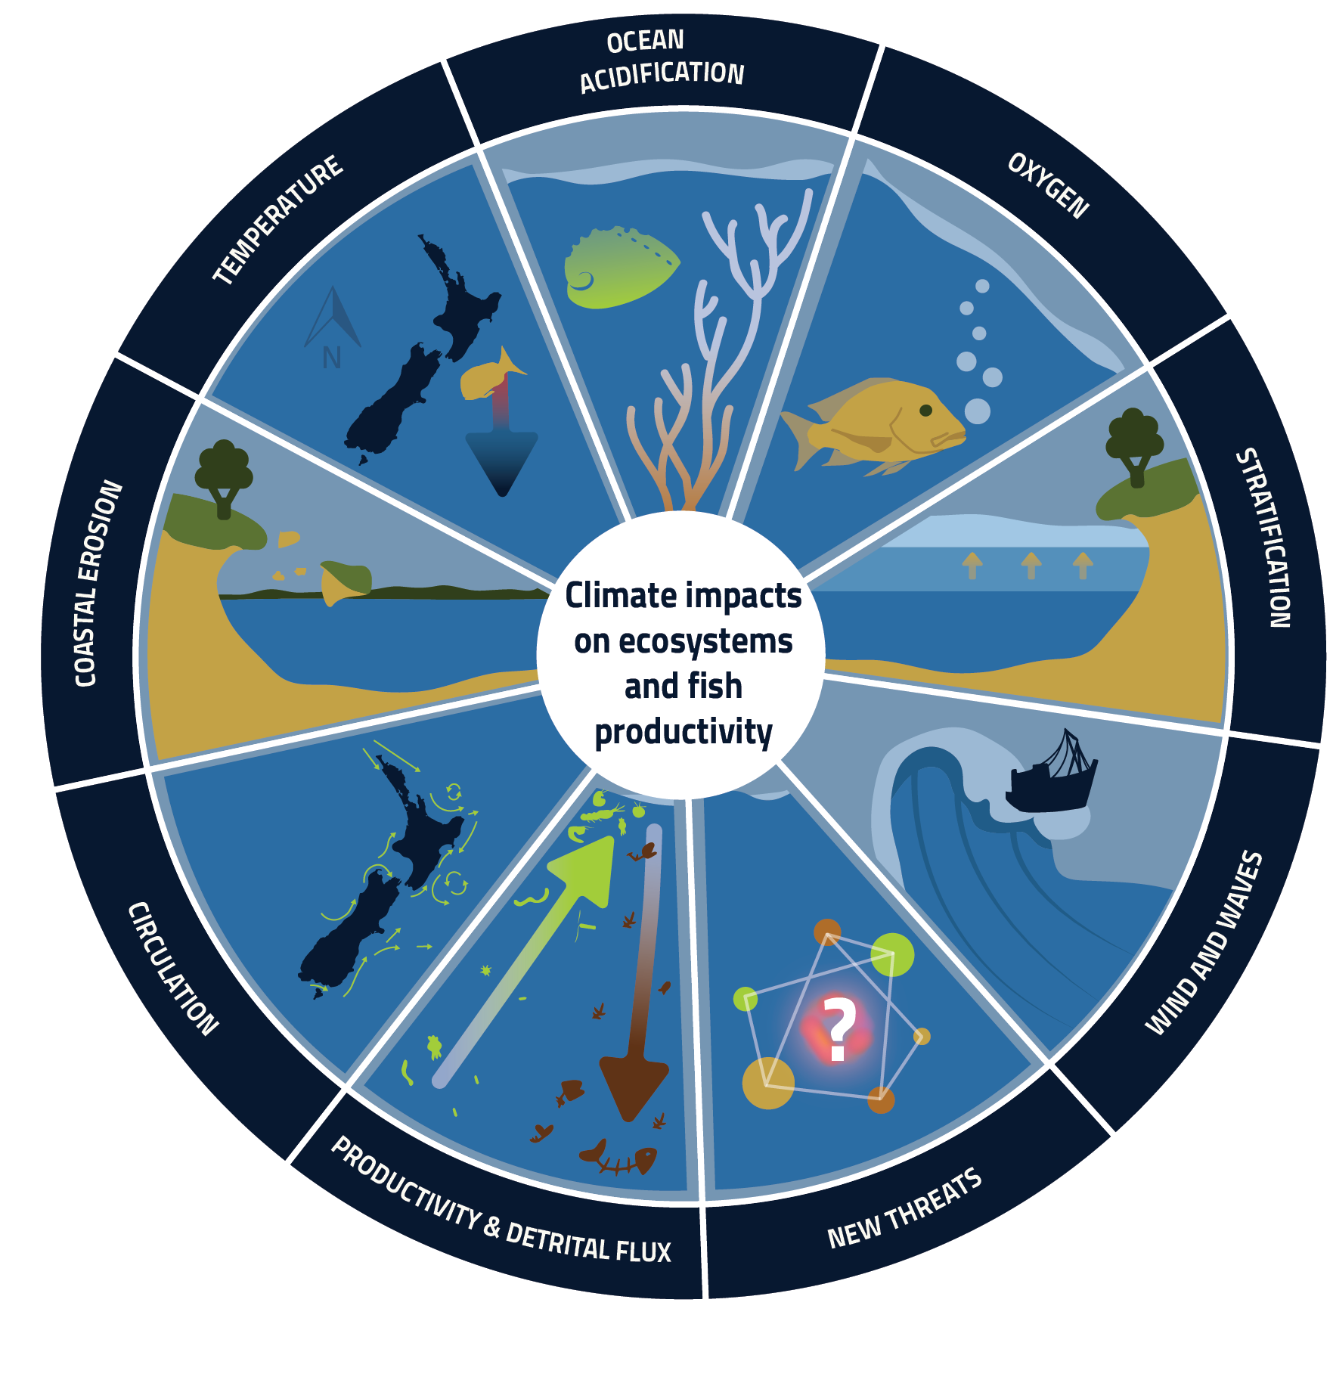
Impacts on aquaculture and fisheries
Marine heat waves
Fish distribution changes
Slower growth rates
Ocean acidification
Calcifying organisms like kina and shellfish have reduced growth rates
Changes in currents
Invasive species
Increased stratification
Reduced mixing of nutrients
Uncertain effects on productivity
Coastal erosion
Increased turbidity causes reduced productivity

Slide 9
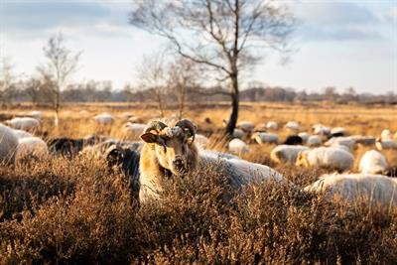
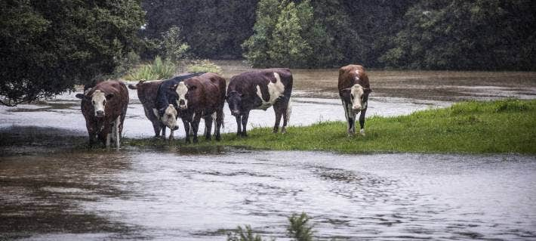
Impacts on agricultural animals
Increased temperatures, more hot days = heat stress
Animal ethics
Reduced growth
Lower fertility
Reduced milk production
Death
More frequent and severe droughts = reduced pasture growth
Reduced animal growth and milk production
Lower fertility
Lower quality feed; more methane produced
More supplementary feed ($$)
Lower prices when sold, reduced profitability
More frequent and severe storms = reduced pasture growth
Stock loss due to floods
Soil contamination by floods

Slide 10
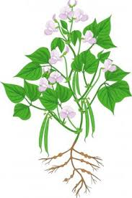
Impacts on horticulture and cropping
Plants are exquisitely sensitive to their environment
They sense and respond to:
Light
CO₂ concentration
O₂ concentration
Temperature
Humidity
Soil water availability
Nutrient availability
Soil and aerial microbes
Soil and aerial invertebrates & vertebrates
As climate changes, our important horticultural, crop and pasture species will respond
How plants respond will directly impact our food security and future climate

Slide 11
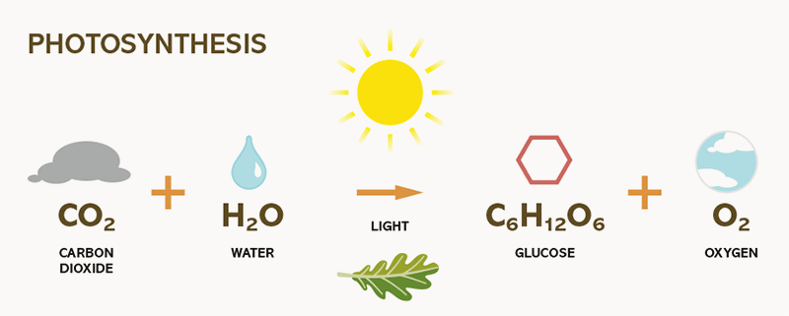
Impacts on plants: Atmospheric CO₂ concentration
Photosynthesis splits water, producing O₂
Splitting water also provides the energy and reducing power to fix CO₂ into organic molecules
Photosynthetic response to CO₂ is saturating
Corn
Photosynthesis
Wheat
CO₂

Slide 12
Impacts on plants: Atmospheric CO₂ concentration
So, burning fossil fuels is a good thing for plants?
Many agricultural plants will grow faster with higher CO₂
BUT there are also changes in the nutritional quality
Carbon-rich molecules increase in concentration
Nitrogen and trace-elements decrease
Total soluble sugars Protein Iron, Magnesium, Zinc
Nutritional security is as important as food security

Slide 13
Impacts on plants: Increased temperature
The thermal optimum for photosynthesis varies with species
The thermal optimum for respiration is much higher
Corn
Photosynthesis
Wheat
Corn
Respiration
Wheat
20ºC
Temperature
60ºC
Temperature

Slide 14
Welcome to the leaf interior
Fly through a chickpea leaf cell
Green blobs are chloroplasts
Red worms are mitochondria

Slide 15
Impacts on plants: Increased temperature
Some important crop species require cold temperature in winter for high productivity
‘Hayward’ kiwifruit requires winter chilling to promote budbreak in spring
Can be substituted for hydrogen cyanamide (Hi-Cane), but is of concern to community
Stone fruit like cherries also require winter frosts for budbreak
We know the number of frost days is predicted to decrease with climate change: will we need to change where we grow kiwifruit and cherries?

Slide 16
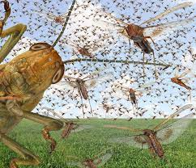
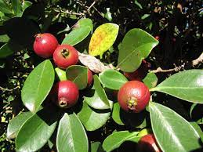
Weeds, crop pests and diseases
New biosecurity challenges for NZ agriculture as climate changes
Increasing trade with SE Asia, India and South America makes NZ vulnerable to sub-tropical invasive species
Of concern are insects already here but not invasive yet
e.g. Migratory locusts will swarm at higher temperatures
Plant species may become more weedy (sleeper weeds)
e.g. Strawberry guava is a weed in Hawai’i and grown in
gardens in North Island

Slide 17
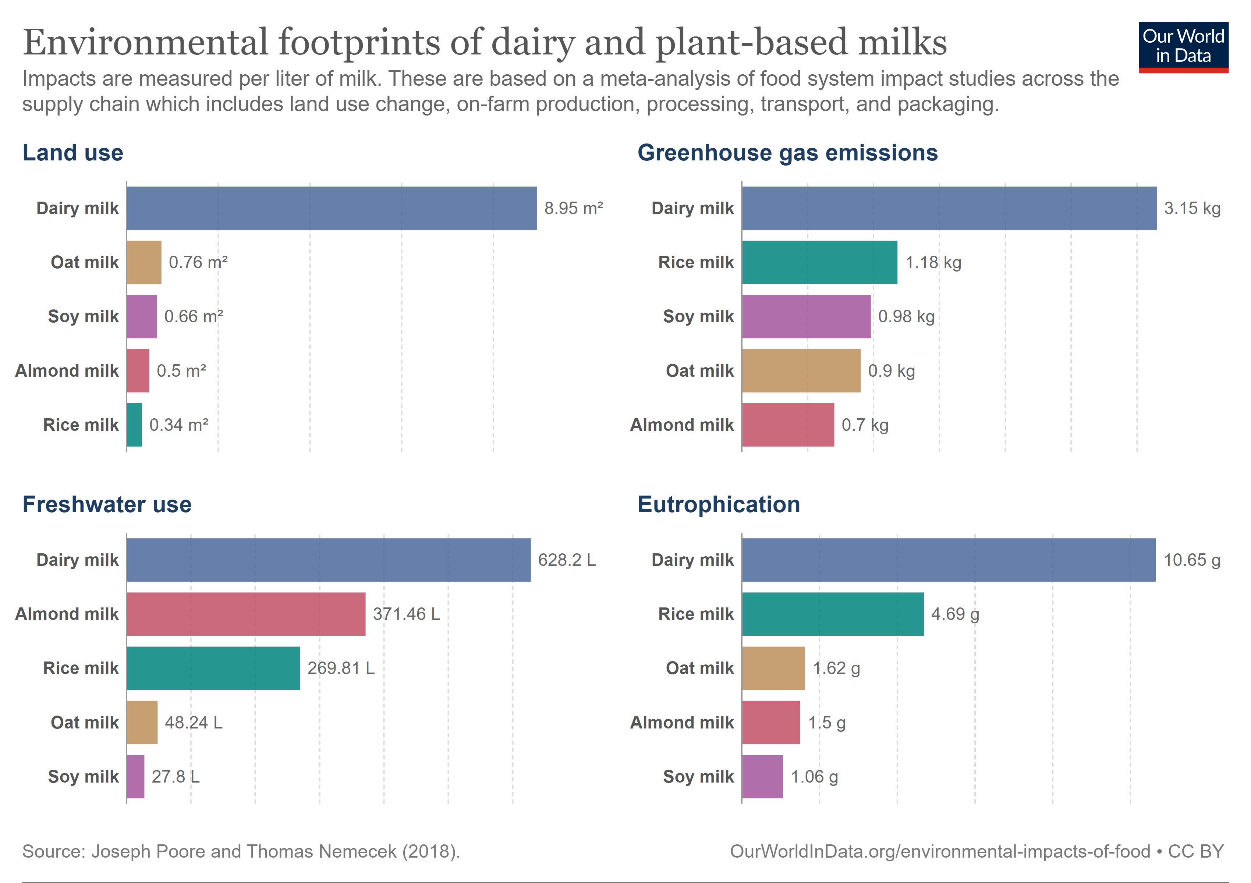
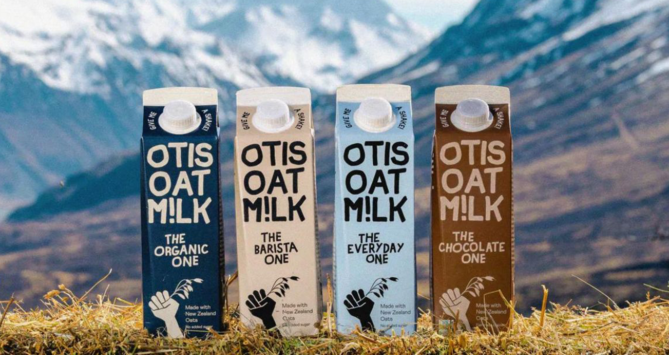
New opportunities
Plant-based milks
NZ-made
Launched 2022
Auckland factory to start production Dec 2023

Slide 18
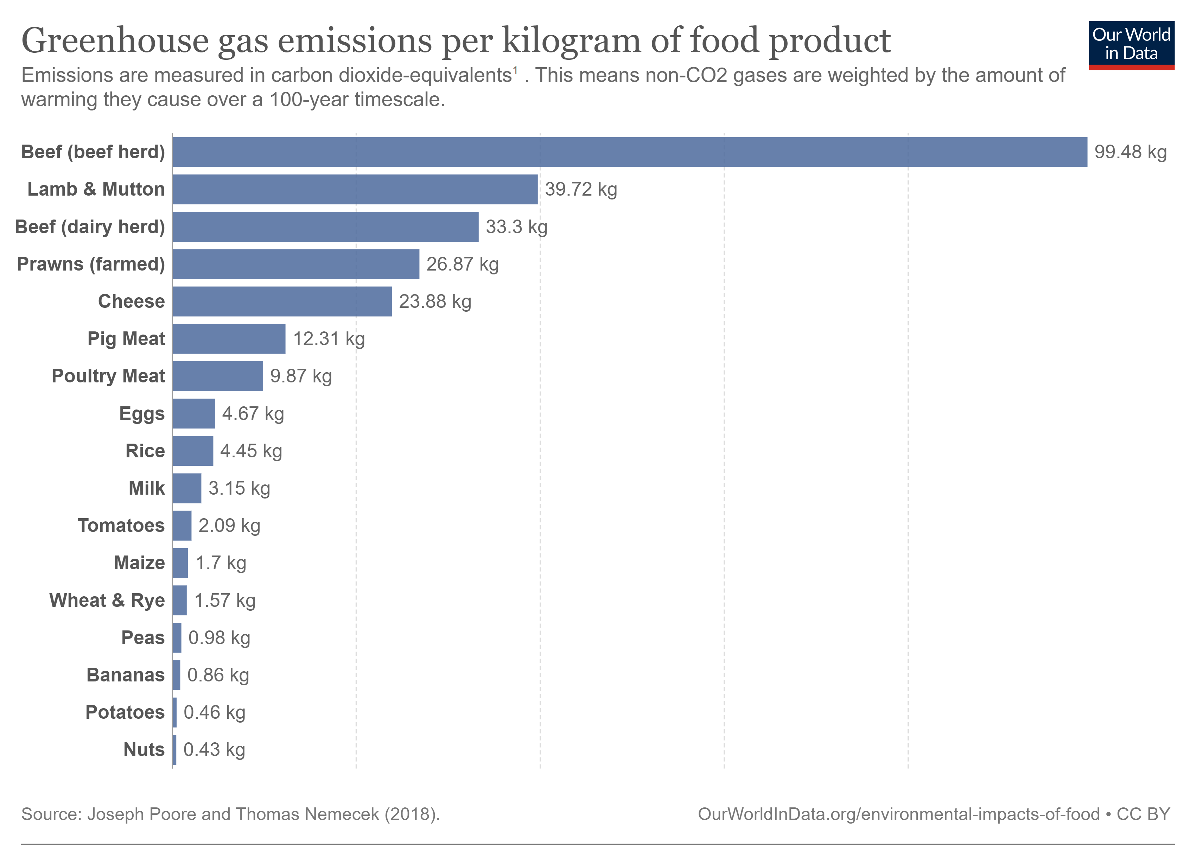
New opportunities
Plant-based proteins

Slide 19
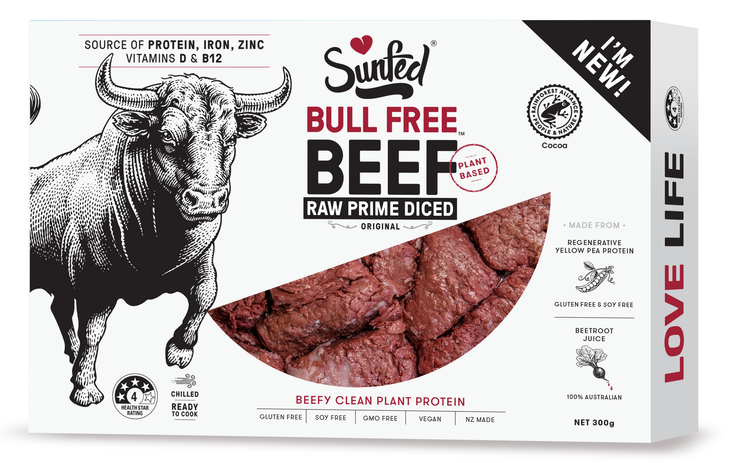
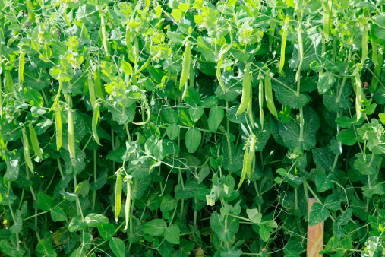
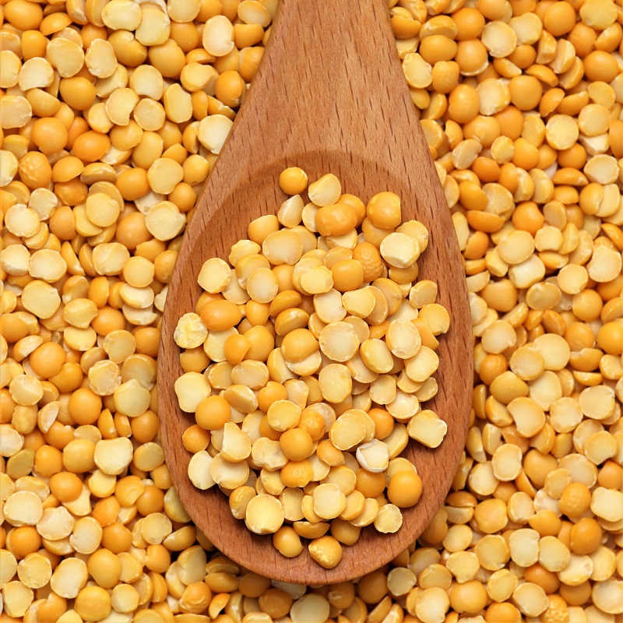
New opportunities
Plant-based meat substitutes

Slide 20
New opportunities
Regenerative agriculture
Not “one size fits all”
Practices that enhance and restore ecosystems
Holistic thinking
Working with biophysical systems
Long-term ecological benefits
May increase productivity and profitability
Limited published data on outcomes for NZ
Must be place-based
https://ourlandandwater.nz/wp-content/uploads/2022/12/Regenerative-Agriculture-Value-Proposition-FINAL.pdf
https://ourlandandwater.nz/outputs/place-based-approaches-to-assessing-the-impact-of-regenerative-agriculture-in-nz/

Slide 21
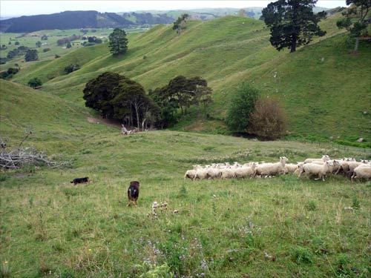
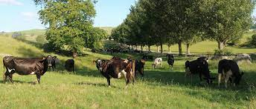
New opportunities: regenerative agriculture in Aotearoa
2022 report commissioned by Ministry of Business, Innovation and Employment (Our Land and Water National Science Challenge)
8 paired conventional and regenerative farms (at least 5 years)
3 x Waikato, 2 x Taranaki, 1 x Canterbury
NB: NZ soils are generally high in carbon
Key results:
All farms had profitability goals, but regenerative farms had more emphasis on health of the pasture
Gross revenue $382 per ha higher for conventional farms
Costs were highly variable, but broadly similar
Total greenhouse gas emissions per ha were the same
Greenhouse gas emission intensity (per kg produced) higher for regenerative farms

Slide 22
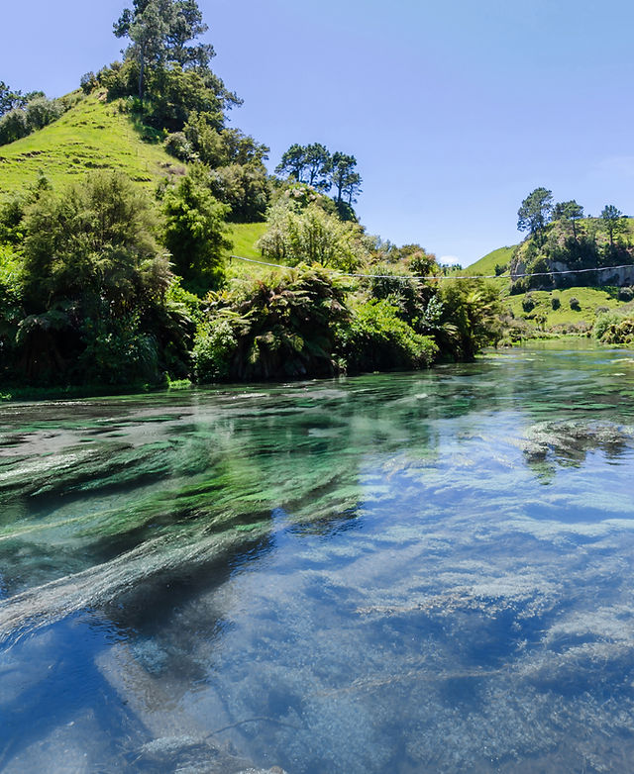
New opportunities: regenerative agriculture in Aotearoa
Case study 1. Kaitiakitanga in Ruahuwai takiwā
Upper Waikato River catchment
Issue:
reduction in freshwater quality due to irrigated dairy farms
replacing pine plantations
Strategic goals:
a) mana tangata (iwi participate in restoration & protection)
b) mana taiao (implement restoration & protection)
c) mana mātauranga (uphold tikanga, preserve wāhi tapu, enhance knowledge)
How:
Re-engage people with their land and rivers
Real-time multidimensional environmental data collection, plus cultural data
Mike Taitoko, Toha Foundry Ltd

Slide 23
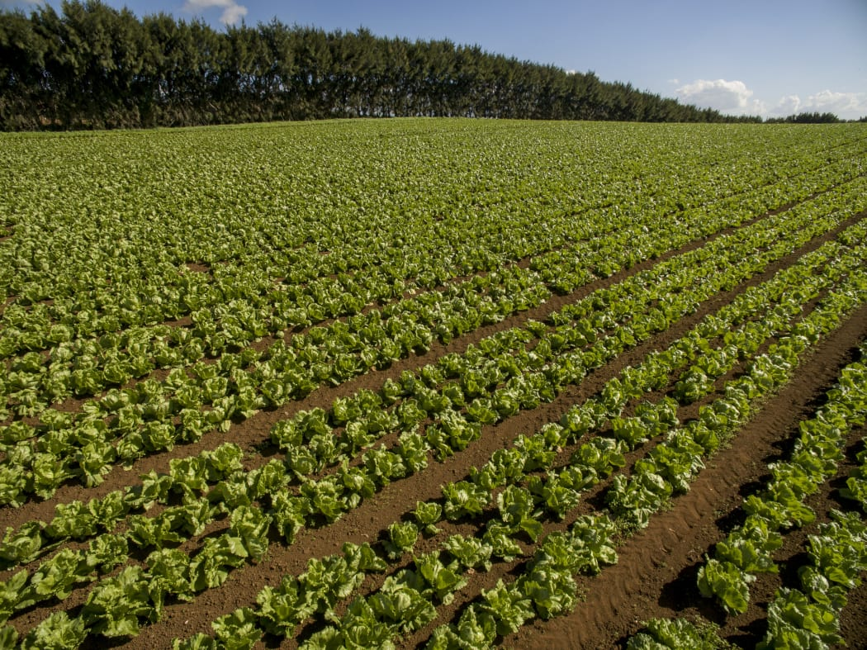
New opportunities: regenerative agriculture in Aotearoa
Case study 2. Outdoor vegetable production
Pukekohe, South Auckland
Issues:
Declining soil carbon due to continuous
intensive cropping
Degraded soil structure leading to erosion
losses and lower water holding capacity
Excessive phosphorus fertiliser
Strategic goal:
Resilient soil ecosystem
How:
Cover crops and minimal tillage; green manure; rotation to pasture
Fiona Curran-Cournane (MfE)

Slide 24
Summary
Climate change will mean food production will have to change
Location
New heat-tolerant cultivars and breeds
Diversification for resilience
Environmentally sustainable best practice – place-based
Low emissions production
Innovation in animal production
Greater emphasis on plant-based proteins

