Slide 1
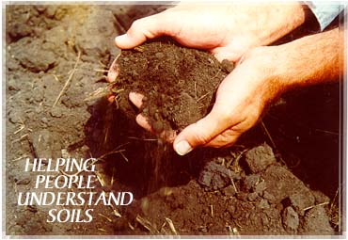

Slide 2
Where does soil come from?
Rocks
Minerals
Organic Matter

Slide 5
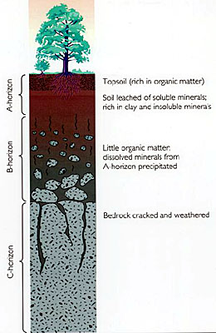

Slide 6
What are the main components of soil?
Mineral Matter – sand, silt and clay (largest to smallest)
Air
Water
Organic Matter

Slide 7
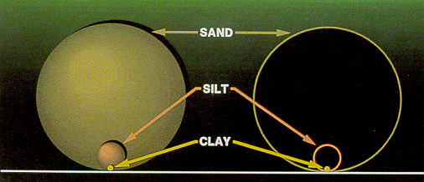

Soil Particles
Note: clays are microscopic in size !

Slide 9
Clay minerals
photographed
with an electron
Microscope.
Note: they are plate
or flake like and
are stacked on top
of each other.
They are electrically
charged and act like
magnets that attract
and hold plant
nutrients.

Slide 11
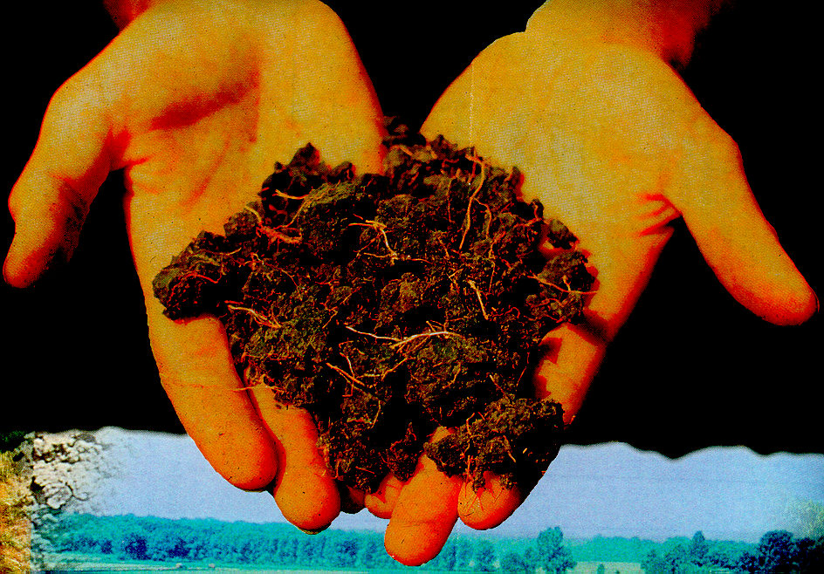
Soil should have aggregates!

Slide 12
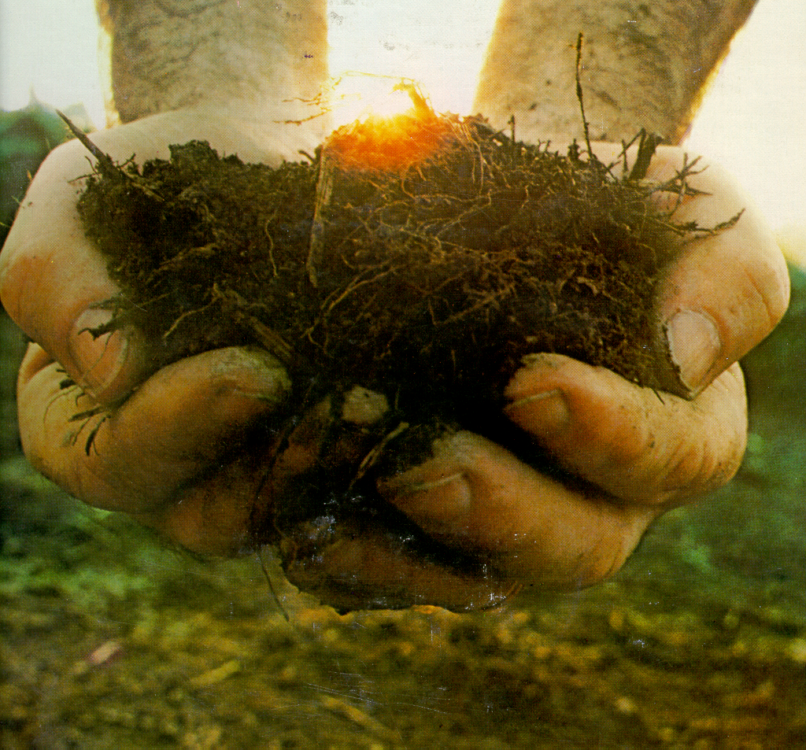
Organic matter is soil gold !

