Slide 1
DSL Plant Brief
Feb 2019

Slide 2
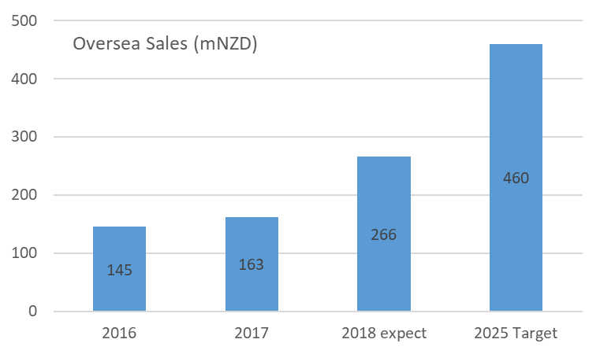
Top Message (from Daiken Spirit Jan 2019)
Kato san
Representative Director Daiken JP
Two Main Topics FY2018
1. Acquisition of DSL
PMI(Post Merger Integration) going smooth
Contributing to whole Daiken profit very much
2. Approaching the sales target in oversea markets
FY2018 expect 265mNZD include DSL sales
(>10% of Total Daiken sales)
2019 policy
Further growth Sales in the expanding oversea markets
Catch actual demand of each individual markets

Slide 3
Top Message
Yamazaki san
Managing Director DNZ&DSL
2018 was a memorial year as DSL joined to Daiken Group
DSL transition smoothly, achieving result exceeding our expectation, by great effort of local members (plus Japanese expats)
DNZ also attained a record-high production volume in 2018
2019
Raw material, Resin, Logistics cost is increasing even in 2019, so cost reduction is the key for both DNZ and DSL
Synergy to maximize our both plants efficiency from any perspective is the key

Slide 4
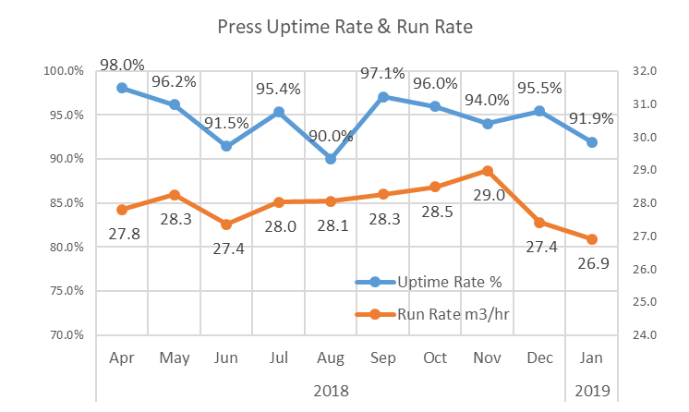
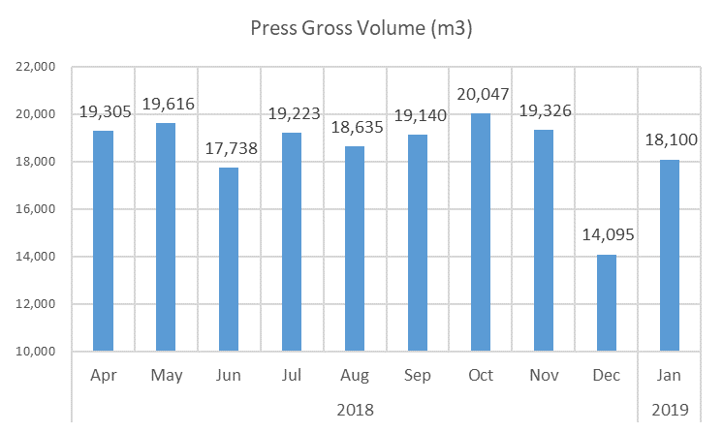
Results
Production: Press
Sep-Nov:
・Good Uptime Rate
・High Run Rate
(New Resin, Good Product mix etc.)
・Reached 20,000m3 in Oct
Dec-Jan:
・Annual Shut completed within 8.5days
・SFA Screw restricted after the shut
・Log Crane troubled
・Resin 2011A stop
New Resin re-start
plus trial to unify two resins
Annual Press Volume
Reaching 220,000m3

Slide 5
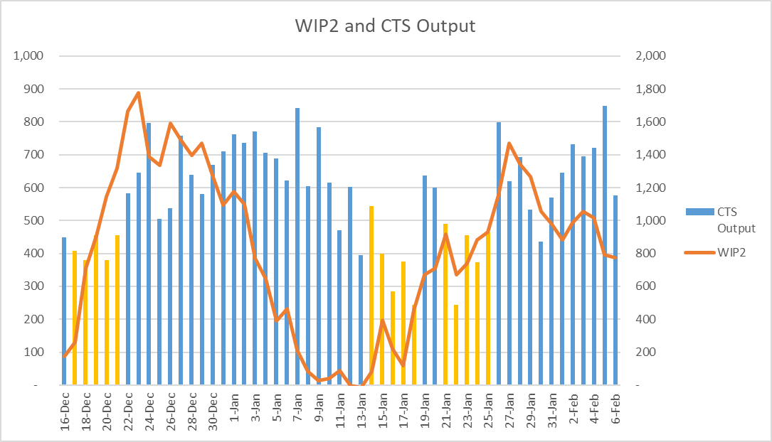
Results
Production: Finishing WIPTS
CTS PLC Upgrade and Cooling Wheel work in progress
Max. >800m3
Ave. 680m3 per day

Slide 6
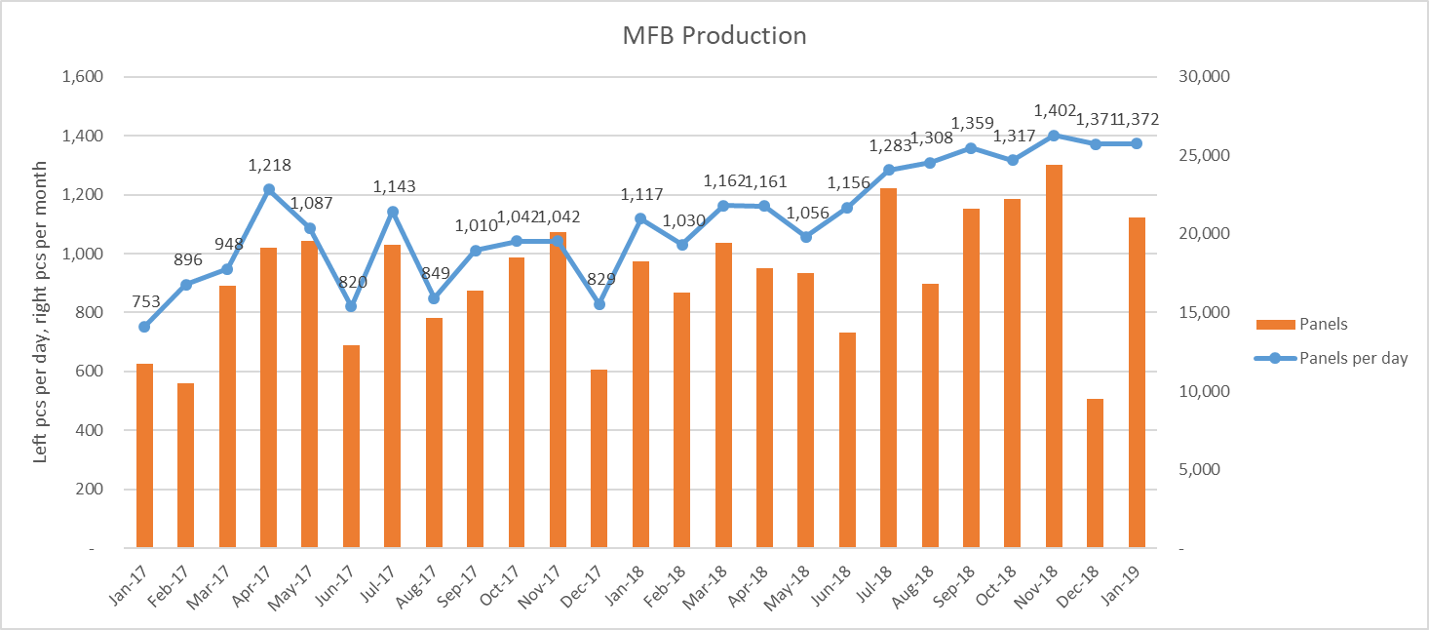
Results
Production: MFB
Sales forecast to be 20-25k in 2019

Slide 7
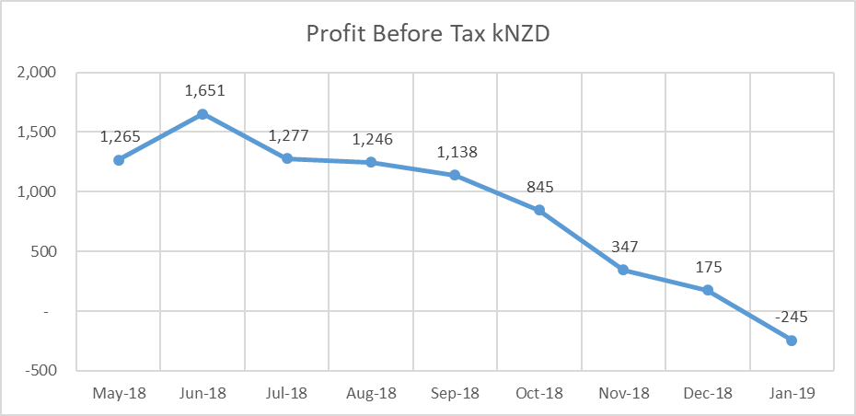
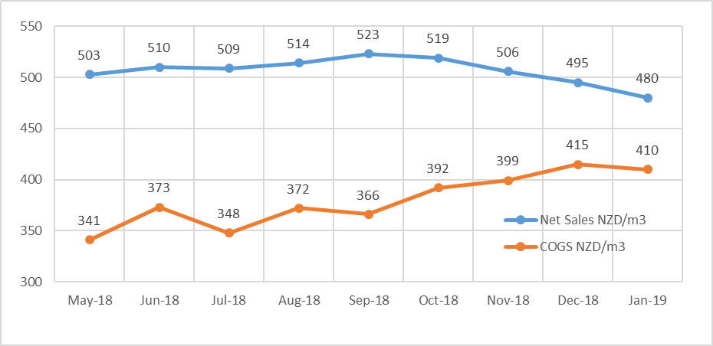
Results
Profit and Cost

Slide 8
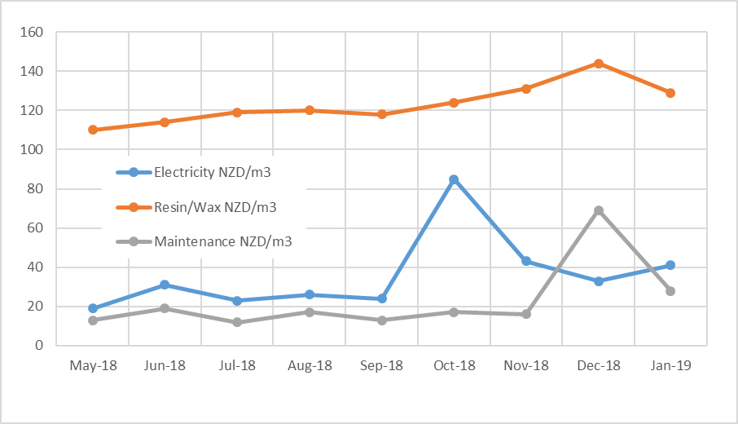
Results
Manufacturing Cost
Resin
Electricity
Maintenance
(annual shut as necessity)

Slide 9
2019
Manufacturing Cost : Resin Forecast
We are Here

Slide 10
2019 Strategy
As DSL Production
Keep Safety 1st, and Good Quality (leads to Good Sales Price for future)
Constant Production (Maximize Uptime Rate and Run Rate)
Density / Thickness Control to be reasonable
Reduce Manufacturing Cost
Electricity Hedge/Resin Delivery Management (Kiwi Rail)
MFB Paper Supplier trial
Major Projects
Guarding Upgrades (Sander Outfeed, Cooling Wheel)
New Resin Tanks to secure Resin logistics
New Cooling Wheels
CTS Upgrades
etc.

Slide 11
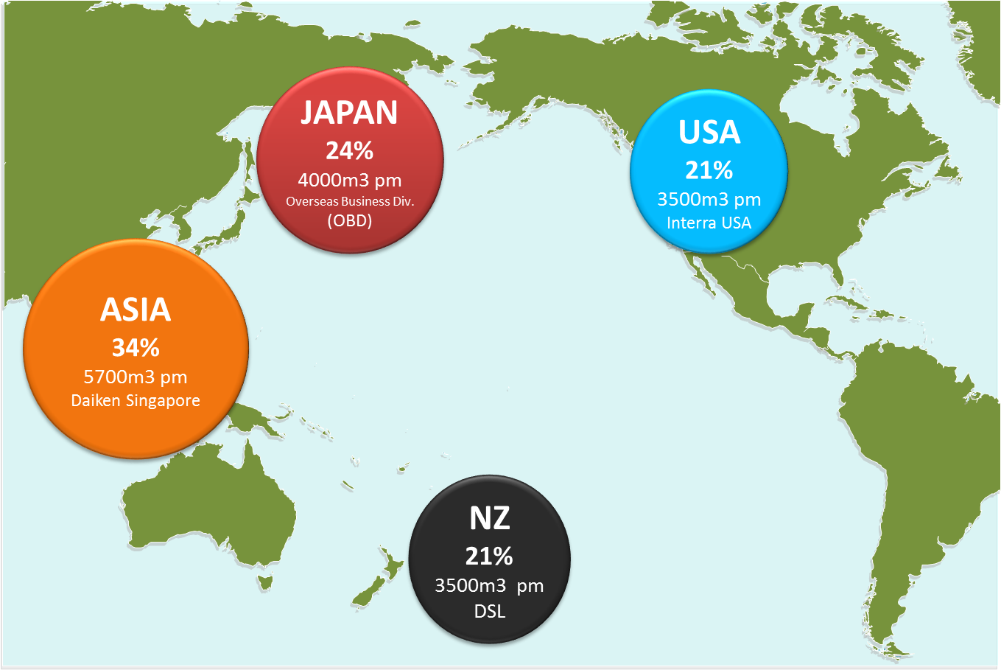
Markets & Sales channels
17 / 34
DSL Markets 2018
Notes:
Tristan slide – 1/3

Slide 12
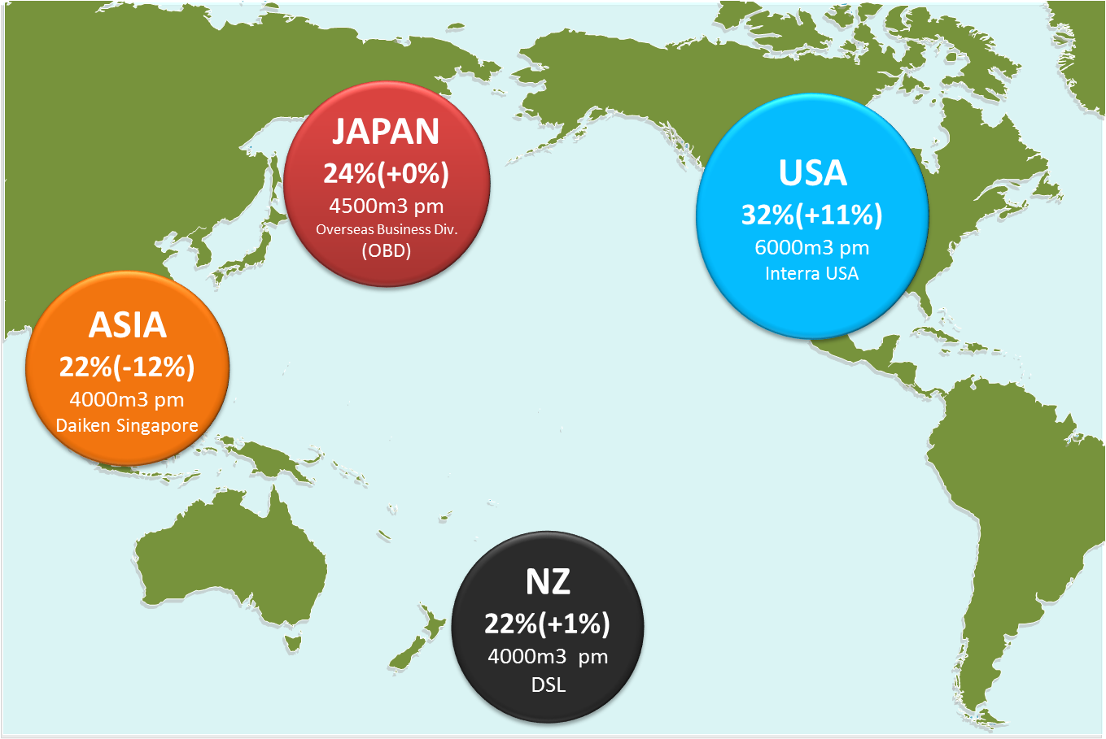
Markets & Sales channels
18 / 34
DSL Markets 2019 & beyond
Notes:
Tristan slide – 2/3

Slide 13
Sales Performance
16 / 39
Monthly Sales review
- Sales comparison(2017 vs 2018)
Notes:
TT slide – 1/3

Slide 14
Sales by Market
17 / 39
Monthly Sales review
- 2018 monthly Sales Q’ty Distribution(m3)
(工場直売り)
(海外営業部向け)
Notes:
TT slide – 2/3

Slide 15
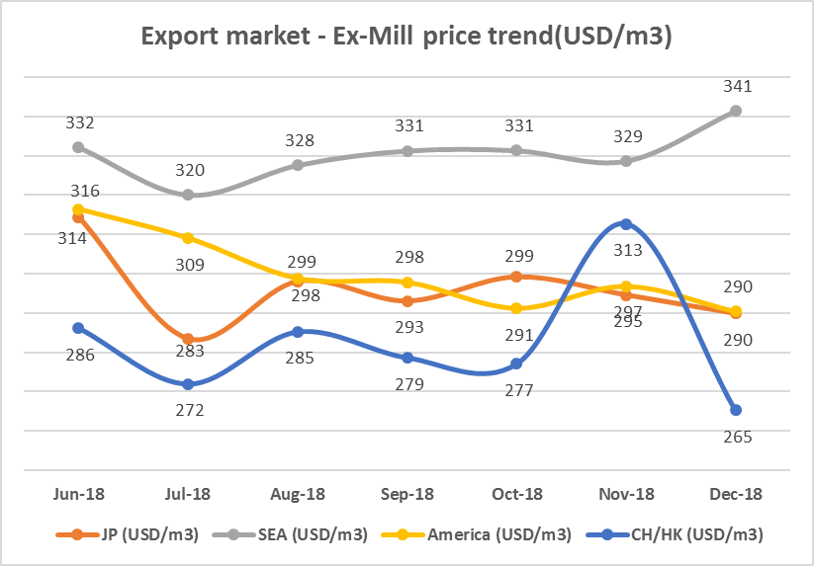
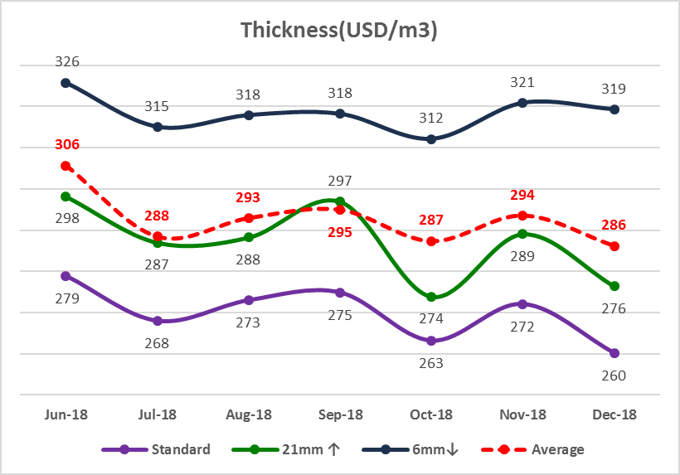
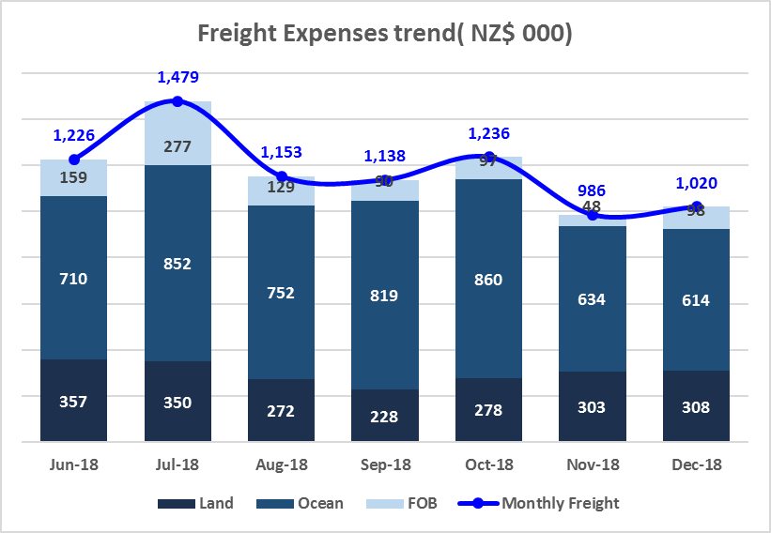
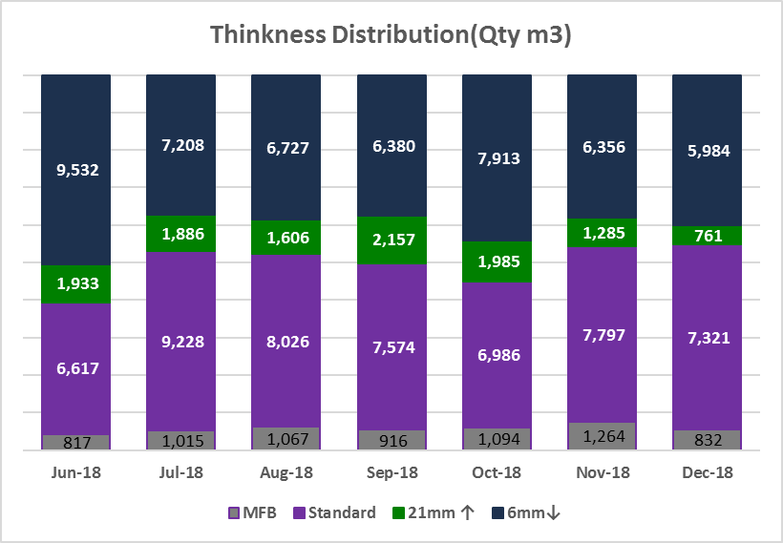
Sales – product range & price
18 / 39
Monthly Sales review
- 2018 Sales KPI Trend Graph
Notes:
TT slide – 3/3

Slide 16
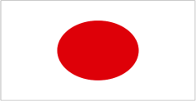



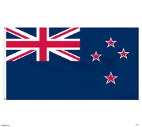
Market Situation
USA
General market condition/demand softening
Domestic mills short on orders
Price pressure for reductions
Expectation of market improvement from next quarter
ASIA
Market imbalance as supply exceeds demand
Strong price competition to maintain market position
NZ
Market conditions stable
Market dynamics still uncertain as 3 suppliers reduced to 2
Threat of imports
JAPAN
Currently overstock situation
Generally stable market conditions
Notes:
Update -> Takahashi San

Slide 17
Sales Strategy
USA
Introduce ULEF product
Segment market into West Coast, Southern & East Coast
Simplify sales channel
ASIA
Introduce additional agents/sales channels
Direct sales
NZ
Review market strategy to deliver maximum volume & profitability via duel supply from DSL & DNZ
JAPAN
Leverage off dominant market position
Daiken has great strength in Japan, despite shrinking market size
Notes:
Update -> Takahashi San

