Slide 1
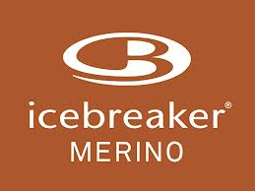
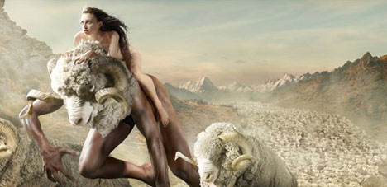
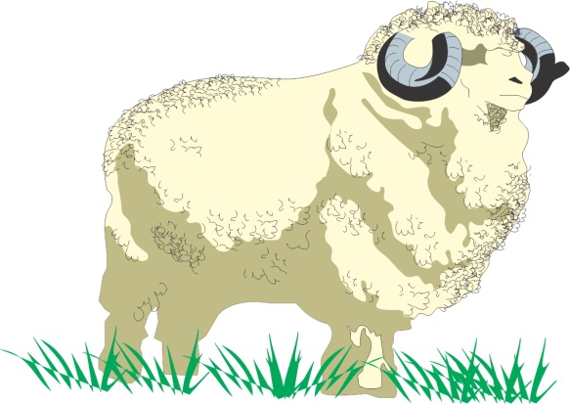
Fine wool farming – The Merino

Slide 2
Research and report on the impact of factors on the profitability of a New Zealand primary product
INTERNAL
Physical and climatic conditions; social, technological (eg value-added innovations), economic, political, and cultural factors
Profitability refers to the ability to make a profit for the producer. Profitability may be determined by on-farm practices, off-farm processes, and other factors
Merino Wool

Slide 3
Production – all aspects under the producer (farmers) control
Production process
Management practices
Quantity
Timing
Product attributes

Slide 4
Product attributes - measurable characteristics that affect the profitability
For example
Fat content
Sugar levels
Size
Mass
Diameter
Tenderness
shelf life
Yield

Slide 5
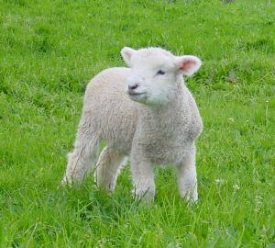
Demonstrate understanding of how the production process meets market requirements for a New Zealand primary product(s)
May include quality (product attributes and other considerations such as consistency, uniformity, or presentation); quantity; timing, and price
EXTERNAL
Merino Wool and Lamb
Refers to the sequence of manipulated management practices from establishment until harvest

Slide 6
Assessment Specifications
Candidates may be required to demonstrate:
understanding of quality considerations such as consistency, uniformity, or presentation for a specific market

Slide 7
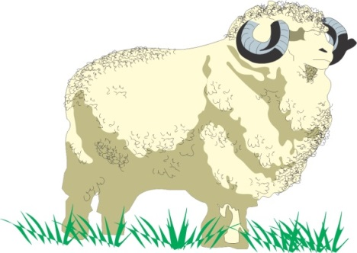
may include: seasonality, quantity available, quality requirements, reliability of supply, prices, market manipulations, promotion, market trends, consumer preference, political intervention, phytosanitary regulations, exchange rate, weather events, production costs
EXTERNAL
Demonstrate understanding of market forces affect supply of and demand for New Zealand primary products
Merino Wool and Lamb

Slide 8
Assessment Specifications
Candidates may be required to demonstrate:
at least two products
both supply and demand factors for at least one product that ‘earns significant export revenue
Candidates may be required to compare and contrast the market trends on their selected export-orientated product provided in a resource.

Slide 9
Why use wool?
The base layer
http://www.youtube.com/watch?v=p2t9b3Qfeas
We love wool
http://www.youtube.com/watch?v=0L1WvAM6hZ8&list=PLBACB12E96006435F
Fashion
http://www.youtube.com/watch?v=2yPFFmae5Ck

Slide 10
What are quality requirements?
Micron
Colour
Length
Tensile strength
Free of vegetable matter
Free of chemicals
Free of animal cruelty
Sustainable practices

Slide 11
Micron (μ)
Micron – this is how we measure the “width” of each fibre
The lower the micron the “finer” the wool and finer the fabric is made from this wool
Woollen suits are made from 11-15μ
Icebreaker garments are made from 16-19 μ

Slide 12
Colour
Bright white wool is able to be dyed pastel shades and have a consistent look for fashion garments.
Bright white wool is a demanded by all high end manufactures of merino such as Italian Woollen mills for high fashion garments, Icebreaker or Untouched World

Slide 13
Length
Long fibres are easier to process
Long fibres cause less wastage
Therefore contract specify fibre length from their suppliers

Slide 14
Tensile Strength
Each bale has their staple (bunch of fibres) tested for tensile strength
Tensile strength is how well in copes with being “stretched” before breaking.
This is important because the processing of wool requires it to be stretched during carding and spinning and breakages cause wastage of fibre and the time

Slide 15
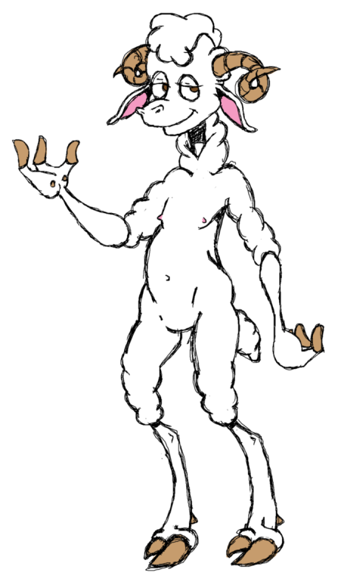
Sexy and I shear it
http://www.youtube.com/watch?v=Qt-qPSvW6vM

Slide 16
Free of foreign matter
Small pieces of matter such as plant seeds, dog hair or string can cause huge problems in the spinning and fabric process.
Each piece of foreign matter must be hand removed after a fabric had been made and this is very costly
Wool with imperfections will therefore be rejected and our ZQUE accreditation has increased demand for NZ merino because it gives and assurance that this will not be present.

Slide 17
Animal Welfare
http://www.mapp.co.nz/zque/animal-health-and-welfare/
Research indicates that good animal welfare practices rate higher in UK consumer purchasing decisions that prices or carbon-footprint
http://www.odt.co.nz/tags/agriculture/3988/nz-avoids-boycotts-dropping-mulesing
https://www.google.co.nz/webhp?source=search_app&gws_rd=cr&ei=6K4jUvGBFInqiAfV0YEI#q=Mulesing

Slide 18
What is ZQUE?
http://www.discoverzque.com/modules/what-is-zque/
http://www.discoverzque.com/modules/super-soft/index.php
http://www.discoverzque.com/modules/summer-comfort/index.php
http://www.discoverzque.com/modules/winter-warmth/index.php

Slide 19
The wool process
http://www.youtube.com/watch?v=yafkK0uk65U

Slide 20
Merino farmer wool contract
http://www.youtube.com/watch?v=t1Pa5OLWXZ0
Soldiers
http://www.youtube.com/watch?v=sLoXPQTW1P4

Slide 21
Smart wool
http://www.youtube.com/watch?v=MS154AN2mfk

Slide 22
REDA
http://translate.google.co.nz/translate?hl=en&sl=it&u=http://www.reda.it/&prev=/search%3Fq%3DREDA%26biw%3D1454%26bih%3D704
REDA – the Italian company will pay a premium for wool – around 20% more than would be achieved at auction
http://www.nzherald.co.nz/business/news/article.cfm?c_id=3&objectid=10602359
So … why would REDA pay 20% more??

Slide 23
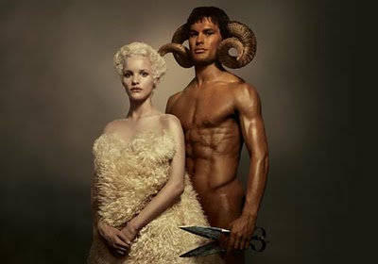
Icebreaker attributes video
http://www.youtube.com/watch?v=9ieuFQy8Rx8
http://www.youtube.com/watch?v=XFWecIJ_30Q&list=PLA7F9B057C044E055

Slide 24
Attributes
There are 5 main attributes
Fibre diameter
Fibre strength
Length
Diameter
Purity
They developed a system of paying forward price that is sustainably profitable to the grower
In return growers supply the highest quality merino. It’s scanned by laser to ensure it meets their fibre specification.

Slide 25
Icebreaker
Clean wool without seeds and other vegetable matter will produce clean, non-prickly fibre that will not be itchy if worn close to the skin
Low μ diameter wool ( 15-20 μ) produced by merino sheep will produce the fine yarn needed to make soft flexible fabric
Solid non-medullated (not hairy) fibres will take up brightly coloured dyes required by Icebreaker.
Tensile strength of 35-50N/Ktex
Low fibre colour Y-Z value of 0-2 is required so that high colour dye will be able to be absorbed
Length 70-90mm

Slide 26
What do they promise?
Odour Resistant
Icebreaker has natural anti-bacterial properties so it won’t hold odour
Breathable
Icebreaker merino pulls moisture vapour to the surface of fabric before it becomes sweet – leaving you drier and more comfortable
Regulates Temperature
Icebreaker merino fibres were designed to buffer the body against extremes of temperatures. On cold days, the fibres trap body heat, on hot days, they release moisture.
Soft and Non-Itch
Icebreaker merino feels soft as silk because it’s made from the same protein in your hair, skin and nails. It’s fibres are so fine that they wont itch.
Icebreaker BAACODE
Trace your natural, sustainable Ice breaker right back to the station in NZ. Simply type the unique Baacode on the tag inside your garment into www.icebreaker.co.nz

Slide 27
Icebreaker supply chain
http://us.icebreaker.com/on/demandware.store/Sites-IB-US-Site/en/Page-Show?cid=what-is-our-supply-chain

Slide 28
Chapter 1: The Fibre
http://www.youtube.com/watch?v=XFWecIJ_30Q

Slide 29
Chapter 2: The cleaning
http://www.youtube.com/watch?v=HzTwe4hIWEg

Slide 30
Chapter 3: The Yarn
http://www.youtube.com/watch?v=2vjKrGkKEB8

Slide 31
Chapter 4: The Fabric
http://www.youtube.com/watch?v=w31knfaMzkE

Slide 32
Chapter 5: The Sewing
http://www.youtube.com/watch?v=lUstiZBvs5w

Slide 33
Putting it together
http://www.youtube.com/watch?v=a9VwDiCgCBs

