Slide 1
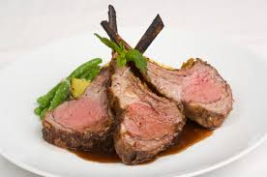
A/S 3.4 Demonstrate understanding of how the production process meets market requirements for a New Zealand primary product

Slide 2
Lamb
For meat production, lamb is a young sheep which is under 12 months of age, or which does not have any permanent incisor teeth in wear.
At birth, or within a week or two, a lamb has small front teeth on its bottom jaw.
These first teeth are called milk teeth and will last for about year.
Between 12 and 18 months the lamb will grow two new permanent incisors. Once these permanent incisors are in use the lamb can no longer be sold as ‘lamb’

Slide 3
Production process
Production process refers to the sequence of farm management practices from establishment until harvest.
This is sometimes called a schedule of operations.
In the case of lamb management practices include everything from establishing the breeding flock of ewes to getting the lambs ready for transport.
Production is everything the farmer does to the lambs on the farm, but not things that happen once the lambs leave the farm.
Calendar of operations

Slide 4
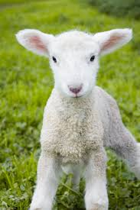
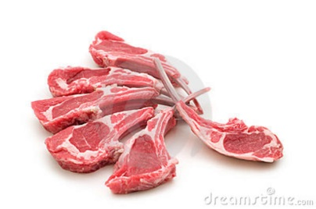
Gantt Chart or calendar of operations
Management Practice | Month
 | Jan | Feb | Mar | Apr | May | Jun | Jul | Aug | Sep | Oct | Nov | Dec
Flushing
Tupping
Scanning
Vaccinating
Lambing
Tailing
Ewe crutching
Weaning
Drenching
Lamb crutch
Lamb weighing

Slide 5
Calendar of operations

Slide 6
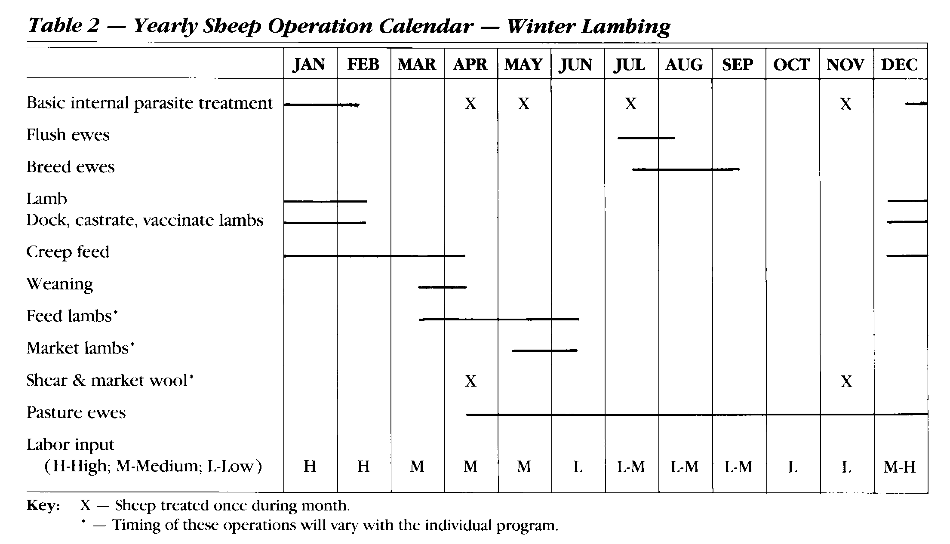
Example

Slide 7
Management practices
What the farmer does
Breed selection
Rams
Ewes
Preparation for Tupping
Day length (light)
Nutrition
Flushing
Synchronisation
Tupping
Ram:ews
Cycling
Scanning
Feeding
Lambing
Shelter and weather
Birthing problems

Slide 8
Management practices
Growing lambs
Birth to weaning
Weaning
Feeding
Health

Slide 10
Market requirements
Market requirements are the things that the market wants in the lamb. This includes:
quality
attributes such as flavour, tenderness, colour, size, amount of fat
consistency
uniformity
presentation
quantity (how much of the product is needed)
timing (when the product is required)
price

Slide 11
Lamb exports – from Beef & Lamb NZ
Total exports of lamb decreased by 2.5 per cent over the first half of the 2013-14 season, compared with same period last season, reflecting a smaller lamb crop.
The decrease in volume, to 158,200 tonnes shipped weight, was offset by a 14 per cent increase in average value. As a result, the total value of lamb exports rose by 11 per cent to $1.33 billion FOB.
Lamb exports averaged $8,430 FOB per tonne over the six months.
The European Union remains the largest market region, accounting for 42 per cent of New Zealand's lamb exports by volume and worth $675 million FOB.
North Asia is second, accounting for 33 per cent by volume and worth $311 million FOB.
However, the European Union's market share is on a downward trend, while North Asia is trending upward.
Total returns achieved from North Asia averaged $6,000 FOB per tonne, compared with $10,200 FOB per tonne from the European Union, reflecting the different product mixes exported to the two regions.
Notes:
http://www.beeflambnz.com/news-events/media-releases/2014/april/export-statistics-for-the-first-half-of-2013-14/

