Slide 1
LAND USE
30th August

Slide 2
Land includes soil and rock, plant and animal communities in the soil, and the landforms and vegetation that cover it.
Land use decisions require social, economic, and environmental needs to be balanced.

Slide 3
There are three main land uses in New Zealand:
Production (agriculture, forestry, and horticulture).
Conservation Over one-third of land is legally protected for conservation purposes
urban development. Where we live
Due to economic, environmental, technological, social, political, and workforce factors certain land uses are better suited for particular purposes.

Slide 4
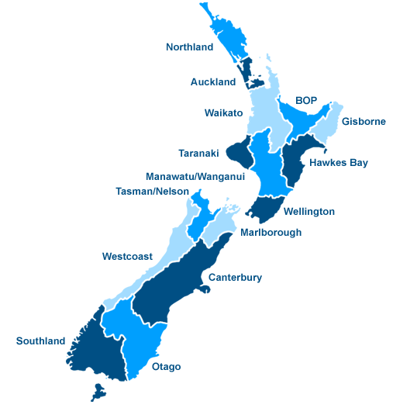
What do you know about land use in NZ?
Go to a regional map of NZ and describe what land use is happening
For each region

Slide 5
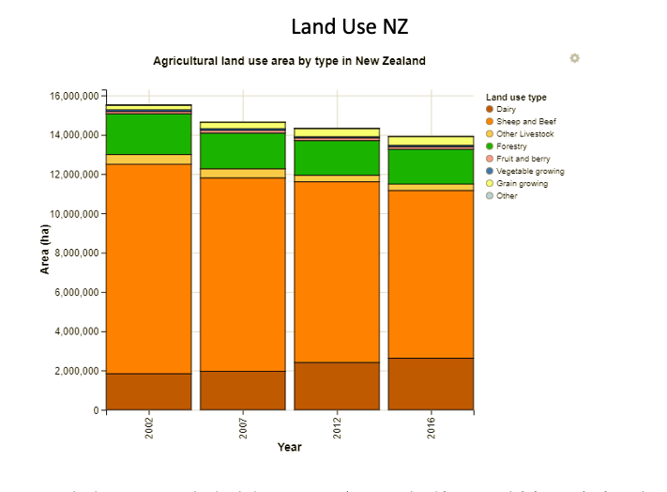
Page 10 of module

Slide 6
Analyse the table and the bullet points from page 10 to 11
Do the table on page 13- looks at horticultural crops and why we
find them, where we do
3. Go over the six factors that influence land use (from weebly)

