Slide 1
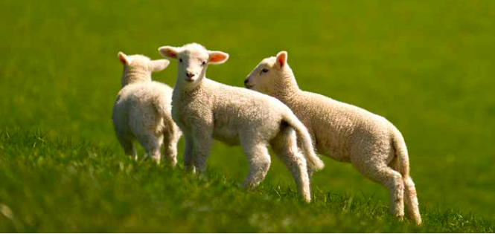
Nutrition and Profitability in Lamb Production
40239 - 1

Slide 2
Remember 80% of Animal Production
is due its Environment
Only 20% due to genetics

Slide 3
So define Environment

Slide 4
Nutrition.
Several critical points in the production cycle can have a significant affect on profitability.
Pre-mating – to influence ovulation
Third trimester of pregnancy – to influence lamb survival and early lactation, and
Mid- to late lactation – when lambs are consuming increasing amounts of pasture

Slide 5
While targeting feeding better at critical times there are several key points to consider:
Improved production requires increased energy intake, not just more drymatter
Increased energy intake requires increased feed on offer at some times of the year, particularly late winter and early spring when feed quality is generally good but pasture covers may be limiting
Increased energy intake requires increased quality of feed at times of the year, particularly pretupping and in late lactation when pasture quality may be poor, and
Getting the balance right throughout the year invariably takes planning and can involve supplements, specialist forages, or nitrogen fertiliser.

Slide 6
Pre-mating – to influence ovulation
What is flush feeding:
Flush feeding is the practice of supplementing the diet of an ewe with a high-quality feed before mating. This ensures that they gain weight and body conditions, which in turn stimulates ovulation and conception rates.
What are the benefits of flush feeding:
Increases the rate at which the whole flock ovulates.
Increases the rate at which individual ewes ovulate.
Improves conception rates.
Improves the rate of implantation.
Increases the lambing percentage.

Slide 7
The aim of flush feeding is to get a sheep at an optimum body weight and body condition. It has been found that malnourished ewes or ewes with a body condition score of 3.0 or under, struggle to ovulate and conceive. (https://www.molatek.co.za/flush-feeding-in-ewes/)
The higher the ovulation rate, the greater the potential for multiple lambs and the lower the occurrence of dries which leads to a higher overall lambing percentage.
On average, one extra kilogram of ewe body weight can increase flock lambing by 1.3%.
Allowances may be required to be as high as 1.5-2kg of quality drymatter to increase body condition and improve ovulation rate.
Making Every Mating Count publication states that increasing the condition score of an average-sized ewe from 2 to 3 is equivalent to 5kg of body weight. Therefore each ewe that requires a 5kg increase in her postweaning body condition significantly increases the feed demand over flushing. (https://farmersweekly.co.nz/#)

Slide 8
Putting some value to this Pre-mating – to influence ovulation
If 1 extra kg of body weight increases flock % by 1.3, then 5kg would bring about 6.5% increase.
Lets say we have a flock of a 1000 ewes, an average lambing % of 110
Would normally mean 1100 lambs. $180/lamb = $198000
A 6.5% increase to 116.5 % would mean an extra 65 lambs. An extra
$11700
Average sheep /farm is 3750, so an extra $43700/farm

Slide 9
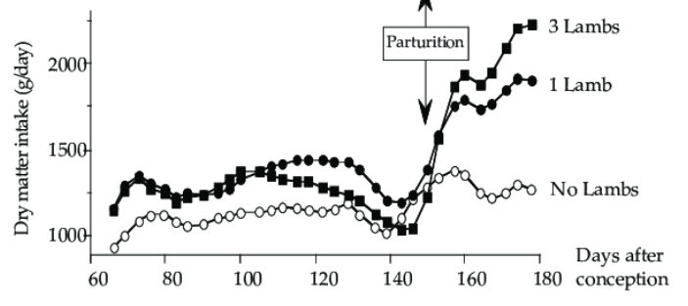
Third trimester of pregnancy – to influence lamb survival and early lactation
This is when the lamb grows fastest in the womb
Proper feeding during pregnancy is critical if
subsequent milk production is going to be maximized .
At lambing, ewes should have a slight build-up of fat
reserves (body condition score of 3.0 to 3.5) to be used
during early lactation. Excessive body conditions
(4.0 plus) are not desirable.
For ewes bearing singles, feed requirements are
29% higher, twins 52% and triplets 73%, compared
with a dry ewe two weeks before lambing.

Slide 10
So what does this mean, as far as profitability is concerned
Scanning percentage: | 120 | 140 | 160 | 180
% lamb loss: | 16 | 17 | 18 | 19
Lets look at the lambing percentage of 120% , if we underfeed in the last 2 to four weeks of pregnancy
The lamb losses could be up to 16%
For a 1000 ewe flock (120% should give 1200 lambs- a loss of 16% represents 192 lambs.
192 lambs @ $180 = $34560 loss
Average flock size 3750, so a potential loss of $119992 of lost income.
So well worth getting the feeding of our ewes right in the last month of pregnancy
https://www.ceresfarm.co.nz/improvinglambgrowth.htm#Survival

Slide 11
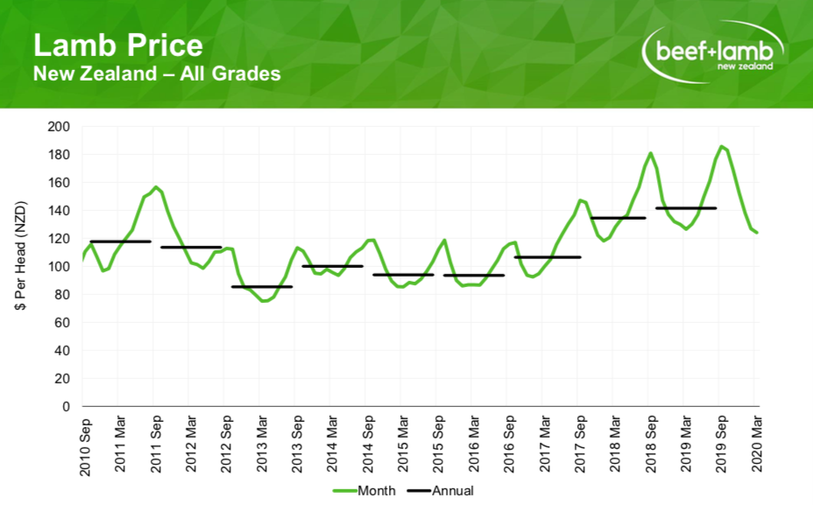
Mid- to late lactation – when lambs are consuming increasing amounts of pasture
The best price for your lambs is before christmas
Early lactation: birth to 4 weeks.
Mid lactation: week 5 to 8
Late lactation: over 8 weeks

Slide 12
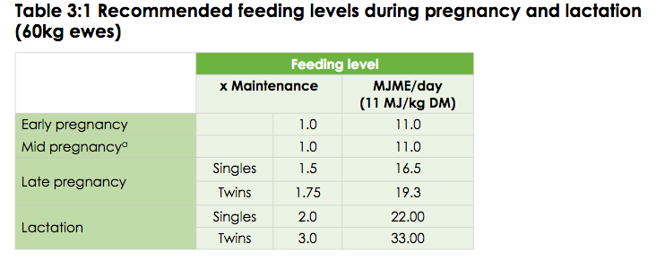
So attain this our ewes need to produce lots of milk and then post weaning our lambs need to best feeds to attain the required liveweight prior to be sent to the works.
Best CW for this is 15.5 – 17.4 kg (30 – 35 kg liveweight)
Target growth rates for lambs up to eight weeks of age should be greater than 250g per day If a lamb (with a 4kg birthweight) gained an average of 250g per day from birth to eight weeks (56 days) it would weigh 18kg, or 21kg if it gained at 300g per day.
https://beeflambnz.com/knowledge-hub/PDF/lactation-lamb-growth-and-lamb-weaning-decision

Slide 13
https://shannonag.weebly.com/uploads/1/3/6/8/13686553/400_plus_-_a_guide_to_improved_lamb_growth.pdf

Slide 15
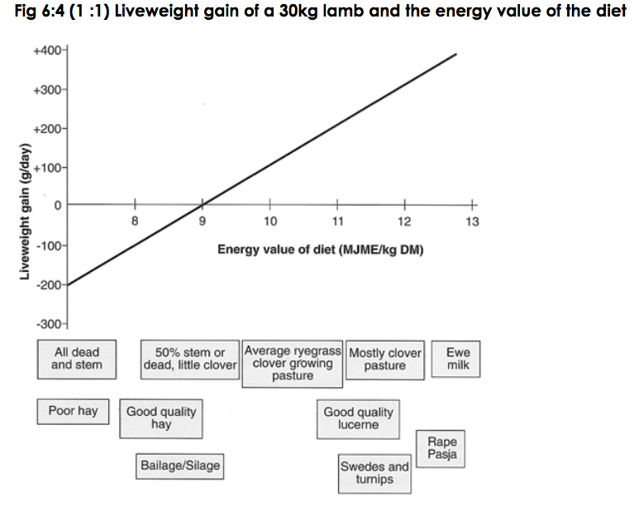

Slide 16
So how does this nutrition affect in late lactation and after weaning
Lead to more profit
Same farm 1000 ewe flock lambing at 120% producing 1200 lambs
If all 1200 lambs could be sold pre Christmas
1200 @ $180 = $216000
If sold by end of Febuary lambs might fetch $160
1200 @ $160 = $192000 ( loss of $24000)
If sold by March lambs might get $140
1200 @ $140 = $ 168000 ( loss of $48000)

