Slide 1
Physical Factors & Climatic Conditions

Slide 2
Seasonality
Seasonality is the pattern shown in the life cycle of a plant or animal in relation to the time of the year.
When there is abundance of produce the price is lower if all other conditions remain the same.
E.g. strawberries. They are available from the end of October to March. The time of peak production is November, December and January. The price obtained for strawberries is related to their availability – low availability means higher price, high availability mean lower price.

Slide 3
Seasonality
Seasonality is determined by;
Seasons in New Zealand. In winter people eat fewer salad vegetables such as lettuce and tomatoes. They eat more cooked vegetables such as pumpkin and peas.
Seasons in other countries. The northern hemisphere has the opposite seasons. When it is winter in New Zealand, it is summer over there. This influences the demand for seasonal products grown in New Zealand.
Seasonal demands – e.g. poinsettias for Christmas, African violets for Mothers day, Roses for Valentines day.

Slide 4
Seasonal effects (unseasonal conditions)
Unseasonal conditions means weather conditions that are not normal for a particular season. Examples are drought, above or below normal temperatures, out of season frosts or heavy snowfalls.
This can affect the timing of production, crop physiology, out of season production, both for local and overseas markets.
Bad weather conditions are likely to reduce supply. Good weather conditions are likely to increase supply.
Bad weather in a local area may affect individual farmers and reduce their supply without significantly affecting the total supply for the country. However, if unseasonal conditions are widespread total supply for the country will be affected.
Seasonal effect are environmental factors that cause problems with the production of produce. E.g. winds flattening crops, hail damaging fruit, frost damage to plants at blossoming, cold, wet weather killing new born lambs, floods destroying crops and causing animal deaths.

Slide 5
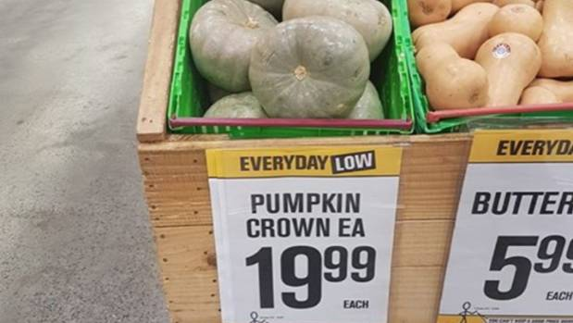
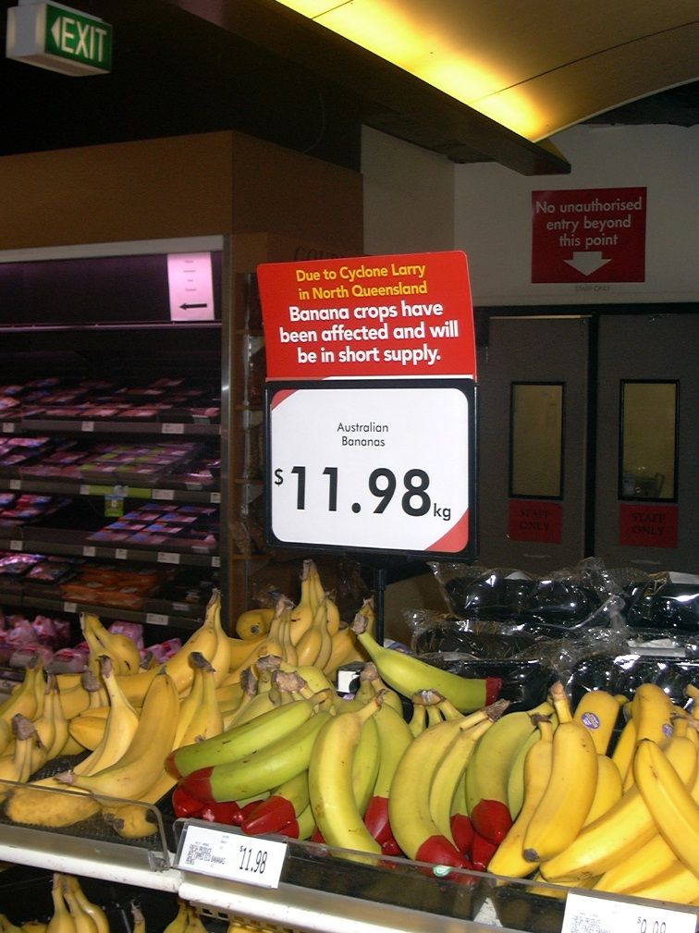

Slide 6
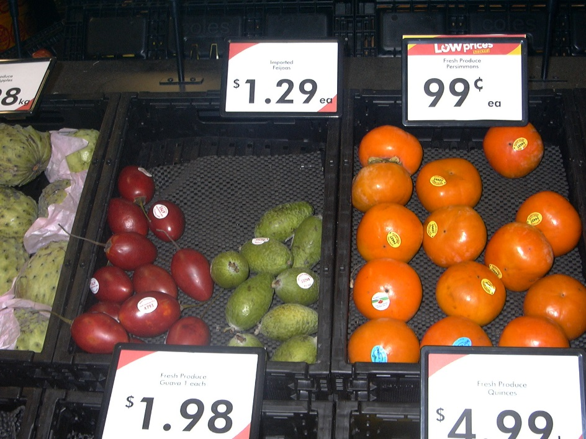

Slide 7
Climate
The climate of an area determines the products that can be successfully grown. Climate includes temperature, rainfall, and sunshine hours found in an area.
Some crops are dependent on certain climatic conditions to produce a good quality crop. Citrus need warm temperatures all year around. Pip fruit require a frost in winter to set fruit buds.
Climate effects product choice and location.

Slide 8
Environmental
Products can only be supplied to meet the market if the environment is manipulated to provide optimum productivity of the product, i.e. optimum inputs to gain optimum outputs.
E.g. (Horticulture) light, H₂O, nutrients & CO₂ need to be at an optimum, pests & diseases have to be controlled to reduce stress.
E.g. (Agriculture) Plant productivity for feed & living conditions (shelter, H₂O, pests & diseases control) have to be at an optimum.

