Slide 1
Political Factor
AS91529
Level 3 Agricultural and Horticultural Science

Slide 2
The Basis for Trade
Countries trade with each other to receive goods and services they can not produce themselves, or can only produce at a higher cost.
Countries will specialise in the production of goods and services in which they have a comparative advantage.
New Zealand has a comparative advantage in the production of primary goods and services.
We have good growing conditions, suitable climate and soils compared with other countries.
New Zealand has greater technical expertise, especially in the production of primary products (dairy, forestry) than many other countries.
The closeness of our major cities to ports, good transport links and lower production costs add to New Zealand’s comparative advantage.

Slide 3
Free Trade
Free trade is where trade between countries occurs without government intervention.
Free trade allows producers to gain access to a wider range of markets and consumers a wider range of products at lower prices.
Free trade has the advantage of allowing countries to specialise in certain products that they are best suited to producing and to buy products that they could possibly only produce at a higher cost.

Slide 4
Market Manipulations
A market manipulation is something the artificially influences supply and demand.
Industry demands impacting on production.
Two main influences;
Political intervention
Grower organisations

Slide 5
Political Interventions
Political intervention occurs when a government has regulations through legislation in Parliament (Act of Parliament) that affect:
Either, products entering and leaving a country
Or the supply of products within a country.
Examples are;
Government bans a product from entering a country for pest or disease control reasons.
There are trade negotiations between governments on the amount of a product that can be traded.
Government tries to protect the future supplies of a product such as native timber, crayfish and some fish species.
Government bans the introduction of a disease for pest control such as myxomatosis for pest control .
Legislation is carried out by government departments, such as Ministry of Primary Industries (MPI).

Slide 6
Reasons for political intervention
To control the spread of animal and plant pest and diseases such as foot and mouth, scrapie, and Mediterranean fruit fly.
The effect of these on New Zealand’s agricultural and horticultural production would be disastrous.
Strict hygiene controls are put in place such as banning some products and animals, quarantining some imported plants and animals, spraying insecticides and inspecting overseas ships and mail.
The Ministry of Primary Industries is responsible for biosecurity.
Protect the growers and producers in one country from cheaper imported products.
Barriers on trade between the exporting country and the domestic country prevent free trade and artificially influence the market.
These include; trade barriers, quotas, tariffs, incentive grants and subsidies, tax concessions, and international commodity agreements.

Slide 7
Trade barriers
A country will not accept another country’s primary products because they wish to maintain their own production without competition.
Trade barriers may be imposed for biosecurity reasons.
Tax concessions
Government reduces or eliminates taxes for producers who produce a given product.
Tax concessions are sometimes offered in the crop establishment period to encourage the growing of certain crops.

Slide 8
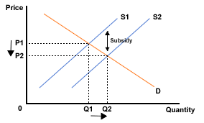
Subsidies
A subsidy is a government payment to producers to help them produce a given product or a quantity of a given product.
It reduces the cost of production. This artificially makes the product cheaper and helps to maintain international competitiveness.

Slide 9
Incentive grants
The government offers financial incentive for producers to produce certain type or number of products.
Dumping
Countries that subsidise exports are accused of dumping (getting rid of) their goods at really low prices e.g. used cars from Japan to New Zealand, or tomatoes from Australia.
Is the fear of low prices charged by foreign sellers.
May hurt domestic producers but it always benefits domestic consumers.

Slide 10
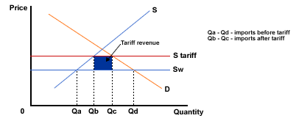
Tariffs
A tariff is a tax levied (added) to a product imported into a country to raise the price of the imported product.

Slide 11
Duties imposed on imported goods.
Is a rate or % of value of a good.
Can be set based on:
Type of good
Country of origin
Value of the good
Used where a product is competing with domestically produced goods.
Raises the price of imported products.
Tariffs allow local producers to raise their prices to ensure profitability while remaining competitive with the imported good.

Slide 12
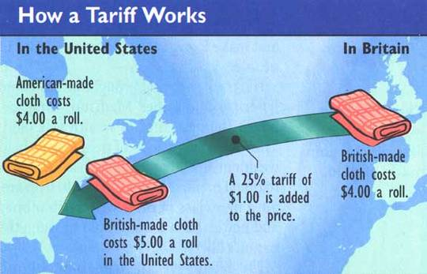

Slide 13
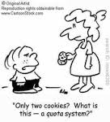
Quotas
The maximum quantity of primary product which will be accepted by an importing country. To protect home producers.
E.g. the EC (European Community) will only accept a specified quantity of butter and meat each year from NZ. These have to be negotiated at regular intervals.

Slide 14
Quotas work by restricting the quantity of imports in a given time period. The restriction on the quantity of imports allows domestic producers to supply more goods and effectively protects them from unrestricted competition.
Is a limit on the amount of a product which can be imported.
Used to reduce the competition for domestic producers from imported products.
Tries to be an amount great enough to top up local supply but not so great as to create a surplus.
Tries to maintain prices received by the domestic producer.

Slide 16
How tariffs and quotas work
Both tariffs and quotas restrict supplies coming in from abroad and drive up prices.
The tariff works by raising prices and hence cutting the demand for imports while the sequence associated with quota goes the other way – restriction in supply forces prices up.
An import quota on a product normally will reduce the volume of that product traded, raise the prices in the importing country and reduce the price in the exporting country.
Any restrictions of international trade that is accomplished by a quota normally can also be accomplished by a tariff.

Slide 17
International commodity agreements
International commodity (trading) agreements are negotiations between governments that decide which products should be traded and at what quantities.
TPP (Trans-Pacific Partnership) is a free trade agreement (FTA) that will liberalise trade and investment between 12 Pacific-rim countries: New Zealand, Australia, Brunei Darussalam, Canada, Chile, Japan, Malaysia, Mexico, Peru, Singapore, the United States and Viet Nam.
It was signed by the 12 countries on 4 February 2016 in Auckland, but has not yet entered into force.
TPP will give New Zealand better access to globally significant markets.
It will diversify New Zealand's trade and investment relationships, and provide a platform to build on the NZ$28 billion of New Zealand goods and services exported to TPP countries in 2014.

Slide 18
EU (European Union) is an association of European countries that aim to:
Eliminate custom duties and trade restrictions between members
Establish a common external tariff
Encourage free movement of labour (workers) between member countries
Establish common economic policies for agriculture.
GATT (General Agreement on Tariffs and Trade) is an international agreement to reduce trade restrictions. It aims to negotiate tariff reductions and eliminate import quotas.
CER (Closer Economic Relations) is an agreement between New Zealand and Australia that aims to expand the export opportunities of both countries by reducing the trade barriers between them. For some products these barriers include duty (an import tax) and restrictions on the quantity imported.

Slide 19
Food Aid
Government provides food aid or relief instead of money for goods.
Mostly used in 3rd world countries.
Guaranteed price schemes
Government guarantees a particular price for goods. If normal market forces does not reach this price, then the government will make up the difference.

Slide 20
Quarantine
Imposed by an importing country on the country that is supplying the product
Usually imposed on the plant where a product is processed, and the way the product is processed
Includes bans due to health or pest concerns e.g. New Zealand apples not allowed to be exported to Australia which was the case until 2011.
Officials from the country coming to inspect plants, where animals or product is produced
Can affect exports by causing lengthy delays during delivery.

Slide 21
Embargo
An embargo is a complete ban on trade with a particular country due to the political policies pursued by the government.
Regulations are a way to control imports. Strict health and hygiene regulations, such as those that apply to food processed in an exporting country, can and have been used against New Zealand. Freezing works must comply with standards of cleanliness, or risk foreign inspectors taking away export licences.

Slide 22
Quality Control
An importing country may impose quality standards to the extent that they limit supply. This can also reduce competition for domestic producers, and may be put into place instead of tariffs and quotas.
E.g.
Dairy Industry standards on milk quality and production standards.
Animal Welfare issues such as tail docking; inductions and residues.
Traceability issues.
Environmental issues. (Concerns on the use of chemicals in the environment and in the production of food stuffs are having a major effect on demand for certain products).

Slide 23
Political intervention and how it affect supply and demand of products.
Political intervention.
Affecting supply.
Controlling pests and diseases entering a country
Establishing tariffs
Negotiating trading agreements
Controlling the volume of a product into a country
Maintaining quality control as MPI.
Affecting demand.
Maintaining quality control as MPI.

Slide 24
Questions
What does market manipulation mean?
What is political intervention?
List the two main reasons for political intervention.
Name four methods of political interventions. Explain two of these.

