Slide 1
What contributes t0 lamb profits

Slide 2
Profit = income-expenditure

Slide 3
What Factors influence the profitability of lamb
Nutrition
Sire slection
Lambing percentage
Health
Costs
Stocking rate
Price
seasonality

Slide 4
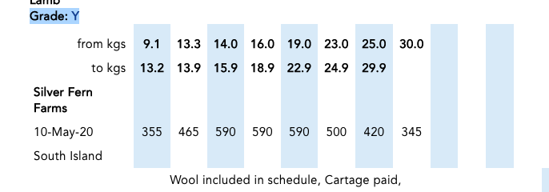

Slide 6
More lambs
Growing faster
With less fat
And less stress
There is a link between overall growth rate and fat deposition. As liveweight increases, so too does fat deposition – with the market preferring lean, large carcasses.

Slide 7
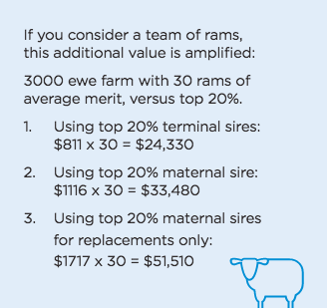
Sire selection and breeding
“Cheap rams are costly. The opportunity cost of buying average or unrecorded rams can be tens of thousands of dollars.”
The choice of ram can considerable influence profit,
so WHAT IS A BETTER RAM WORTH?
https://beeflambnz.com/knowledge-hub/PDF/better-sheep-breeding-ram-buying-decisions

Slide 8
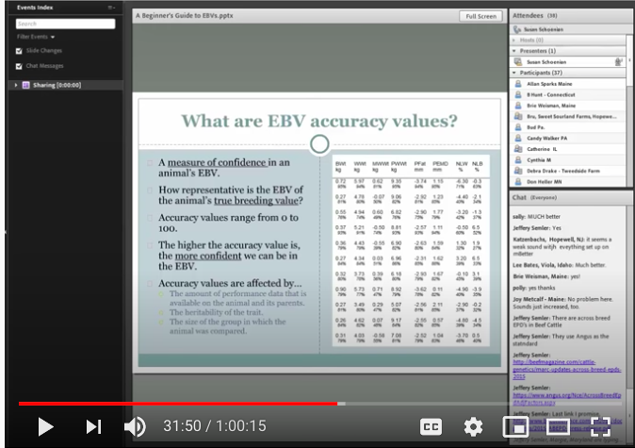
How do we measure a sire value
An eBV is an estimate of the breeding value of an animal as a parent for a particular characteristic or trait. The math (Best Linear Unbiased Prediction (BLUP)) used to calculate the eBV adjusts for known non-genetic effects and how heritable the trait is. This means the eBV represents the worth the animal can actually pass on to its progeny.
RAM BUYING MADE SIMPLE
Choosing rams has been made easier by the introduction of two New Zealand standard indexes.
NZ Maternal Worth (NZMW) is based on value derived from: Reproduction, Lamb Survival, Growth, Adult Size and Wool
.2. NZ Terminal Worth (NZTW) is based on value derived from: Growth, Lamb Survival and Meat Yield.

Slide 9
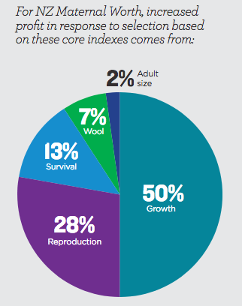
eBVs are calculated from:
• The ram’s family
• His own performance
• His offspring (if he has any yet).

Slide 10
There are different levers you can pull to get more value such as having:
• A higher lambing percentage (benchmark is 140%)
• Greater lamb survival from birth to weaning (benchmark is 84%)
• More seasons from your rams (benchmark is four years)• More seasons from your ewes (benchmark is four years)
• More ewes mated per ram (benchmark is 100)
• More replacement lambs retained (increase mating of lesser quality ewes to a terminal sire).The ram value calculator allows you to plug in “what if” scenarios to calculate ways to get even more value from your ram investment.

