Slide 2
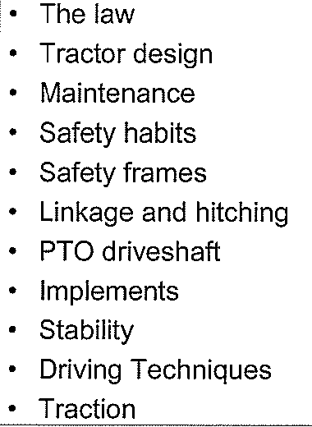

Slide 3
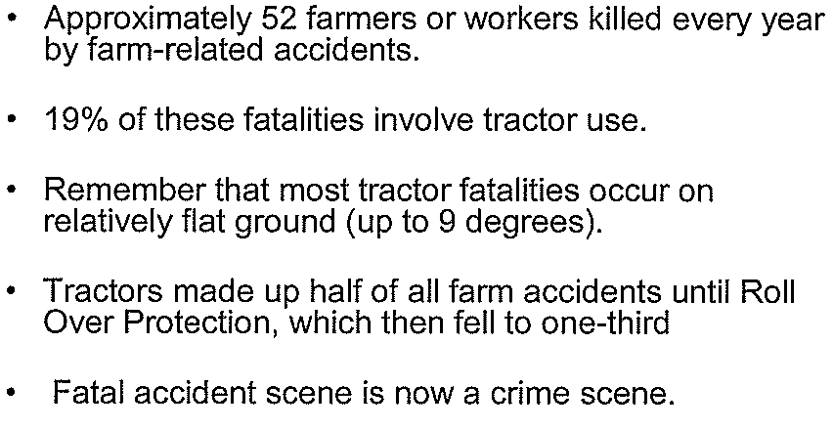

Slide 4
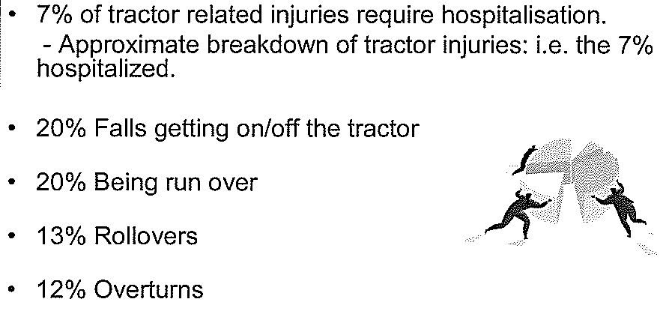

Slide 6
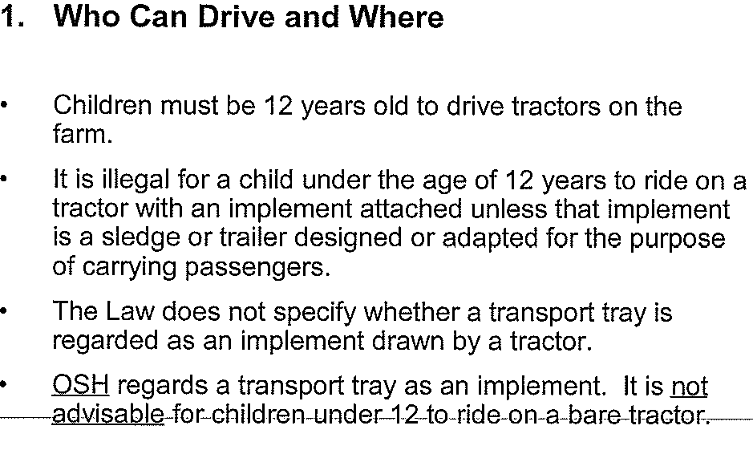

Slide 7
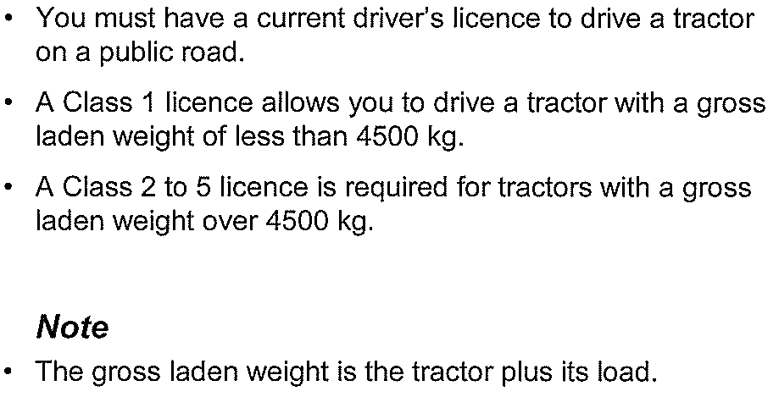

Slide 8
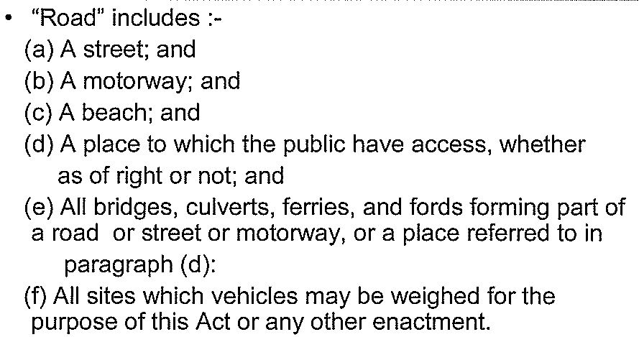

Slide 9
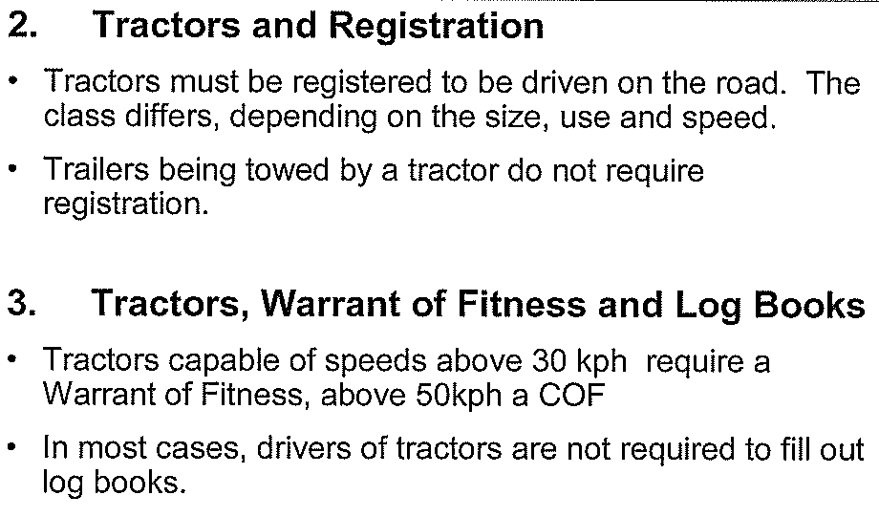

Slide 11
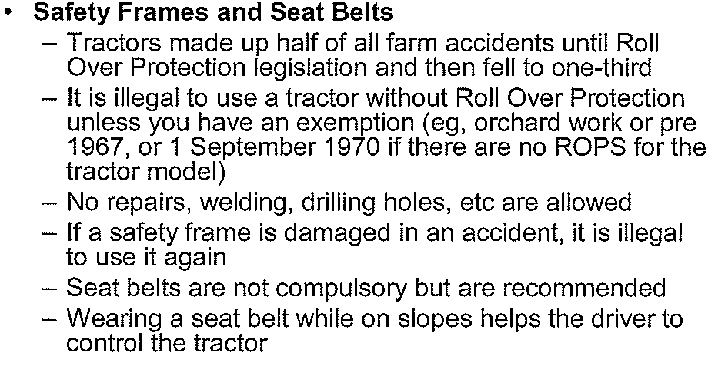

Slide 31
Lateral Stability & Speed tipping Axis of a Tractor

Slide 32
Driving on Slopes

Slide 33
Driving on slopes (cont)

Slide 34
Driving on Rough Ground

Slide 35
Traction

Slide 36
Ways to Improve Traction

Slide 37
Dual Wheels

Slide 38
Tractor tyres

Slide 39
Clean Down

