Slide 1
Gore High School
Year 12
18 March 2019

Slide 2
Marketing Department - Tristian
How has a change of government affected your business?
How does the political stance in other countries impact you?
What are overall strategic objectives for business?
Where are your consumers based?
Are you aware of demographic changes in the demand for products of Daiken? How do you know this?
Notes:
Dean

Slide 3
Process Technologist – Paddy Holland
What technological influences have made an impact on your business?
How your chosen business has responded to these technological changes
What advantages and disadvantages have you gained from technological advancements?
Notes:
Dean

Slide 4
Finance Department – Fiona Bell
Has there been a legal change that has significantly impacted your business?
What sort of taxes influence Daiken?
Notes:
Dean

Slide 5
Human Resources Department – Nicky Cooper
How does Employment Relations Act impact Daiken?
What is the Employment Relations Act:
Guidelines to interact in a professional way:
Provides the legal backdrop for all relationships between employees, employers and unions.
It provides the frameworks for how we interact when dealing with certain situations, e.g. Disciplinary processes, how we engage is union negotiations – impact can take time, can be frustrating
Promotes the concepts of good faith and fair process.
Good faith means neither the employee nor the employer can act in any way to deliberately lie or deceive the other.- impact - relationships break downs , resignations etc
Promotes and regulates collective bargaining, and protects an employee’s choice about whether to be a member of a union.
Promotes mediation as the first step when resolving employment relationship problems.
Encourage avoidance of discipline – coaching conversations, appraisal, one to one coaching
What are the costs of complying with the ERA?
Notes:
Dean

Slide 6
Human Resources Department – Nicky Cooper
How does Employment Relations Act impact Daiken?
Guidelines to interact when it goes wrong:
Governs the personal grievance process.
Individual feels the above has not been upheld and have been adversely effected or unjustifiably dismissed.
Established the Employment Relations Authority and Employment Court, which help to resolve employment relationship problems.
Promotes the effective enforcement of employment standards.
What are the costs of complying with the ERA?
Notes:
Dean

Slide 7
Holidays Act 2003
The purpose of this Act is to promote balance between work and other aspects of employees’ lives and, to that end, to provide employees with minimum entitlements to—
(a)Annual holidays to provide the opportunity for rest and recreation:
(b)Public holidays for the observance of days of national, religious, or cultural significance:
(c)Sick leave to assist employees who are unable to attend work because they are sick or injured, or because someone who depends on the employee for care is sick or injured:
(d)Bereavement leave to assist employees who are unable to attend work because they have suffered a bereavement.
Strict rules on the calculations around annual leave , annual leave entitlements, holiday pay, incentive payments etc

Slide 8
Non Compliance ERA or Holidays Act 2003
What are the costs of complying with the ERA?
Area of Impact | Cost
 | Broken trust in managers, employees, company reputation both internally and externally
 | Legal fees ranging for a few thousand dollar to a minimum Of 20k for a potential personal grievance.
 | Adjustment of leave balances Back payments due to incorrect treatments in relation to A/L, bonus etc. Liable 6 years https://www.employmentcourt.govt.nz/assets/Documents/Decisions/2017-NZEmpC-115-Schollum-and-Hastings-v-Corporate-Consumables-Ltd-Judgment.pdf

Slide 9
Environmental Health and Safety – Robin Wilkins
Resource Management Act (RMA)
Background: The RMA passed in 1991 is a significant, and at times, controversial Act of Parliament.
The RMA promotes the sustainable management of natural and physical resources such as land, air and water.
Defines Environmental conditions (through environmental consents) that Daiken Southland Limited must operate with-in.
Administered by two local bodies:
Gore district council, 18 consents including: Odour, noise, Lighting, water supply, discharge to air.
Environment Southland – 8 consents including Ash, air discharge, Effluent discharge to land, river discharge
Q: How does the RMA influence Daiken?
Positives vs negatives
Positive
Through Consent conditions DSL have a clear understanding of what regulations apply to our process and situation
Defines DSL’s monitoring, testing, and discharge (water, air, land) limits and requirements.
Negatives
Costly: People, equipment, Monitoring and testing (internal / external) consumables E.G polymer for waste water process.
Costly and slow: applying for new consents or modifying existing consents
Can affect MDF production - Resin development (pMDI)
If Non compliant possible ramifications: Abatement notices, Criminal prosecutions, fines and penalties (up to $300,000 for individuals, $600,000 for company, two years imprisonment).
Notes:
Dean

Slide 10
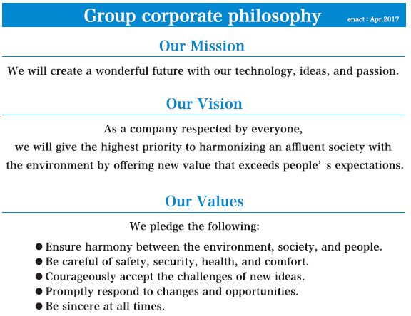
Environmental Health and Safety – Robin Wilks
What Ethical issues face Daiken in the short to long term?
How does Daiken ensure our staff operate ethically,
in a way that relates to moral principles.
Management: clear and consistent message
Daiken group corporate philosophy: Mission, Vision, values
Detailed in Daiken employee handbooks
Embedded in company standard operating procedures
Employee training and education.
We conduct business / ourselves with a degree of integrity, our people, our environment, our community
No obvious upcoming Ethical issues in the horizon identified by Daiken
Notes:
Dean

