Slide 1
Gore High School
Year 13
18 March 2019

Slide 2
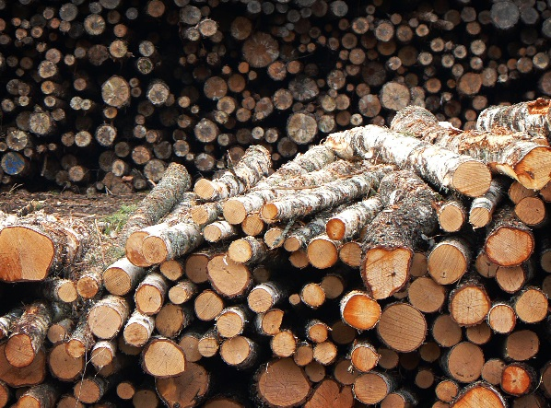
Purchasing Department – Dean Cochrane
Where do you source all your logs? Do you need resource consent to do so?
Do you use all of the logs to make MDF, if not what happens to the waste.
What are the main costs for making your products?
1: Our logs are sourced from Southland and Otago, we purchase our raw materials delivered so do not require resource consent
2: We lose a small percentage of bark through debarking the logs and fines (5mm and under) though our chipping process which this is then used as fuel for our energy centre
3: Our main costs are raw materials/Resin and power usage
Notes:
Dean

Slide 3
Marketing Department Tristan Dawson
Where are your markets for your products? Local or Overseas?
How do you communicate to foreign markets? Do you have representatives?
What future goals do you have for your business? Expansion in size or product diversity
Notes:
Dean

Slide 4
Engineering Department – Mark Smith Question 7
With any project there must be a payback justification. Typically this site is between 2.5 – 3 yrs. Return on Investment.
This can be as simple as justifying that reduced R&M can be saved by investing a new peace of equipment, which could be technology advancements.
Capital investment for safety reasons to meet our obligation under the H&S Act. Where in payback can be justified.
Production gain justification, which is usually business case driven.
Question 7 :What factors do you take into account when making capital expenditure decisions?
Health & Safety
Resource consent constraints , (Noise, Air Quality, Building )
Location onsite
Impacts on other departments
Timelines
Spare parts
Manufactures ( Local or Overseas) 4 x suppliers( Kontra, Siempelkamp, Dieffenbacher & E.M.G)
Cost.
New or Used
Manpower levels before and after
Running costs, R&M
Construction Costs
Notes:
Dean

Slide 5
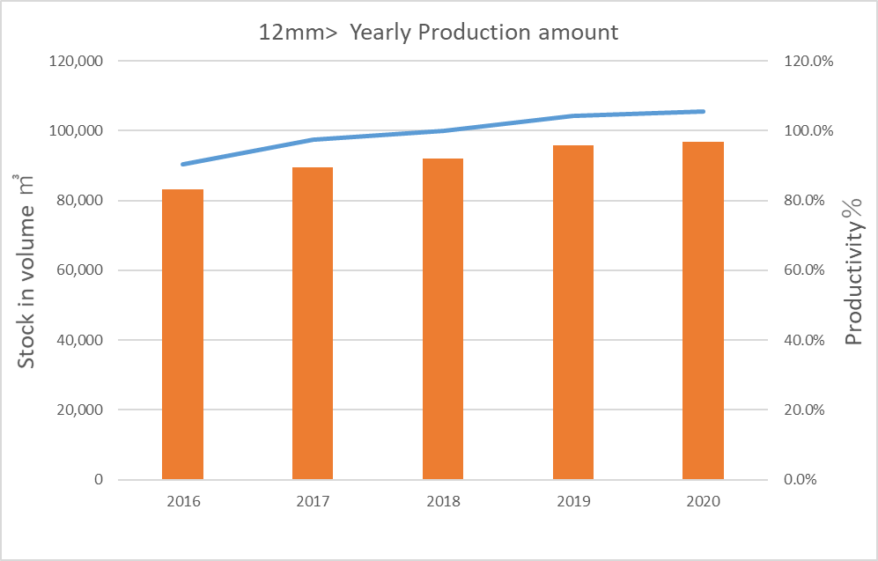
Question 8 & 9
Question 8. When investing in new capital, do your staff require more training.
Yes staff do require more training.
However this can be either done in-house via SOP’s developed by the operators or trades staff. These SOP’s are either drafted using the manufactures operating manuals or from experience over time. As some machines imported from overseas do not have manuals or were never specified in the project scope. ( Example MFB) note Korean staff.
When specifying a machine the project should allow for training but this is typically absorbed by the business under normal operations.
Specialized training is outsourced
Question 9. What is a recent example of Daiken spending capital to increase production?
Cooling Wheel
Main aim for this project is to improve productivity of above12mm thickness board without increment of downgrade and its expected additional stock in volume is 5,000m3/year against to beginning Y2018 stock in volume.
Notes:
Dean

Slide 6
What the cooling wheels are for:
Our process involves pressing and heating fibres coated in thermo setting resin to form panels, core temp required = 100ᵒC.
The formed panels then need to be cooled before stacking and downstream processing.
We currently have 1 cooling wheel (OEM German 1997 manufacture)
The existing cooling wheel does not give us enough cooling capacity to cope with other process improvements that have
increased production (design 140,000 M³ pa, current 220,000 M³ pa)
The result of insufficient cooling capacity is increased downgrade, reject and production surges as currently thick panel is held in storage
24 - 72hr for extra cooling
The two new cooling wheels will be used in addition to our existing cooling wheel to increase panel cooling time,
current time is approx. 0.75 min / mm thickness, ideal is > 2.0 min / mm thickness
Existing cooling wheel is a production bottleneck, the addition of 2 new cooling wheels will reduce production costs and allow for further
production increases
How do they do the cooling
Cooling wheel receives hot panels max speed 1000mm / sec every 7 sec
Conveyor loads panels individually into cooling wheel, then cooling wheel turns to receive next panel
When panel is in cooling wheel all surfaces are exposed to air for cooling
Each cooling wheel has 45 active slots, 2 wheels = 90 panels cooling at any one time
Ideal cooling time is > 2 min per mm panel thickness
Conveyor then unloads panels individually from cooling wheel and accelerate panels back to 1000mm / sec for downstream processing
Reasons for purchasing overseas as opposed to sourcing locally
OEM for Daiken Southland process line is Europe
Purchasing from European OEM specialising in panel handling equipment will give us latest technology in a developing market
New OEM equipment will mechanically and electrically integrate with existing OEM equipment, c/w synchronised control and data tracking
Daiken Southland does not have access to enough design information to pass onto local contractor for manufacture of fully integrated equipment

Slide 7
Question 10
Question 10: How does the new capital item affect the operating costs of Daiken?
There is a major issue with product flow through the warehouse, and due to this IFOT to our customers. The lack of on-line cooling means we need to complete stack cooling of 72 hours. This, coupled with the saw tooth profile (thin to thick, back to thin etc.) of the press line production, causes surge flow to the sander. As sander production is a combination of both lineal meters for thin product and cubic meters for thick product the surge effect is exacerbated. The implications are even worse at the CTS. This surge flow was one of the causes to the failure of the trial to reduce Sander / CTS shifts from four to three.
Lack of panel cooling has directly lead to production cost increases as we struggle to overcome bowing and wavy thin panel. The reject numbers are somewhat hidden as we record some off grade as coversheets. We believe almost all of these numbers can be attributed to the increase in sander marks/glut marks after we changed all thick panels to “72 hour on hold” products. Due to the surges that reach the sander we also hold thin panel much .
It is also believed that there should be less forklift movements, as some packs will go direct to the Sander instead of WIP for storage.
None of this can be realised till after the commissioning, this is in September 2019.

Slide 8
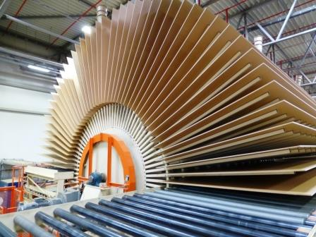
Question 11
Questions 11 - In financing this capital purchase, what options were explored to purchase it? What are the medium to long term impacts of the selected option was on the business?
There are four main suppliers of cooling wheels:
Kontra
Siempelkamp
Dieffenbacher
E.M.G
Each of these firms was approached for the cost to supply two 180° cooling wheels complete with the three internal conveyors required. We believe that any of these wheels will do the job with little between them other than cost and shipping method.
In fact, Kontra and Dieffenbacher are almost identical due to employment movement of the lead engineer between the two firms. The only other main difference is the diameter of the internal core. Kontra and Dieffenbacher are 2.7m, a standard shipping width, whereas the Siempelkamp one is 3.3m.

Slide 9
Question 11 Continued
 | Kontra |  | Siempelkamp |  | Dieffenbacher |  | E.M.G
Core diameter | 2.7 m |  | 3.3m |  | 2.3m |  | unknown
Number of active pockets / wheel | 40 |  | 40 |  | 45 |  | 30
Price | € 432 | $ 686 | € 648 | $ 994 | € 616 | $944 | € 800 | $1227
Installation supervisors | € 85 | $ 130 | € 143 | $ 227 | € 85 | $ 130 | € 85 | $ 130
Foundation Engineering Cost | $25 |  | $25 |  | $25 |  | $25
Foundation installation – estimate | $80.2 |  | $80.2 |  | $80.2 |  | $80.2
Mechanical Installation 1500 man hours + cranes | $126 |  | $126 |  | $126 |  | $126
Electrical Installation + Electrical safety installation | $54+$20 |  | $54+$20 |  | $54+$20 |  | $54+$20
Mechanical Safety Equipment and Installation | $82 |  | $82 |  | $82 |  | $82
New conveyors | $150 |  | $150 |  | $- included |  | $- included
Freight | € 34k + $30k = $ 74 |  | € 50k / $ 79 |  | $ 74 (ex-Shanghai wksp) |  | $100 includes packaging
Roof Fans | $15 |  | $15 |  | $15 |  | $15
Latest Best Estimate | $1,421 |  | $1,848 |  | $1543 |  | $1864

Slide 10
Question 11 Continued
    Financial Losses
Year | Period | Reject | Reject % | Relative thick panel press speed
2017 | 2nd half | 2110m³ | 2.0% | 126%
2017 | 1st half | 1508m³ | 1.6% | 121%
2016 | 2nd half | 1160m³ | 1.1% | 115%
2016 | 1st half | 528m³ | 0.5% | 113%
As a best estimate of the production losses per m³, at $115, for premium product vs. coversheet production, the total projected losses 2017 are $416k.
    Payback
Based on losses of $416k / yr., and selection of two 180-degree cooling wheels, this project has a payback of approximately 3 years.

Slide 11
Question 12
This proposes that we install a pair of 80 pocket 180 degree cooling wheels. These wheels, at 45 active pockets each, will increase the cooling time of our products to 2.12 minutes / mm board thickness at the current speed of production.
The best option studied, it allows for the existing 360 degree unit to be retained, for thick panel use, however for thin panel we would go straight through the cooling wheel. After each press cycle from thin panel we would start with an empty wheel, running the panels through, until at the thickness that requires the extra cooling time that the extra 50 pocket wheel affords is required. We calculate this thickness to be in between the 12 mm and 14mm products.
Pro’s
Full cooling of all products reducing downgrade.
Minimal cost to achieve the desired outcomes
Adequately allows for plant speed increases that a mat heating system will afford.
Con’s
Reduction in Warehouse space
This option has been costed with a 15% surety.

Slide 12
Question 13 Sander Upgrade
 | Planned | Actual
Sander Upgrade MY Purchase &delivery | 49,976.00 | 240,092.40
Sander Upgrade Repairs and Steineman Sup | 194,341.44 | 386,777.27
Sander Upgrade Foundation Alterations | 42,073.14 | 43,181.37
Sander Upgrade Internal Labour | 0 | 3,351.15
Sander Upgrade Electrical Requirements | 178,806.80 | 181,509.88
Sander Upgrade Installation and Upgrades | 251,570.67 | 261,755.79
Sander Upgrade Non Stop Feeder | 117,547.78 | 123,535.83
Sander - extra parts required | 24,071.50 | 32,219.01
Total | 858,387.33 | 1,272,422.70
Sander Upgrade – Safety Installation
154,501.72
165,073.95
Installation delays incorporated with the of the safety systems.
Unavailability of external contractors.
Not being in a position to complete the work internally. ( Resource)
Planning work for downtime events not utilisied effectively.
Equipment purchased not fit for purpose.
Costs to re-wire original install due to issue with the equipment bought. ( $10k)
Mechanical safety handles redesigning & Installing.
Dust extraction not considered in the initial upgrade. On-going dust issues continue today, improvements still to be work through.
Project was originally about reducing shifts / manning, however production increases have eroded this plan.
There has been a decrease in Sander belt usage and gains in liner metres. Which is a cost savings which was not consider at the time of the project inception
Part of this is due to the increased heads as sand off is shared over more heads.

Slide 13

HR Department – Nicky Cooper
29 / 32
General Statistics
People | Commentary | Actual
 | February | Jan | Feb
Staff Numbers | Average Age 44.79 Average YOS 8.87 | 117 | 120
Staff Turn Over | Export Documentation Administrator Accounting/IT Support MDF Technician | 1 | 3
Currently Recruiting | Logistics & Export Docs Production Admin Assistant MFB/MDF Techs Assistant Accountant Resource Operator Production Training Coordinator |  | 11
Notes:
Dean

Slide 14
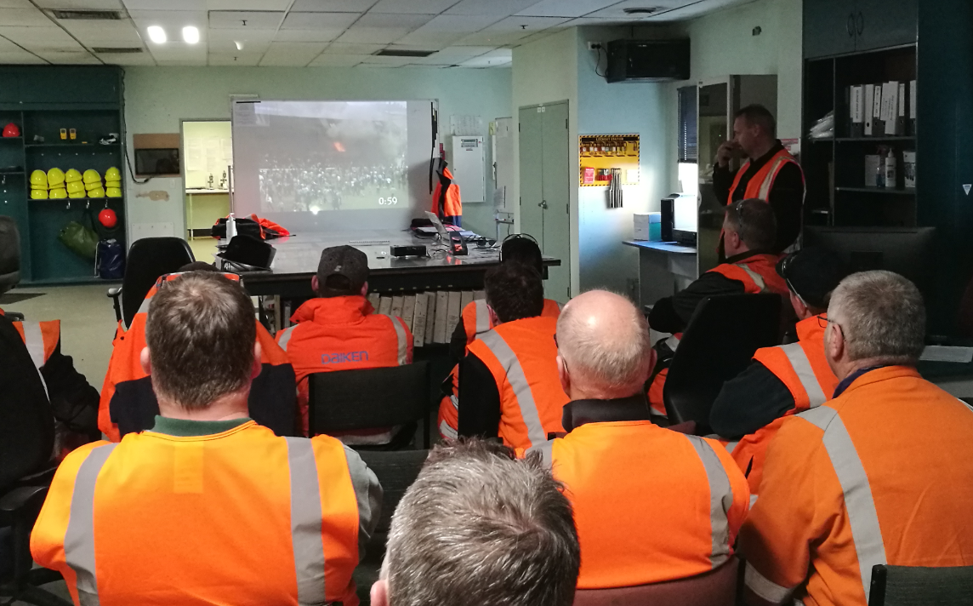
Environmental Health and Safety – Robin Wilks
Yr 13
Q. Health and safety related training
By the numbers 2018/2019:
DSL employees 124 full time staff
248 staff, 33 different / individual courses, delivered internally and externally
Training Budget: $76,604
Average cost $308 per person
Everything from Biosecurity to Programming Logix5000 Motion Applications to How to operate a chain saw.
Challenges
Bums on seats, multiple shifts, annual leave, sick leave, shift cover ETC, ETC.
Tracking, who has done what?
  Managed through VAULT health and safety application
  Individual training records
How do these regulate your business?
Compliance or regulatory based training
Delivered by external resources E.G ST Johns or Employers manufactures association (EMA)
Working at height, first aid, HSNO certified handlers
Internally based training
Job specific training
Employee competence
Notes:
Dean

